Slide 1




Welcome To
Escambia County Public Schools
New Hire Benefits Orientation 2025
Notes:
Welcome to the Escambia County Public Schools New Hire Benefits Orientation

Slide 2

Overview of topics
Enrollment Opportunity's
Health Benefits
In-hospital Indemnity Plan
Dental Benefits
Vision Benefits
Medical Expense Accounts
Life Insurance
Cigna Supplemental Health
Short & Long Term Disability
Florida Retirement Systems
Voluntary Retirement Plans
Health & Wellness Center
Employee Assistance Programs (EAP)
Other District Benefits
Notes:
During this benefits presentation we will go over the following topics: Enrollment Periods, Medical Dental and Vision benefits, the different medical expense accounts. We have a flexible spending account and Health savings account. Life insurance, short and long term disability, retirement options, the health and wellness center, Cordova counselling and other district benefits.

Slide 3

Enrollment Opportunity’s
New Hire Enrollment:
  You Have 30 Days To Enroll For All Listed Benefits. This Begins On Your Start Date.
  If You Miss The Deadline For Your New Hire Enrollment, You Will Have To Wait Until Open Enrollment To Sign Up For Benefits.
Open Enrollment:
  During October Or November Each Year
  This Is Your Chance To Make Changes, Cancel, Or Start Benefits.
  These Elections Take Effect January 1st Of The Following Year.
Qualifying Life Event:
  You Have 30 Days From The Time The Qualifying Life Event Takes Place To Make Changes.
    Example: Birth Or Adoption, Marriage Or Divorce, Gain Or Loss Of Other Coverage, Death
  Documentation Is Required To Approve The Change Request.
Notes:
Right now you are entering your New Hire enrollment period. You have 30 days from your start date to enroll in benefits. If you have questions about your enrollment deadline please contact a benefits specialist. If you have missed your deadline you will have to wait until open enrollment to sign up for benefits.
Open enrollment occurs every year during October or November, This is your chance to make changes, cancel or start benefits. Any elections made will take effect January 1st of the following year.
Another way to make changes is to have a Qualifying Life Event, these are major life changes decided by the IRS. For example Birth/ adoption, Marriage/ Divorce, or A Gain/ Loss of coverage. You have 30 days from the time the event takes place to report the change, documentation must be provided for the change request to be approved. If you miss your deadline you will have to wait until open enrollment to make changes.

Slide 4
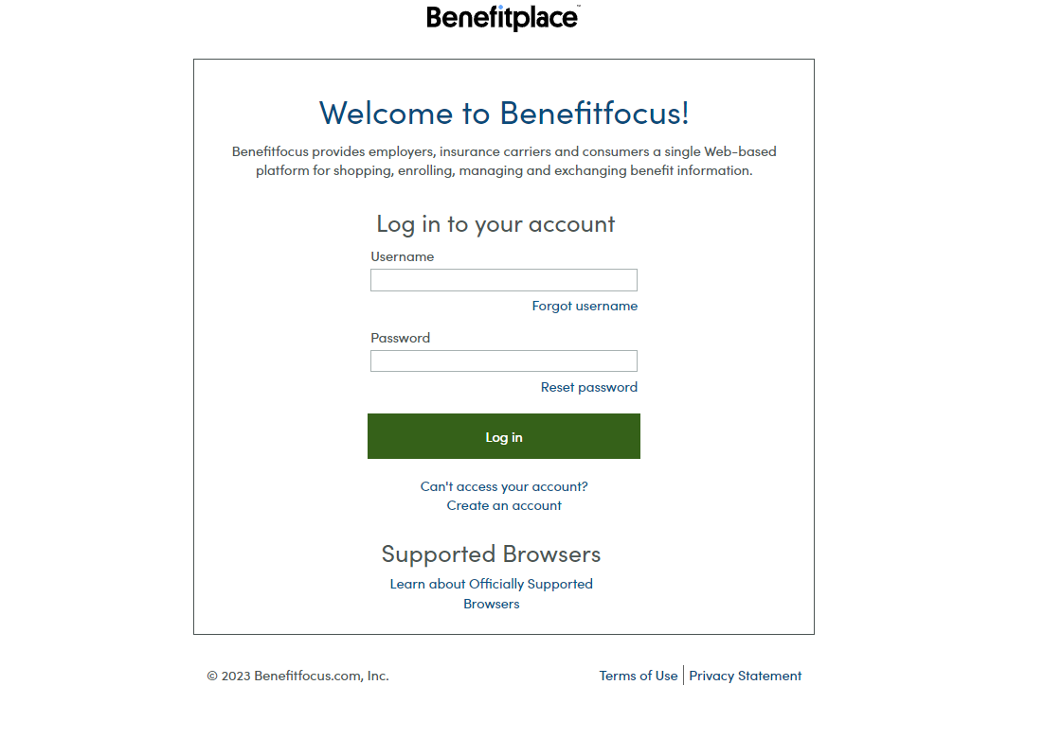
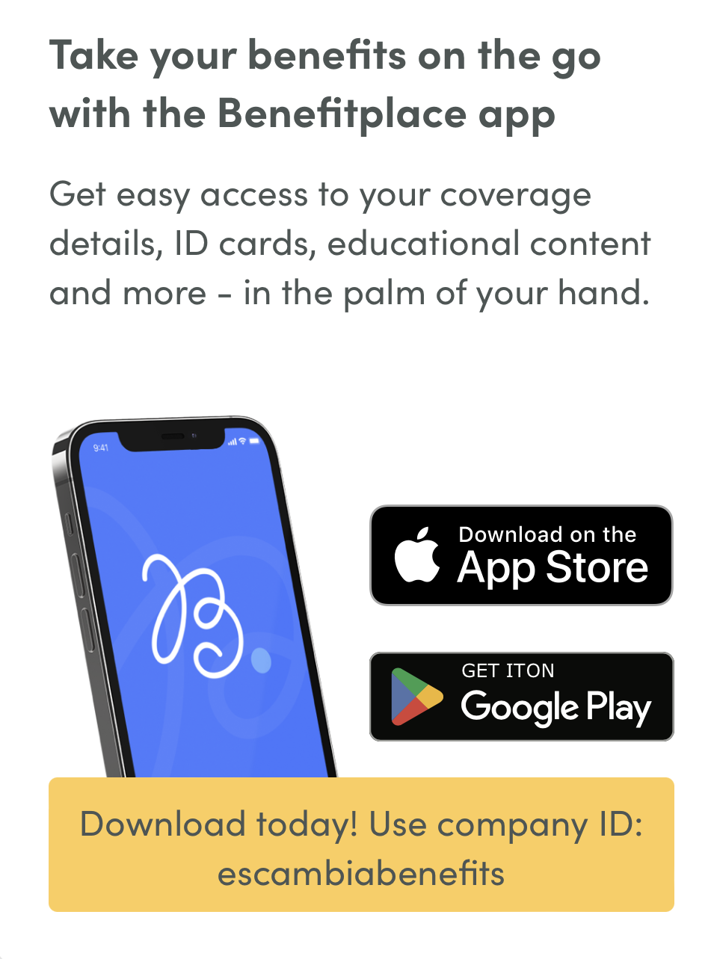
How to enroll
Enrollment Is Completed In Benefitfocus
This Is Located On The District Website Under The Staff Tab Then On The Right Side Of Page Click “Employee Benefits Enrollment Portal”
Login In Using Your School District Credentials
Access Your Coverage Details Through The Benefitplace App.
  Use Company Id: escambiabenefits
Notes:
Benefit Focus is the website you will use to enroll in benefit. This can be accessed by going to the district website, www.escambiaschools.org, under the staff tab you will click on Employee Benefits Enrollment Portal. To log in you will use your district credentials. You can also download the app Benefitplace from your google and apple store.

Slide 5
Tips to save time during enrollment
Beneficiary(s) Address And Phone Number
Dependents Social Security Numbers
The Enrollment Process Can Be Long Depending On How Many Benefits You Choose To Review. To Save Time Finish Each Section Before Exiting The Portal. If A Section Is Not Completed You Will Have To Re-do That Section.
You Are Able To Edit Your Enrollment Options Until Your Deadline.
Start Early, So You Have Plenty Of Time To Ask Questions And Select The Plans Best For You.
Notes:
Here are some enrollment tips to save time. Remember to use your district credentials, this is your user name and password you use for your other school district platforms.
To save time have social security numbers for dependents, address and phone numbers for Beneficiaries.
The enrollment process can be long, to save time try to finish and save a section before exiting.
Start your enrollment early so you have plenty of time to ask questions.

Slide 6
Adding dependents
Documentation Is Required To Add Dependents To Your Benefits.
  Spouse:
    Marriage Certificate Or Your Latest 1040 Tax Form (If File Jointly) And A Signed Affidavit Of Continuous Marriage
  Child(ren):
    Birth Certificate, Adoption Paperwork, Guardian Paperwork, Or Court Order Paperwork
Children Can Remain On Health, Dental, And Vision Until December 31st
Of The Year They Turn 26, Regardless Of Student Status.
Notes:
In addition to social security numbers you will be required to provide documentation in order add dependents to your benefits by the documentation deadline. This date is provided when you complete your enrollment process.
To add a spouse you will need a copy of your marriage certificate or your latest 1040 tax form if you file together and a signed affidavit of continuous marriage.
For children you will need to provide the birth certificate or other documentation required. Children are eligible to be covered until December 31st of the year they turn 26 regardless of student status.

Slide 7
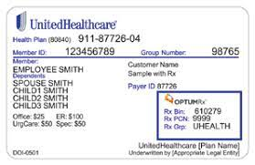

Health Benefits
HSA
Base HRA
Choice HRA 500
Includes Option For Health Saving Account
Lowest Monthly Premium
Highest Deductible And Out Of Pocket
  $5000 Individual/ $10000 Family
Deductible + Coinsurance
Average Premium & Deductible
  $5000 Individual/ $10000 Family
  Primary Care $40 Copay + Coinsurance/ Specialist $60 Copay + Coinsurance
Highest Monthly Premium
Lowest Deductible
  $4000 Individual/ $8000 Family
Plus $500 Goes Toward Your Deductible
Primary Care $35/ Specialist $50
PHARMACY AND PRESCRIPTION DRUG INFORMATION CAN BE FOUND IN THE BENEFIT GUIDE BOOK AND ON THE ENROLLMENT WEBSITE.

Slide 8
Great reason to use myuhc.com
Learn About Health Conditions, Treatments, And Procedures
Compare Costs For Treatments
Obtain Information About Hospitals And Physicians
Organize Your Medical Claims
Talk To Healthcare Professionals, Registered Nurse, And Virtual Visits.
Learn About Your Coverages
Order And Renew Prescriptions Online
Register Your Account After Health Insurance Goes Into Effect.
Notes:
Our healthcare provider is United Healthcare once your insurance is effective you can register your account through their website, myuhc.com.
Here are great reasons to utilize your online account: you can learn about health conditions, treatment, and procedures.
Compare cost for treatment using the cost estimator
Obtain information about hospitals and physicians that are in network
Review medical claims
Talk to healthcare professionals
Learn more about your coverages
Order and renew prescriptions online
View and request copies of your medical ID card

Slide 9
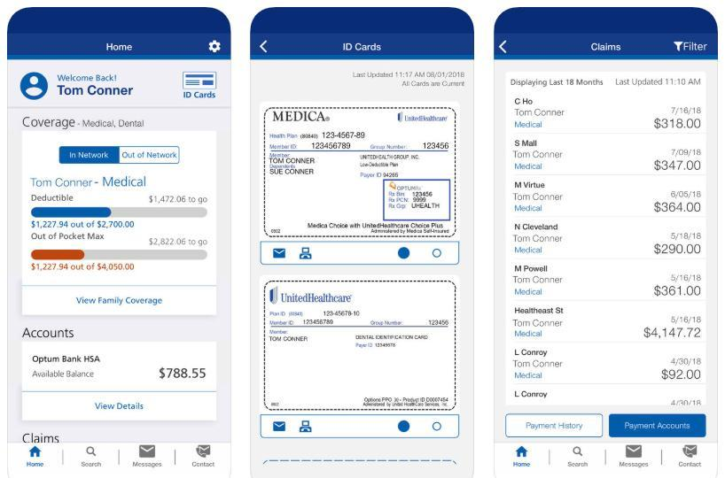
Utilizing the united healthcare app
No Additional Cost To Download
Virtual Visits
  HSA 25% Coinsurance/ HRA $25
Access To Care Online At Any Time
No Driving
No Crowded Waiting Rooms
See And Talk To A Doctor From The Comfort Of Your Home
  24 Hours A Day/ 7 Days A Week
Notes:
Once you have logged into your myuhc account you are able to utilize the United Healthcare app. The app is free to download and is available 24/7.
To access virtual visits you will log into your myuhc account, select your provider and meet with that person through your phone or computer
If you are enrolled in the HSA 25% coinsurance for virtual visit, If you are enrolled in either of the HRA plans you have a $25 virtual visit copay.

Slide 10

In-hospital Indemnity Plan
This is not a major medical plan
No cost option to employee
Employees can not enroll in the in-hospital indemnity plan as well as one of the major medical plans
This pays the employee $75 per day when hospitalized up to 30 dayS AFTER THE 24 HOUR WAIT PERIOD.
Notes:
Another option is the In-hospital indemnity plan, this is not a traditional insurance. The only benefit of the in hospital indemnity plan is that for every 24 hours you are hospitalized the plan will pay you $75 per day up to a maximum of 30 days. This is a free benefit option offered by the district. You may not enroll in this plan as well as one of the major medical plans previously discussed.

Slide 11

Dental benefits- The Standard
Each Dental Plan includes the benefit of rolling over up to $1,000 of your unused Annual Maximum.
Base Plan
  Annual Maximum Benefit $1,000
  In-network Deductible $50 individual/ $100 Family
    Preventive Services 100%/ Basic Restorative services 80%/ Major Restorative Services 50%
  Out-of-network Deductible $100 individual/ $200 Family
    Preventive Services 80%/ Basic Restorative services 60%/ Major Restorative Services 30%
Enhanced Buy-up Plan
  Annual Maximum Benefit $1,500
  In-network Deductible $50 individual/ $100 Family
    Preventive Services 100%/ Basic Restorative services 80%/ Major Restorative Services 50%
  Out-of-network Deductible $100 individual/ $200 Family
    Preventive Services 80%/ Basic Restorative services 60%/ Major Restorative Services 30%
Notes:
The two dental plans offered are through The Standard. The base plan and the enhanced buy up plan both offer the same coverage for services, preventative services are covered at 100%, basic coverages are covered at 80% and major services are covered at 50%. The difference between the two plans is the base plan offers an annual maximum of $1000 and the enhanced buy up plan offers an annual maximum of $1500. With either plan you have the benefit of rolling over up to $1000 of your unused annual maximum to the following year.
You will receive a dental ID card and should provide you card to your dental office.

Slide 12

Vision benefits- Humana Insight
In-network
  Annual Eye Exam $5 Copay
  Lenses Every 12 Months $0 Copay
  Frames Every 24 Months Up To $150
  Contacts Every 12 Months Up To $55
Notes:
Our vision coverage is through Humana Insight, with this plan you have the option for employee only coverage or family coverage.
With an in-network provider you have a $5 copay for annual exam, lenses every 12 months, frames every 24 months for up to $150, and contacts every 12 months for up to $55.
You will not receive a vision ID card, to use this insurance you can use the Humana provider look up tool contact the office of choice and let them know you have the Humana Insight plan as your vision coverage.

Slide 13
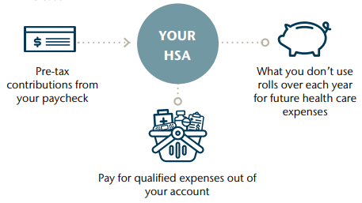

Medical Expense Accounts:
Hsa-Health savings account
When you enroll in the choice HSA medical plan you are eligible to open a Health savings account (HSA)
Funds are pre-tax up to the annual IRS limits
What you don’t use rolls over each year
Pay for qualified expenses
Notes:
Employees have two options to help with future medical cost.
When enrolled in the United Choice H S A medical plan, you are eligible to open a health savings account. You fund your h s a through pre-tax payroll deductions up to the annual I r s limits. This account can be used to pay for eligible out of pocket health care expenses until you meet your deductible. Any unused balances roll over year to year allowing you to build up a savings for future health care expenses. Annual maximum contribution amounts: employee only $4300, employee and dependents $8550

Slide 14
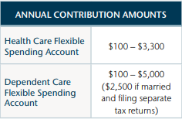
Medical Expense account:
FSA-flexible spending account
The district offers two types of FSA:
A Health care FSA
  Deductibles, copays, prescriptions, over the counter medication, and medical equipment
A Dependent Care FSA
  Babysitter, daycare, day camp, and home nursing
Contributions are deducted from your paycheck on a pre-tax basis in equal installments throughout the calendar year.
USE IT OR LOSE IT! FSA balances do not roll over, however you have a 2.5month grace period to spend any money left in your account.
Notes:
Flexible spending accounts allow you to put aside money for eligible expenses and reduce you income taxes at the same time. The district offers two types of accounts: a health care f s a and a dependent care f s a. during open enrollment you decide how much money to set aside for health care and or dependent care expenses. Your contributions are deducted from your paycheck on a pre tax basis in equal installments throughout the calendar year. Your plan includes an f s a debit card that you can use to pay for eligible expenses at the point of sale. You can also pay out of pocket and submit a reimbursement claim.
Annual contribution amounts: f s a $100 to $3300, dependent care f s a $100 to $5000. $2500 if married and filing separate tax returns.
Please note this is a use it or lose it account. The district allows a two and a half month grace period to spend any money left in your account at the end of the plan year. So you have until march fifteenth to spend you f s a funds.

Slide 15
Life insurance- The Standard
Group Term-life Insurance:
  Basic Term Life – 1x Employee Salary – Provided By The District
      After Age 70 Your Life Insurance Is Equal To 50% Of Annual Salary
  Employee Can Enroll In Additional Term Life Insurance – 1x, 2x, Or 3x Salary
  Dependent Life Insurance Available
  Accidental Death And Dismemberment - 1x, 2x, Or 3x Salary
Notes:
You have a group term life policy through The Standard insurance company, provided to you by the school district. Your basic life insurance policy is equal to the amount of your annual salary. In addition to that you have the option to buy a larger life insurance policy through the enrollment portal, additional life and additional AD&D can be purchase for 1 time, 2 time or 3 times your salary. You can also add dependent life insurance coverage for your listed dependents.

Slide 16
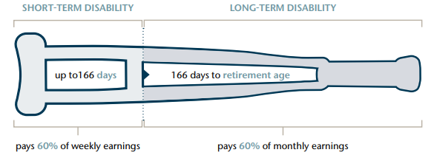
Short & long term disability
Available To New Hires Without Approval Process
Benefits Become Payable After 14 Day Wait Period
Short-term Pays A Weekly Benefit Of 60% Of Earnings For Up To 166 Days
Long-term Pays A Monthly Benefit Of 60% Of First $10000 Of Earnings, Available After 180 Days Until Retirement
  YOU CAN BE DENIED IF YOU ENROLL AT ANY TIME AFTER INITIAL NEW HIRE ENROLLMENT
  YOU ARE REQUIRED TO COMPLETE A EOI AND BE APPROVED FOR BENEFIT TO START
Notes:
Short and long term disability is offered through The Standard Insurance company. As a new hire yu are automatically approved for your short and long term disability enrollment. If you enroll at a later time after your initial new hire you are required to complete the Evidence of insurability (EOI), If you do not complete this form you will not be approved for the short or long term disability coverage.
Benefits become payable after 14 day wait period, short term pays a weekly benefit of 60% of your earning up to 166 days. Long term pays a monthly benefit of 60% of your first $10000 of earning, this benefits is available after 180 days until retirement.

Slide 17

Cigna Supplemental health
The District offers three Cigna supplemental health options:
  Accident Insurance: Pays a lump sum directly to you for a covered injury. The benefit amount is calculated based on the type of injury, its severity and what medical services are required in treatment and recovery.
  Hospital Care Insurance: Receive benefits as soon as you are admitted and additional benefits based on the number of days you are confined to the hospital. You are eligible to receive benefits for inpatient treatment in a rehabilitation facility as well.
  Critical illness Insurance: Pays a lump sum directly to you if you are diagnosed with a covered illness.
To file your claim online you will log into your account at mycigna.com
Notes:
Cigna accident insurance pays a lump sum directly to you for a covered injury. The benefit amount is calculated based on the type of injury, its severity and what medical services are required in treatment and recovery.
With hospital care insurance You receive benefits as soon as you are admitted and additional benefits based on the number of days you are confined to the hospital. This benefit increases if you are admitted and confined to an intensive care unit. You are eligible to receive benefits for inpatient treatment in a rehabilitation facility as well. There are two plan options available, low and high.
Most comprehensive medical plans don’t cover all of the expenses of a serious medical condition like a heart attack or cancer. Critical illness insurance pays a lump sum benefit directly to you if you are diagnosed with a covered illness.
These benefits are paid regardless if you have other insurance coverage.
To file a claim online you will log into your account at my cigna.com, then complete the online claim form and attach any needed documentation.

Slide 18
Florida retirement system
3% Is Automatically Withdrawn From You Paychecks
The District Contributes The FRS Regulated Rate
Please Contact The Florida Retirement System For More Information: 1-888-738-2252
You Will Be Eligible For Full Retirement At Age 65 Or 32 Years Of Service, Which Comes First, But You Must Be Vested. You Are Vested In The Pension Plan After Eight Years Of Service. You Are Vested In The Investment Plan After One Year Of Service.
  Selecting Your Retirement Plan:
FRS Will Mail You A 6-digit Pin 30 days after hire date.
Complete Your New Hire Benefit Enrollment (30 Day Deadline) Before Selecting Your Retirement Plan (8 Month Deadline)
After You Get Your Pin, Login To FRS And Choose The Plan You Want To Contribute
  Investment Vs Pension
    You Will Be Placed In The Pension Plan Until You Make You Selection. If You Do Not Make Your Selection, You Will Automatically Default To The Investment Plan On Month Nine.
After Initial Plan selection, You Have A 1-time Life-time Change Allowance To Switch Plans In The Future.
Notes:
A few weeks after your hire date you will receive a pin from the Florida Retirement system (FRS). Once you receive this you will be able to register your account on the myfrs.com, and choose your plan. You have the option to choose the investment plan or the pension plan. You will be placed in the pension plan until you make your selection, after your initial plan selection you have a 1 time life change allowance to switch plans in the future.
3% Contribution are automatically withdrawn from your paycheck, the district contributes the FRS regulated rate.

Slide 19
Voluntary retirement plan’s
For voluntary retirement savings options please follow the link below or go to the Risk Management Page On The District Website.
403(b) / 457(b) / ROTH
Enrollment Is Completed Through an Authorized TSA Agent.
TSA Information Link
Notes:
If you are interested in saving more for retirement you can consider tax shelter annuities that we can payroll deduct for. We have plan options for a 403 b and 457 deferred compensation plan. If interest you should read through the T S A packet, select which plan you would like to contribute to and choose an authorized company and agent to contact. All paperwork will be completed through your authorized agent.

Slide 20

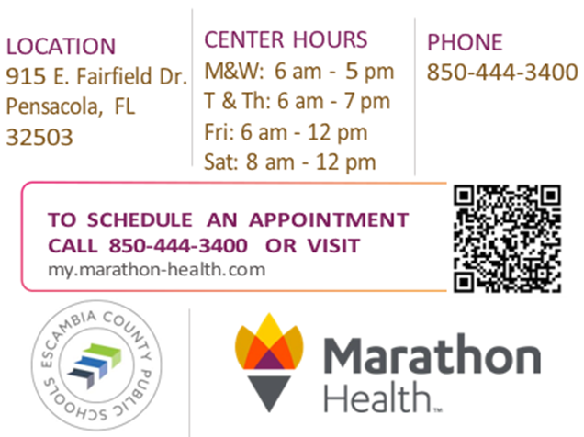
Health & wellness center
Available for employees and their dependents (covered by district insurance) over the age of 6 years.
    HSA $25 copay/ Both HRA plans are Free
Employees can use Marathon regardless if they are covered by district insurance.
    $25 copay
              Some Serviced Provided:
                Care for common illnesses
                Lab work
                Medication for conditions treated at center
                Health Coaching
                Annual Health Assessments
Notes:
Marathon health is Escambia county school district center for health and wellness. As an active employee you can use marathon health for a $25 copay if you don’t have distort insurance.
If you are enrolled in the H S A health plan, you and your covered dependents can visit marathon health for a $25 copay.
If you are enrolled in either of the H R A plans, you and any covered dependent can visit marathon health for free.
Dependents must be older 6 years old to visit marathon health.

Slide 21

Wellness Program
COMPREHENSIVE HEALTH REVIEW
ONLINE RISK ASSESSMENT
BIOMETRIC SCREENING (FINGER STICK)
BE TOBACCO FREE OR COMPLETE A SMOKING CESSATION COURSE
GO OVER ALL OF YOUR RESULTS
THIS WELLNESS ASSESSMENT IS FREE TO EMPLOYEES AND THEIR INSURED SPOUSE.
WHEN YOU COMPLETE ALL OF THE STEPS OF THE COMPREHENSIVE HEALTH REVIEW, YOU WILL QUALIFY FOR AN EXTRA INCENTIVE ON YOUR PAYCHECKS!
EMPLOYEES RECEIVE $40/MONTH FOR A YEAR; SPOUSES RECEIVE $30/MONTH FOR A YEAR (HAS TO BE RENEWED YEARLY)
THAT IS A POSSIBLE EXTRA $70 EACH MONTH FOR COMPLETING YOUR FREE CHR!
SCHEDULE YOUR APPOINTMENT THROUGH YOUR ONLINE PORTAL OR BY CALLING MARATHON HEALTH
Notes:
Through marathon health you can complete the Escambia county wellness program. This comprehensive health review includes an online risk assessment, a biometric screening, and you must be tobacco free. You will go over your results with one of the providers at marathon. All employees can participate in the wellness program, regardless of insurance coverage. When complete, employees can earn an additional $40 per month. Spouses can complete the wellness program if they are covered by the district insurance, this will earn an additional $30 per month. You must complete the wellness program annually to see your credits continue.

Slide 22
Employee assistance program (eap)
Cordova Counseling Center Offers 4 Visits Per Year Free Of Charge.
    Available To Employees And Their Covered Dependents
To Schedule An Appointment Call 850-474-9882 Between 8am-5pm Weekdays
Visit Www.Cordovacounselingcenter.Com For More Information
Notes:
Cordova counseling is offered to employees and their covered dependents. You are offered 4 free visits per year, to make your appointment you should contact Cordova counseling directly. You can find more information on the risk management page on the district website or reach out to one of the benefit specialist for information.

Slide 23

Other district benefits
ECSD Fitness Center
  FREE to you and your dependents.
    Dependents must be covered by District insurance.
    Must be 18+ and accompanied by District employee, Badge is required to enter.
  Access to Personal Trainers and Fitness Classes
Paid Annual & Sick Leave
  12 month employees receive both annual and sick leave.
  10 & 11 month employees receive only sick leave.
2 Week Christmas Vacation
  EVERYONE receives 2 WEEKS PAID!!!
Notes:
As an active employee you will be able to access the Escambia county fitness center. You will be able to use the workout equipment, sign up for fitness classes and personal trainers are available. The fitness center is free to employees and their covered dependents who are older than 18. Dependents must be accompanied by the district employee because they will check your badge before entering the building.
For paid annual and paid sick leave, 12 month employees receive 1 paid annual and 1 paid sick day per month. 10 and 11 month employees will receive 1 paid sick day per month.
All employees will have two weeks paid vacation during Christmas.

Slide 24

Ways To Save
USE IN-NETWORK PROVIDERS ONLY FOR MEDICAL, LABS, PHARMACY, ETC.
USE TREATMENT COST ESTIMATOR ON MyUHC
CHECK YOUR EXPLANATION OF BENEFITS FROM UHC
COMPARE PHARMACIES FOR PRESCRIPTION COSTS
ENROLL IN GOODRX TO FIND LOWEST PRESCRIPTION PRICES AND FOR A FREE SAVINGS CARD!
SAVE ON YOUR TAXES WITH A TAX-FREE FSA
PAY ATTENTION DURING OPEN ENROLLMENT! (READ BEFORE YOU SIGN)
DON’T FORGET ABOUT THE 30-DAY STATUS CHANGE RULE!
Notes:
Here are some ways to save , use in-network providers, use the treatment cost estimator, review your explanation of benefits. Compare pharmacy's and enroll in good r x to find the lowest prescription prices. Save on your taxes with the tax free f s a.
Pay attention during your open enrollment and now during your new hire enrollment. And don’t forget about the 30 day statue change rule

Slide 25
Benefit Deduction
ESP (Educational Support Personnel) Are Paid Bi-Weekly
  Receive 20-26 Paychecks, Benefits are Deducted from 20 Paychecks.
IAP (Instructional Administrative Professional) are Paid Semi-Monthly.
  Receives up to 24 Paychecks and benefits are deducted from each Paycheck.
Notes:
Employees are split into two pay groups, educational support personnel (ESP) and Instructional administrative professional (IAP). As an E S P you are paid bi-weekly, you will receive 20 to 26 checks depending on your position. However, only 20 of those checks will have deductions for insurance taken out, so for 6 checks during the summer no insurance deductions will be taken out of your check. Your insurance will remain active during this time. As an I A P you are paid semi-monthly and all of your checks will have insurance deductions. To review your pay calendar visit the payroll department page on the district website.

Slide 26
Contact Information
Escambia County School District, Home Page: Ecsd Home Page
Risk Management & Benefits Webpage: Risk Management & Benefits
Benefitfocus (Enrollment Website): New Hire Enrollment Website
Payroll Department Webpage: Payroll Home Page
  For contact information or for pay calendars
IT Help Desk: 850-462-9493
Lead Benefit Specialist – Becky Van Ess – bvaness@ecsdfl.Us
Benefit Specialist – Tara Lofton – tlofton@ecsdfl.Us
Benefit Specialist – Ann Baggett - abaggett1@ecsdfl.Us
Notes:
Here is a list of resources that will be helpful during your enrollment and throughout the year. If you have any questions please reach out to a member of the benefits staff.

Slide 27
Thank You
Any questions
Please contact Risk Management or visit the risk management & benefits page on the district website.
Notes:
If you have any questions please reach out to a member of the benefits staff

