Slide 1
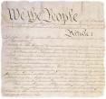

CELEBRATE
Constitution Day
September 17th
We the People…

Slide 2
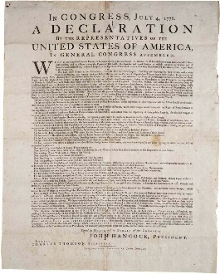
Celebrate the Constitution
Magna Carta
1215
After declaring independence from Great Britain, the colonies knew that if they wanted to grow and prosper, they would need a plan for unity.
Effective March 1, 1781, the colonies were governed by the Articles of Confederation.
After declaring independence from Great Britain, the colonies knew to grow and prosper, they needed a plan for unity. Effective March 1, 1781, the colonies were governed by the Articles of Confederation.
Mayflower Compact
1620
Thomas Jefferson
Author of the “Declaration of Independence”
English Bill of Rights
1689
Declaration of Independence
1776
Articles of Confederation 1781

Slide 3
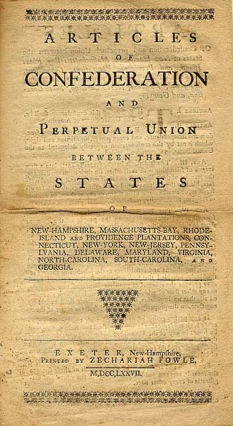
Celebrate the Constitution
The Articles of Confederation posed many challenges. The powers of the central government were weak and the articles were impossible to amend.
John Adams
Founding Father and 2nd President
Articles of Confederation 1781
The Federalist Papers
1787-1788
United States Constitution
1788

Slide 4
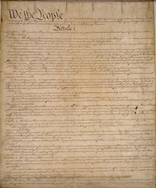
Celebrate the Constitution
In May of 1787, delegates from each state met to write a new Constitution. Through discussion and debate over issues like states’ rights, individual rights, and the power of the national government, a compromise was made and the result became the “law of the land,” the U.S. Constitution.
James Madison
“Father of the Constitution”
United States Constitution
1788
The Bill of Rights 1791
Amendments
11-26
1795-1992

Slide 5
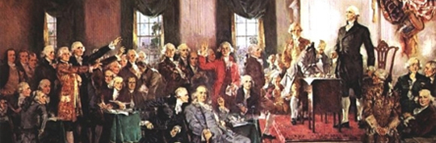
Celebrate the Constitution
Popular Sovereignty
“The Constitution is the guide which I never will abandon. -George Washington
September 17, 1787 was a glorious day! The U.S. Constitution was finally signed by the delegates of the Constitutional Convention. The Constitution included a strong central government based on compromise; it outlined national powers and provided provisions for amending the Constitution.
Checks and Balances
Limited Government
George Washington
President of the Constitutional Convention and 1st President
Separation of Powers

Slide 6
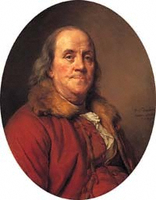
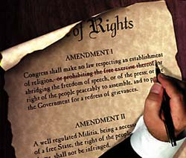
Celebrate the Constitution
Because there was so much interest and debate regarding individual rights, on December 15, 1791, ten amendments known as the Bill of Rights were added to the U.S. Constitution. Since then, seventeen more amendments have been added to the Constitution.
Federalism
Individual Rights
Republicanism
Benjamin Franklin
Signer of the Constitution and Founding Father

Slide 7

Celebrate the Constitution Today
Today, the “law of the land” is still the U.S. Constitution. It has sustained controversial issues, a civil war, and the changes that 200 years of American society brings. But it is strong and enduring. For that, We The People celebrate today the strength and flexibility of the U.S. Constitution.
The Constitution of the United States was made not merely for the generation that then exist, but for the posterity - unlimited undefined, endless, perpetual posterity
-Henry Clay (1877-1852)
American statesman - U.S. Congressman and Senator

Slide 8
Preamble of the U.S. Constitution
We the People of the United States, in
Order to form a more perfect Union, establish
Justice, insure domestic Tranquility, provide for the
common defence, promote the general Welfare, and
secure the Blessings of Liberty to ourselves and our
Posterity, do ordain and establish this Constitution
for the United States of America.
As a class, read the Preamble of the United States Constitution.

