Slide 1
Reports to Support FAST progress monitoring

Slide 2
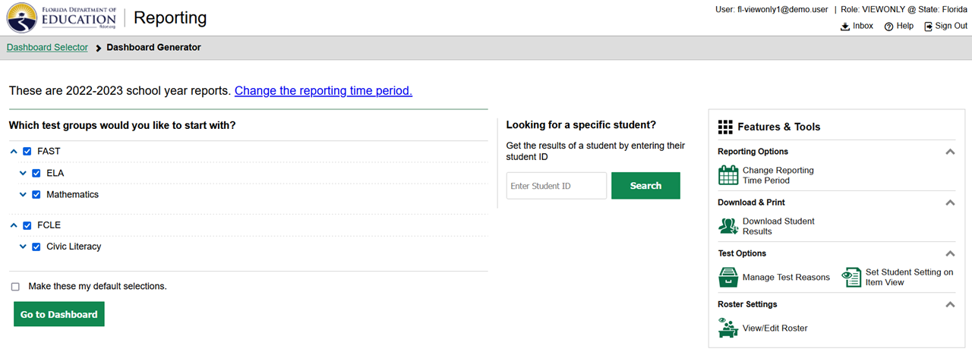
Dashboard Selector
Notes:
All users start with the dashboard selector.
Click on Go to Dashboard

Slide 3
Teacher’s Dashboard View
Teacher sees all tests for the students rostered to them
Notes:
This is the TEACHER’s dashboard view – showing all results for their roster.
Click on FAST ELA Reading

Slide 4
The Teacher Sees Two Tables: All Tests Taken by His/her Students and Listing of All Students
Measures
Test Name
Tested Grade
Test Reason: PM 1, 2, 3
Number of students who have completed and submitted the test
Average Score for all of the tests taken
Achievement Level Distribution
Notes:
This shows results by class, and also individual student.
Click on FILTERS.

Slide 5
Filters Allow the Teacher to Select Data a Single Test or Multiple Tests
Filters
Select Data for Specific Tests and Opportunities
Notes:
Explain the filters.
Click on the up and down arrows next to Grade 5 Reading.

Slide 6
To Provide Teachers with Some Context for Their Class Level and Roster Level Performance, Comparison Scores for the State, District and School are Displayed
Notes:
Now the comparison to state/district/school is shown.
Click on the little i by the achievement level bar.

Slide 7
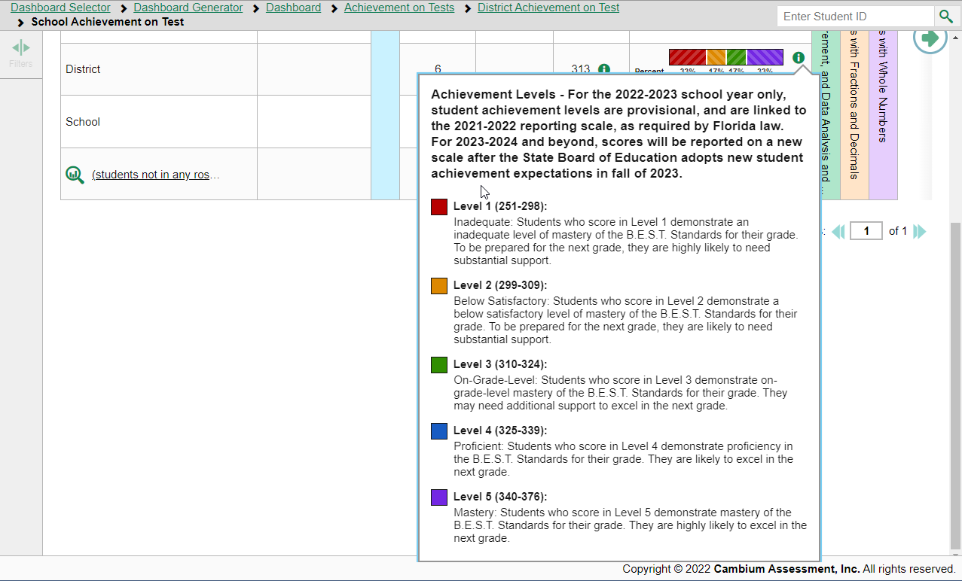
The Definition of the Achievement Levels is Available by Clicking on the Icon
Notes:
The little i buttons show additional information.

Slide 8
To Provide Teachers with Some Context for Their Class Level and Roster Level Performance, Comparison Scores for the State, District and School are Displayed
Notes:
Back at the teacher’s roster view, we can click on Grade 5 Reading to see more info.

Slide 9
Teachers Can See How Each of Their Classes or Rosters Performed on the Test Overall and For Each Reporting Category
Measures
Student Count
Test Completion Rate
Average Scale Score for the Test for each Roster
Achievement Level Distribution for the Roster
Comparison Scores for State, District and School
Notes:
You can expand the Reporting Categories for more info.
Click on the plus sign next to Prose & Poetry.

Slide 10
Teachers can Quickly See Which Standards are Strengths for Their Class and Which Standards Their Class is Struggling With
Measures
Performance for each Reporting Category
The Standards Assessed within the Reporting Category
Proficiency on Each Standard
Performance on Each Standard relative to Performance on the Test as a Whole
Notes:
Explain this, then
Click on a Roster.

Slide 11
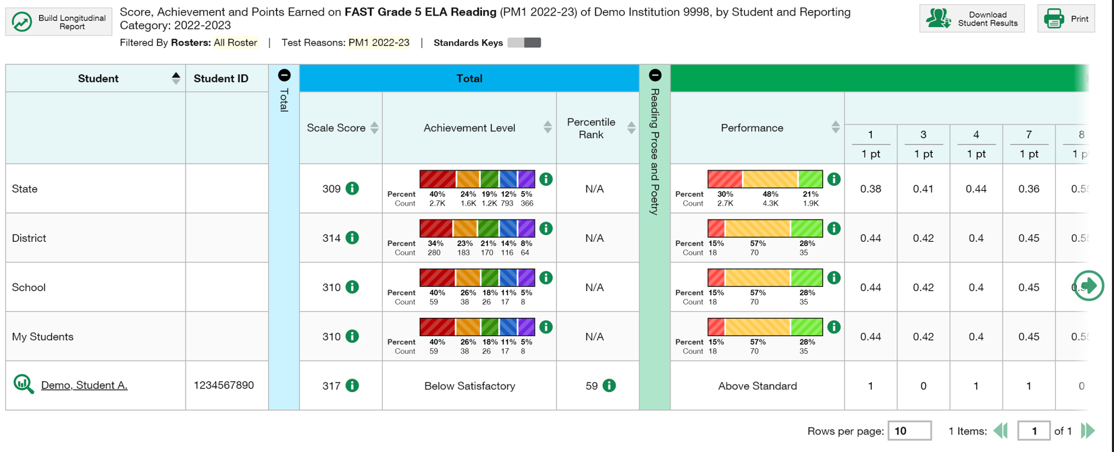
Teachers Can Also See How Each Student Performed on the Test Overall, For Each Reporting Category and For Each Item
Measures
Overall Scale Score for the Test
Achievement Level
Percentile Rank
Within Each Reporting Category there are 3 Performance Levels: Terminology is still being decided
Item level results
Notes:
You can also see detailed information by student.
Next, we will click on the specific student.

Slide 12
Teachers Can Also View Progress for an Individual Student and Identify Changes in Scores and Performance Across PM 1, 2 and 3
Notes:
Results of progress across fall, winter, spring.

Slide 13
Teacher’s Dashboard View
Teacher sees all tests for the students rostered to them
Notes:
Back on the TEACHER’s dashboard view
Click on Download Student Results

Slide 14
Teachers Can Batch Print PDFs of the Student Report
or Export the Data in Different Formats

Slide 15
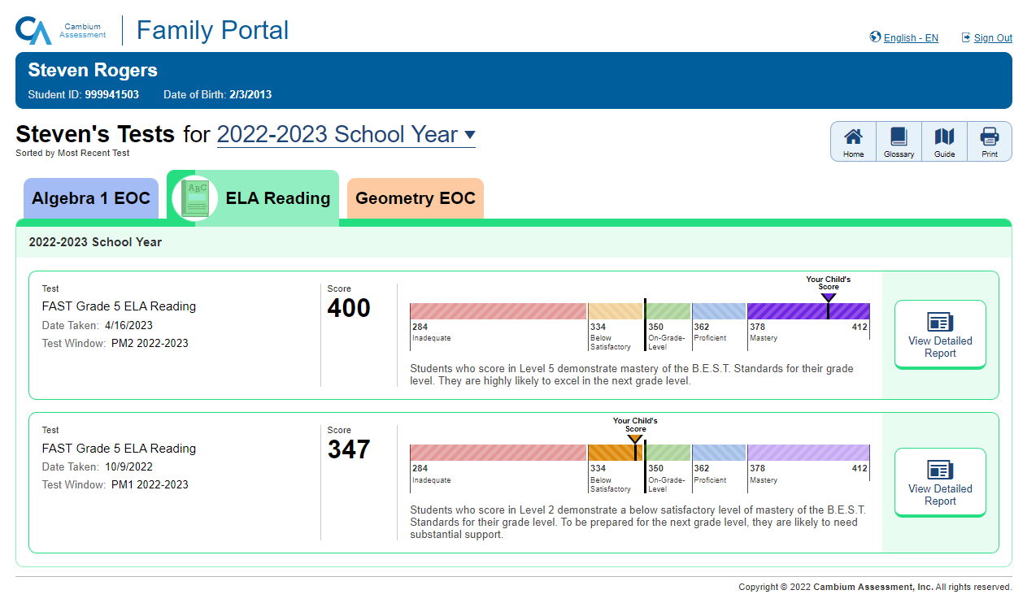
Family Portal Login Page

