Slide 1

Spring 2023
Statewide Assessments
Training Materials
Middle & High

Slide 2
Test Security Review
Per Test Security Statute, s. 1008.24, F.S., and Florida State Board Rule, 6A-10.042, Florida Administrative Code (FAC), inappropriate actions by school or district personnel can result in student or classroom invalidations, loss of teaching certification, and/or involvement of law enforcement.
Examples of prohibited activities are:
Reading or viewing the passages or test items before, during, or after testing
Copying the passages or test items
Revealing the passages or test items
Explaining the passages or test items for students
Changing or otherwise interfering with student responses to test items
Copying or reading student responses
Causing achievement of schools to be inaccurately measured or reported

Slide 3
Test Security
Policies and Procedures
Test administrators should report possible breaches of test security (e.g., secure test content that has been photographed, copied, or otherwise recorded) to the school assessment coordinator immediately.
If a security breach is identified, the school assessment coordinator must contact the district assessment coordinator.
For any test irregularities that require further investigation by the district, a written report must be submitted within 10 calendar days after the irregularity or security breach was identified.

Slide 4
Test Security
Policies and Procedures
Under no circumstances are students permitted to assist in preparing secure materials before testing or in organizing and returning materials after testing.
After ANY administration, initial or make-up, all secure materials must be returned immediately to the school assessment coordinator and placed in locked storage.
No more than three people should have access to the locked storage room. Secure materials must never be left unsecured and must not remain in classrooms or be taken off the school’s campus overnight.
The Test Materials Chain of Custody Form must be maintained at all times.

Slide 5
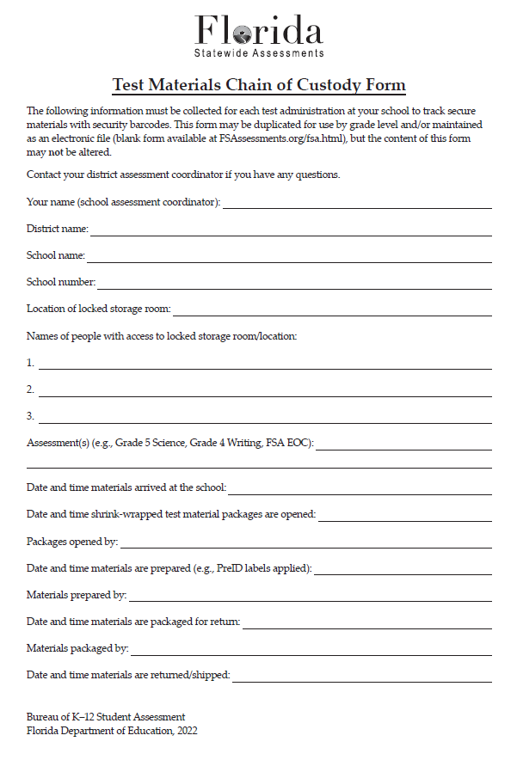

Slide 6
Test Security
Policies and Procedures
All personnel are required to sign and return a Test Administration and Security Agreement stating that they have read and agree to abide by all test administration and test security policies and procedures. Additionally, any other person who assists the school assessment coordinator, technology coordinator, or test administrator must sign and return an agreement.
Test administrators must sign the Test Administrator Prohibited Activities Agreement, located in the manuals.
Copy all agreements, file the copies, and return the originals in your Security Envelope.

Slide 7
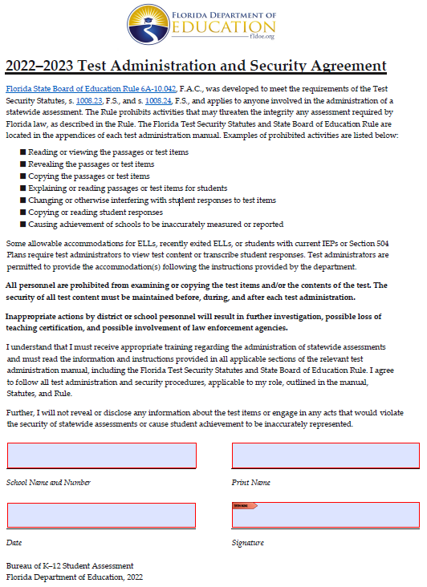
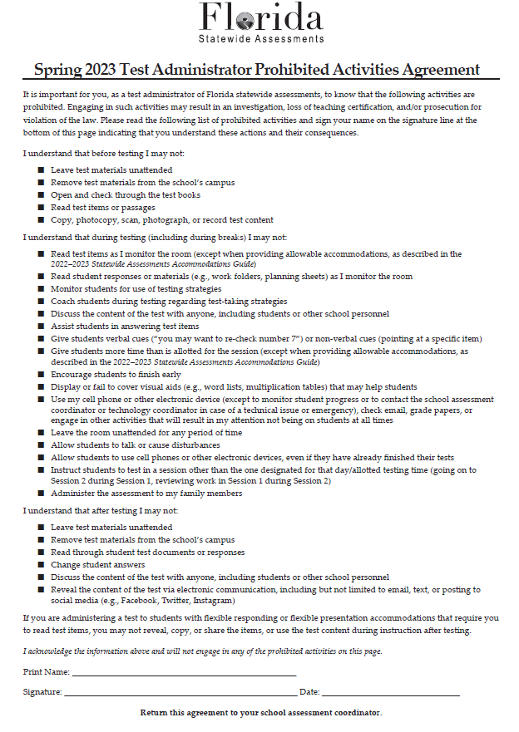

Slide 8
Test Security
Policies and Procedures
Test administrators and Proctors must NOT administer tests to their family members. Students related to their assigned test administrator should be reassigned to an alternate test administrator. In addition, a student’s parent/guardian should not be present in that student’s testing room.
Each test administrator is required to maintain an accurate Security Log, provided in the testing manuals. Anyone who enters a testing room for any length of time is required to sign the log. This applies to test administrators, proctors, and anyone who relieves a test administrator, even for a short break, regardless of how much time he or she spends monitoring a testing room.
Copy all security logs, file the copies, and return the originals in your Security Envelope.

Slide 9
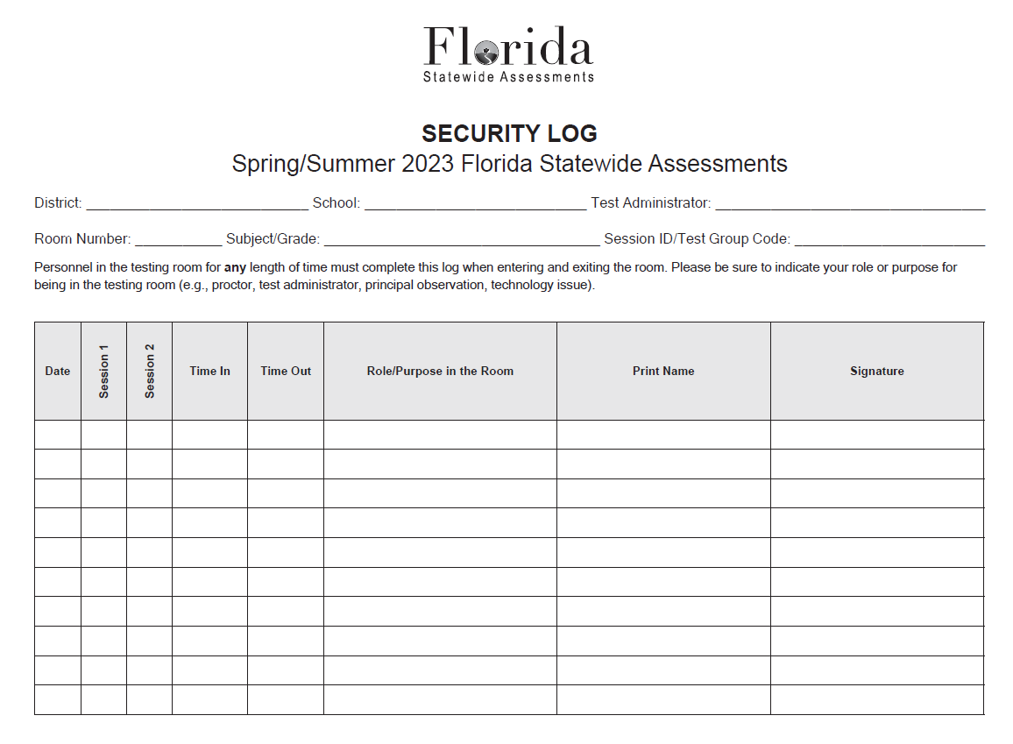

Slide 10
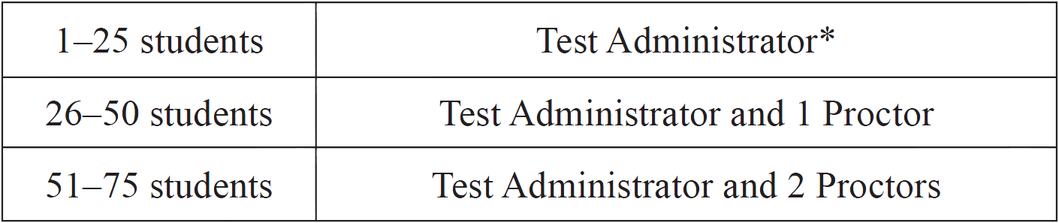
Test Security
Policies and Procedures
Proctors
To ensure test security and avoid situations that could result in test invalidation, FDOE strongly discourages testing students in large groups (e.g., in a cafeteria or an auditorium). If students are tested in a large group, the appropriate number of proctors MUST be assigned to the room to assist the test administrator. Refer to the table below for the required number of proctors.
* FDOE strongly recommends that proctors be assigned to rooms with 25 or
fewer students whenever possible.

Slide 11
Test Security
Policies and Procedures
Proctors (cont.)
School personnel and non-school personnel may be trained as proctors. Prior to testing, inform all proctors of their duties and of the appropriate test security policies and procedures. School personnel proctor duties may include preparing and distributing secure materials (e.g., test tickets).
Non-school personnel may assist test administrators during test administration; however, they may NOT participate in any of the test administration procedures (e.g., distributing and collecting test materials, providing accommodations). Volunteers (e.g., parents, retired teachers) may be trained as proctors and may perform non-school personnel duties.

Slide 12
Test Security
Policies and Procedures
Missing Materials
A written report must be submitted to the Bureau of K–12 Student Assessment within 30 calendar days after secure materials have been identified as missing. The report must include, as applicable:
the nature of the situation,
the time and place of the occurrence,
the names of the people involved,
copies of completed forms,
a description of the communication between the district assessment coordinator’s office and school personnel,
how the incident was resolved, and
what steps are being implemented to avoid future losses.

Slide 13
Test Invalidation
Policies and Procedures
A student has an electronic device during testing. If a student is found with an electronic device that he or she is not using for testing purposes during testing or during breaks within a session, the student’s test must be invalidated.
A student is cheating during testing. Cheating is cause for immediate test invalidation. Possible cheating situations include looking at and/or copying from another student’s test, allowing another student to look at or copy from the student’s test, or accessing unauthorized aids. In situations involving cheating, a report must be submitted to FDOE within 10 calendar days of the incident.

Slide 14
Test Invalidation
Policies and Procedures
A student is not allowed the correct amount of time. If not enough time is given, invalidation decisions should be made based on whether the student was provided adequate time to respond completely to the test items. If the student feels he or she was provided enough time to respond completely, the test should be submitted for scoring. If too much time is given, discuss the situation with the District Assessment Coordinator.
A student becomes ill during testing. If a student reports after testing that he or she was ill during testing and was significantly affected, the test may be invalidated.
If a student is unable to complete a session due to illness, the session may be completed on a subsequent day using the exact time that the student had remaining.

Slide 15
Test Invalidation
Policies and Procedures
A student is given an accommodation not indicated on the student’s IEP, Section 504 plan, or ELL plan. Testing with accommodations not indicated on a student’s IEP, Section 504 plan, or ELL plan may be cause for invalidation.
A student was not provided an allowable accommodation indicated on the student’s IEP, Section 504 plan, or ELL plan. The situation should be discussed with the student and his or her parents/guardians to determine if the lack of the accommodation significantly affected the student’s performance and if the test should be scored.

Slide 16
Test Invalidation
Policies and Procedures
A student is given an accommodation not allowed on statewide assessments. If a student is given an accommodation that is not allowed on statewide assessments and compromises the validity of the test, that student’s test must be invalidated.
A student works in the wrong session. If a student working in session 2 goes back and works in Session 1, the test must be invalidated.
An error occurs in test administration procedures that could compromise the validity of test results. If the validity of the test results has been compromised (e.g., a student had access to an unauthorized visual aid that gave an unfair advantage), the test must be invalidated.

Slide 17
Test Invalidation
Policies and Procedures
A disruption occurs during testing. If students are disrupted during testing due to a circumstance out of their control (e.g., severe weather), test invalidation may be considered if a student feels his or her performance was significantly affected by the disruption.
A student is disruptive during testing. If a student is disruptive during testing, the school assessment coordinator should determine whether invalidation is an appropriate course of action.
A student is given unauthorized help during testing. If a student received unauthorized assistance or has been given an unfair advantage (e.g., a test administrator has told a student to check the answer to a specific item), the student’s test must be invalidated.

Slide 18
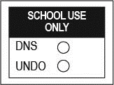
Test Invalidation
Policies and Procedures
For computer-based assessments, test invalidations are entered in TIDE. Invalidating a test will require the student’s ID number and the reason for invalidation.
For paper-based tests, grid the DNS bubble on the front cover of the test and answer book. If a DNS bubble is gridded by mistake, erase it completely and grid the UNDO bubble.
Remember that invalidated paper-based tests should be returned with TO BE SCORED test and answer books in order to be counted for participation purposes.

Slide 19

Florida Statewide Assessments
Grades 6-10 FAST Reading
Grades 6-8 FAST Mathematics
Grades 6-10 BEST Writing Field Test
FSA Retakes (ELA and Algebra 1)
BEST Algebra 1 EOC
BEST Geometry EOC
Biology 1 EOC
Civics EOC
U.S. History EOC
Grade 8 Science

Slide 20

Test Administration Resources
Policy Information
Instructions
Checklists
Signs & Forms

Slide 21

Test Administration Resources
TIDE User Guide
TIDE Quick Guide
Test Administrator User Guide
TDS Quick Guide
Accommodations Guide
TA Certification Course
*SCRIPTS
Florida Assessment Portal – www.fsassessments.org

Slide 22
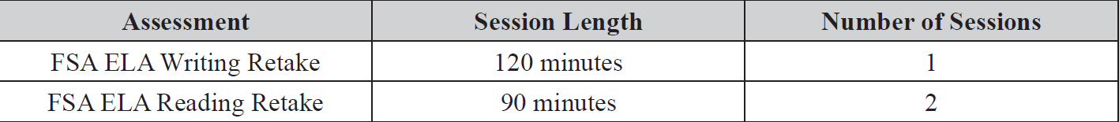
Test Administration Schedule
Session Lengths by Subject
FSA Retakes (ELA & Algebra 1)
The FSA ELA Writing Retake is administered in one 120-minute test session.
The FSA ELA Reading & Algebra Retakes are administered in two 90-minute test sessions over two days. Session 1 must be completed before Session 2.
Any student who has not completed a session by the end of the allotted time may continue working up to half the length of a typical school day.

Slide 23

Test Administration Schedule
Session Lengths by Subject
FAST Reading and Math
FAST assessments have only 1 session.
Students can only take one subject test per day.
Any student who has not completed a session by the end of the allotted time may continue working up to the length of a typical school day.

Slide 24


Test Administration Schedule
Session Lengths by Subject (cont.)
BEST Algebra 1 and Geometry
Biology 1, Civics, and U.S. History EOC Assessments
These assessments are administered in one 160-minute test session in one day. Students finished after 80 minutes may be dismissed.
Any student who has not completed a session by the end of the allotted time may continue working up to the length of a typical school day.

Slide 25
Test Administration Schedule
Session Lengths by Subject (cont.)
Grade 8 Science
The Statewide Science Assessment for grade 8 is administered in two 80-minute test sessions in one day (PBT).
BEST Writing Field Test
The BEST Writing Field Test is administered in in one 120-minute test session with a 90-minute dismissal option.
No additional time unless with accommodation.
This is a computer-based test with no PBT accommodations.

Slide 26
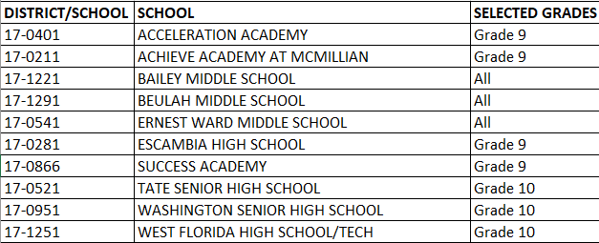
Test Administration Schedule
BEST Writing Field Test Schools

Slide 27
Test Materials
Planning sheets – FSA Writing Retake & BEST Writing Field Test
ALL students taking the Writing tests will receive Writing Planning Sheets that they may use to take notes and plan their responses.
The planning sheet is a one-page, letter-sized sheet. The front of the sheet is lined. Planning sheets are distributed to students at the beginning of the test session.
Ensure that students have enough desk space to use their planning sheets.
Used planning sheets are considered secure materials and must be kept in locked storage and returned in the District Assessment Coordinator ONLY box.

Slide 28
Test Materials
CBT Worksheets – FSA ELA Reading, Civics & U.S. History
CBT Worksheets are one-page, letter-sized worksheets. Students may use the front and back of the worksheet to take notes.
Worksheets are distributed to students at the beginning of each session for ELA Reading, Civics and U.S. History EOC assessments.
Ensure that students have enough desk space to use their worksheets.
Each student must be given a new worksheet for each ELA Reading test session.
Used worksheets are considered secure materials and must be kept in locked storage and placed in the District Assessment Coordinator ONLY boxes.

Slide 29
Test Materials
Four-function Calculators
Grade 6 FAST Math includes a four-function calculator in the TDS, and handheld calculators are optional.
Biology 1 includes a four-function calculator in the TDS, and handheld calculators are optional.
Grade 8 Science students must be provided a handheld four-function calculator for both sessions of the test (PBT).

Slide 30
Test Materials
Scientific Calculators
Grades 7–8 FAST Math includes an online scientific calculator in the TDS.
The BEST EOC’s (Algebra 1 and Geometry) include an online scientific calculator in the TDS.
The FSA Algebra 1 Retake includes an online scientific in the TDS for Session 2 only.
Handheld scientific calculators are optional.

Slide 31
Test Materials
Work Folders – FSA Algebra 1 Retake & Biology 1
Students may use work folders to work the problems. The last page of the folder (back cover) is printed with graph paper.
Each student must be given a new work folder for each test session.
All used work folders are considered secure materials and must be kept in locked storage and returned in the District Assessment Coordinator ONLY box.
Pens/Pencils & Scratch Paper – Grades 6-8 FAST Math
Students must be provided a pen or pencil and scratch paper to work the problems. Grid/graph paper may be provided as scratch paper.
Scratch paper is considered secure materials and must be stored in a secure location after testing, and returned in the District Assessment Coordinator ONLY box.

Slide 32
Test Materials
Reference Sheets & Periodic Tables are provided in an online format for computer-based testing. They are displayed in pop-up windows in their respective tests. Reference Sheets & Periodic Tables for students with paper-based accommodations are packaged with the test materials.
Reference Sheets
  FAST Math Grades 6-8
  BEST EOC’s (Algebra 1 & Geometry)
  FSA Algebra 1 Retake
Periodic Table
  Biology 1

Slide 33

School Assessment Coordinator
Before Testing
Preparation and Training
You are responsible for training all test administrators and proctors, including non-school-based instructors (e.g., itinerant teachers). In the absence of sufficiently trained administrators, postpone testing until trained personnel are available.

Slide 34
School Assessment Coordinator
Before Testing
Preparation and Training (cont.)
Test Administrators
Test administrators must read and be familiar with all appropriate sections of the manuals.
Test administrators who will be administering a test to students with accommodations must be trained in the use of those accommodations.
Test administrators should refer to the Test Administrator Checklists, located in the manuals, before, during, and after testing.
Test Administrators must check for and remove all unauthorized visual aids posted in classrooms or affixed to student desks prior to testing.

Slide 35
School Assessment Coordinator
Before Testing
Preparation and Training (cont.)
Electronic Devices and Breaks
  Determine your school’s policy for the storage of electronic devices during testing. Before testing begins, test administrators ask students to raise their hands if they have any electronic devices with them. Direct test administrators on what to do if students have electronic devices in their possession before testing begins.
  Ensure that test administrators are aware of the policy that students are not allowed to access electronic devices at any time during a test session, including breaks. If a student accesses his or her electronic device(s) during a break, his or her test must be invalidated.
  Ensure test administrators are aware of how to secure a student’s computer or device during a break. For short breaks (e.g., restroom), it is recommended that a visual block be applied to the student’s computer screen or device. For longer breaks, it is recommended that the student pause the test.

Slide 36
School Assessment Coordinator
Before Testing
Prepare for CBT Administration
Ensure that all test administrators have active usernames and passwords to log in to TIDE. Test administrators will need access to the TA Interface in TIDE in order to administer tests.
Work with your district assessment coordinator to ensure that all students are uploaded into TIDE. Verify that student eligibility is correct and that accommodations and test settings are correct.
The Florida Education Identifier (FLEID) is now required. A student’s social security number with an X or a 10-digit district number is no longer accepted.

Slide 37
School Assessment Coordinator
Before Testing
Meet with Technology Coordinator
It is important that technology coordinators understand their responsibilities before, during, and after a computer-based test administration.
The latest version of the secure browser must be installed on all computers or devices that students will use for testing.
Review the instructions and information for technology coordinators, as well as all test administration and security policies and procedures included in the manual, with your technology coordinator and create a plan for handling issues during testing.

Slide 38
School Assessment Coordinator Before Testing
Print Test Tickets
Each student must have a test ticket to log in to computer-based assessments.
See the TIDE user guides for instructions on generating and printing test tickets.
Prior to computer-based test administrations, print test tickets to distribute to test administrators.
Test tickets are considered secure materials and must be stored in a secure location before and after testing, and returned in the District Assessment Coordinator ONLY box.

Slide 39
School Assessment Coordinator
Before Testing
Assign Test Group Codes and Print PreID Labels
For paper-based tests, each test administrator must be given one unique four-digit test group code to use in the testing room for each test administered. Each testing room must use a different test group code.
Different unique test group codes must be used for make-up sessions.
If a PreID label is not available, an On-Demand PreID Label must be printed and applied to the test and answer book.
School staff may verify and apply labels no sooner than one week prior to testing.

Slide 40
School Assessment Coordinator
Before Testing
Required Administration Information
Communicate to test administrators the process for collecting the required administration information, which includes the following:
  Students assigned to each testing room—provide Student Names and Student FLEID Numbers
  Attendance information—P=Present, A=Absent, W=Withdrawn,
  and P/I=Present but Invalidated
  Grade level
  Session ID or Test Group Code
  Accommodations provided AND accommodations used
  Signatures of test administrator and school assessment coordinator
  Unique security numbers of secure documents assigned to each student
  Dates and times when secure materials (e.g., test tickets, test and answer books, passage booklets) are received and returned
  After testing, copy all admin records, file the copies, and return the originals in your Security Envelope.

Slide 41
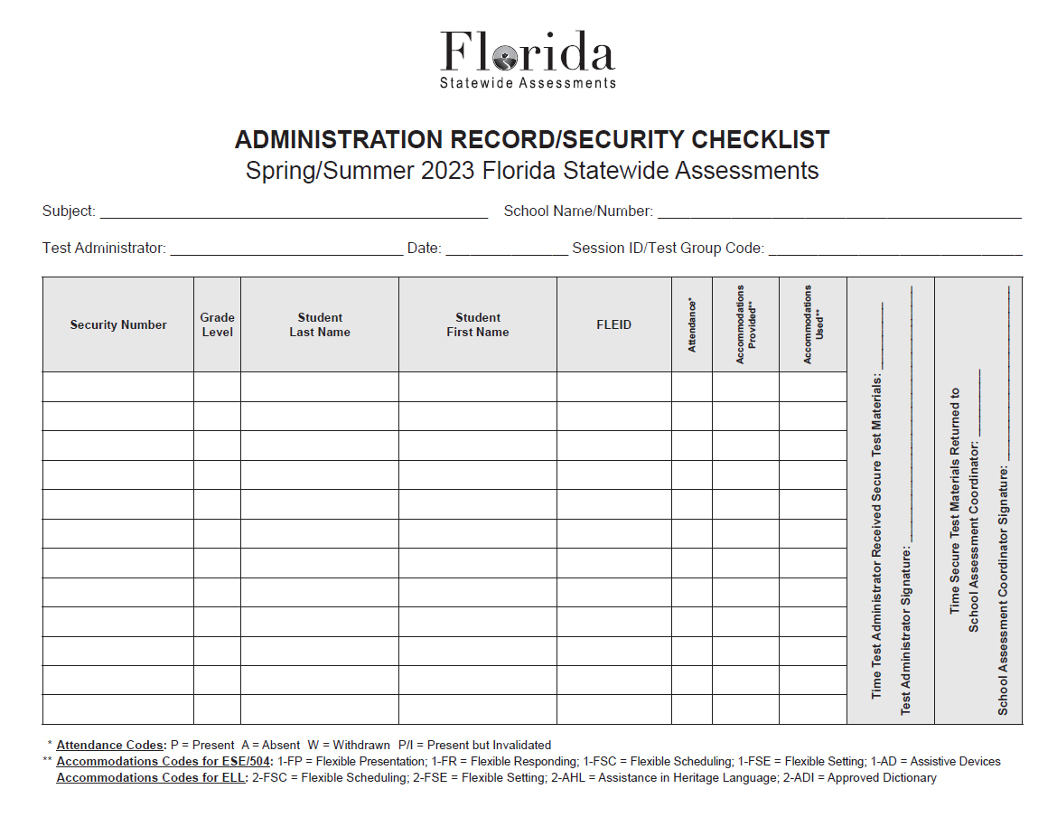

Slide 42
School Assessment Coordinator
Before Testing
Seating Charts
Test administrators are required to maintain an accurate seating chart for each group of students in their rooms during testing.
Arrows showing the direction the students are facing are now REQUIRED
Create a new seating chart if the seating configuration changes during a test session.
After testing, copy all seating charts, file the copies, and return the originals in your Security Envelope.

Slide 43
School Assessment Coordinator
Before Testing
Ensure Implementation of Accommodations
Appendix A in each manual provides information concerning allowable accommodations for students with disabilities and for ELLs.
When testing students with accommodations, prior planning is necessary to ensure that accommodations indicated on student IEPs, Section 504 plans, or ELL plans are implemented. Arrangements for implementing accommodations must be made prior to the administration dates.
Make sure that test administrators have been properly trained regarding accommodations, and have made provisions for the exact accommodations needed for individual students to avoid test invalidations.

Slide 44
School Assessment Coordinator Before Testing
Ensure Implementation of Accommodations (cont.)
In TIDE, ensure the appropriate accommodations by selecting them on the student details page.
This must be done before testing.
Detailed instructions are given in the TIDE user guide.
Accommodated scripts are available on the Florida Assessment Portal.

Slide 45
School Assessment Coordinator Before Testing
Assessment Viewing Application (AVA)
All test administrators who will administer the paper-based version of the FSA ELA Reading Retake test must be assigned the Assessment Viewing Application (AVA) Test Administrator role in TIDE.
AVA contains audio content, Closed Captioning (CC), and American Sign Language (ASL) videos for ELA Reading listening items for students with paper-based accommodations.

Slide 46
School Assessment Coordinator
During Testing
Distribute Test Materials
On each day of testing, you are responsible for providing each test administrator with the following test materials, as applicable:
Test tickets
Admin Record
Security Log
Seating Chart
Planning Sheets/Work folders/Worksheets
Test and answer books or special document materials (PBT)

Slide 47
School Assessment Coordinator
During Testing
Supervise Test Administration and Maintain Test Security
Provide test administrators with additional materials during testing, as necessary.
Monitor each testing room to ensure that test administration and test security policies and procedures are followed.
You and the technology coordinator must be available during testing to answer questions from test administrators and to assist with technical issues. The test administrator must have a way to contact the school assessment coordinator or technology coordinator without leaving the room unattended.
Ensure that Admin Records, Security Logs and Seating Charts are being completed properly and that all required administration information is being maintained in each testing room.

Slide 48
School Assessment Coordinator
During Testing
Supervise Test Administration and Maintain Test Security
Submit “Re-open a test session” and “Re-open a test” requests in TIDE when necessary.
The Invalidations & Requests Summary on the next slide is available on the Florida Assessment Portal

Slide 49
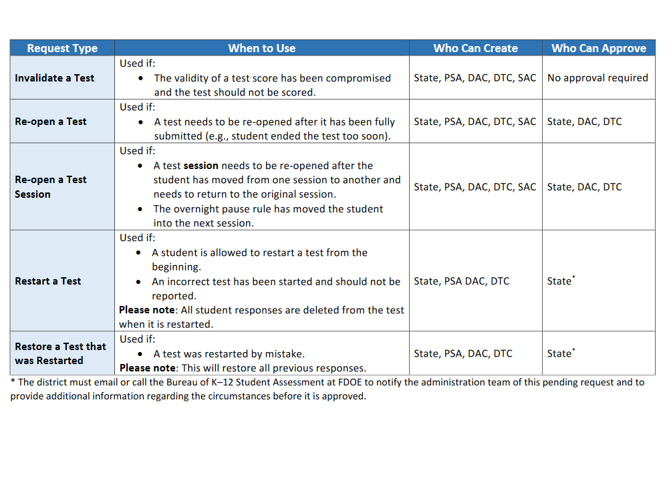

Slide 50
School Assessment Coordinator
During Testing
Monitor Student Progress
  Student progress and test completion rates for computer-based tests can be monitored in TIDE. School assessment coordinators should use Participation Reports in TIDE to track completion rates and determine which students still need to be tested. Further information on Participation Reports can be found in the TIDE User Guide.

Slide 51
School Assessment Coordinator After Testing
Receive Materials from Test Administrators
  Verify that all secure materials have been returned. Notify the district assessment coordinator immediately if any secure materials are missing and complete the necessary investigation.
  Make copies of the following completed documents and file the copies:
    Administration Records
    Security Logs
    Seating charts
    Chain of Custody forms
Return the originals in your Security Envelope.

Slide 52
School Assessment Coordinator After Testing
  Update Student Information
  If student information is discovered to be incorrect during testing, update the corrected information in TIDE immediately following test administration.

Slide 53
Test Administration Resources
IT Department – Technical Support
Technical Support for Testing Hotline
  (850) 462-9825

