Slide 1
FAST Grades 3–10 Progress Monitoring Training Cambium's Testing Systems: TIDE and TDS
Copyright © 2022 Cambium Assessment, Inc. All rights reserved.
Notes:
Welcome to the online training module for the Test Information Distribution Engine, also known as TIDE. This training module includes many examples of TIDE’s features. The TIDE User Guide on the portal has additional information about features in TIDE.

Slide 2
Objectives
Preparing for Testing
Activating your new TIDE account and logging in to TIDE
Navigating the TIDE interface
Understanding account permissions
Managing user accounts
Managing student information, rosters and test settings
Administering Tests
Print Test Tickets and PreID Labels
Managing invalidations and requests
Monitoring test progress
After Testing
Secure Materials Tracking Reports
Test Completion Rates
Notes:
This presentation will address numerous topics in TIDE, including tasks that typically take place while preparing for testing, during test administration, and after testing has concluded.
At its core, TIDE is a registration system for users who will access CAI systems and students who will take CAI tests. Users of all CAI systems must be added to TIDE before they can access any CAI system. Students must be added to TIDE before they can test in TDS. Rosters must be added in TIDE so FAST Reporting can display scores at the classroom, school, district, and state level. Depending on the role of the user in TIDE, before/during testing, users can print test tickets, place additional orders, view order history/summary, manage invalidation requests, and monitor test progress. After testing, TIDE users can clean up data and track returns of paper testing materials, find test completion rates and get Family Portal access.

Slide 3
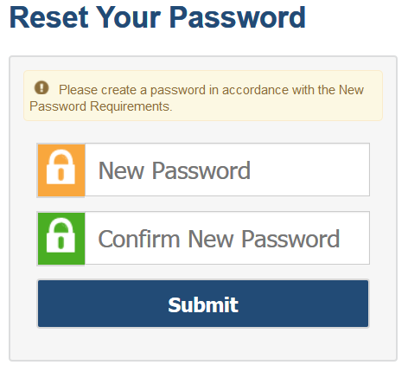
Activating Your Account
Follow the activation link in your email.
Create a password for TIDE that meets the password requirements:
At least 8 characters
At least 1 uppercase letter
At least 1 lowercase letter
At least 1 special character
At least 1 number
Submit your new password.
Notes:
When you are first added to TIDE, you will receive an account activation email containing a temporary link to reset your password. The sender’s address will appear as DoNotReply@cambiumassessment.com
The email contains two important links:
An activation link
A second link to request a new activation email
The activation link is only valid for 15 minutes. After that time, the link will expire, and you will need to click the second link to request a new activation email.
When you click the activation link, the Reset Your Password page will appear. Create the password you will use to access TIDE. If the password you enter is not processing, please ensure that you have met all system password requirements.
Your TIDE password must contain at least 8 characters, 1 uppercase letter, 1 lowercase letter, 1 special character, and 1 number.
If you do not reset your password, you will not be able to access the system.
If your password meets all requirements, click Submit.

Slide 4
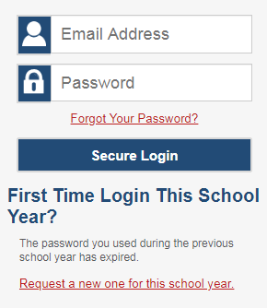
Logging into TIDE
Notes:
After activating your account, you will have access to the various systems located on your portal.
To access TIDE, go to your portal and select the TIDE icon. On the login page, enter your email and password and click Secure Login.

Slide 5
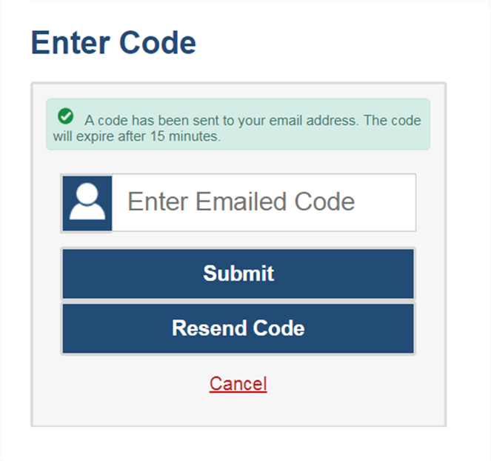
Logging into TIDE, continued
The system has an authentication process that will be triggered when you log in from a different device or browser or after clearing your browser’s cache.
If you see this screen, an email containing the code will have been sent automatically to your email address.
Enter the code and click Submit.
If you need the code to be resent, click Resend Code.
Notes:
When logging in to the system using a new device or browser, or after clearing the cache on a previously used browser, you will see an Enter Code page.
If you see this screen, will need to enter the code on this page within 15 minutes of receiving the email. If you do not receive a code or do not enter the code within the 15-minute time limit, click Resend Code. Click Submit after entering the authentication code to access the system. You will be taken to the Reset Your Password page or directly into TIDE if you have already set your password.

Slide 6
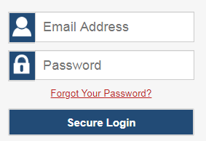
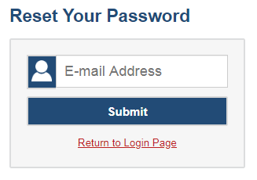
Resetting Your Password
Notes:
If you forget your password, you will need to reset it in order to access TIDE.
You may need to reset your password in the following situations:
You forgot your password.
Your activation link expired.
Your account is locked because you exceeded the account login attempt limit.
It is a new school year.
To reset your password, click the Forgot Your Password? link. You will be taken to the Reset Your Password page. Enter your email address and click Submit. You will receive an email with an activation link. Follow the same steps you would when initially setting up your TIDE account.

Slide 7
Logging into TIDE, continued
Notes:
At the beginning of a new school year, if you already have a TIDE account, your TIDE password and security details will be automatically reset. To reset your password, go to your portal and select the TIDE icon. On the login page select Request a new one for this school year.

Slide 8
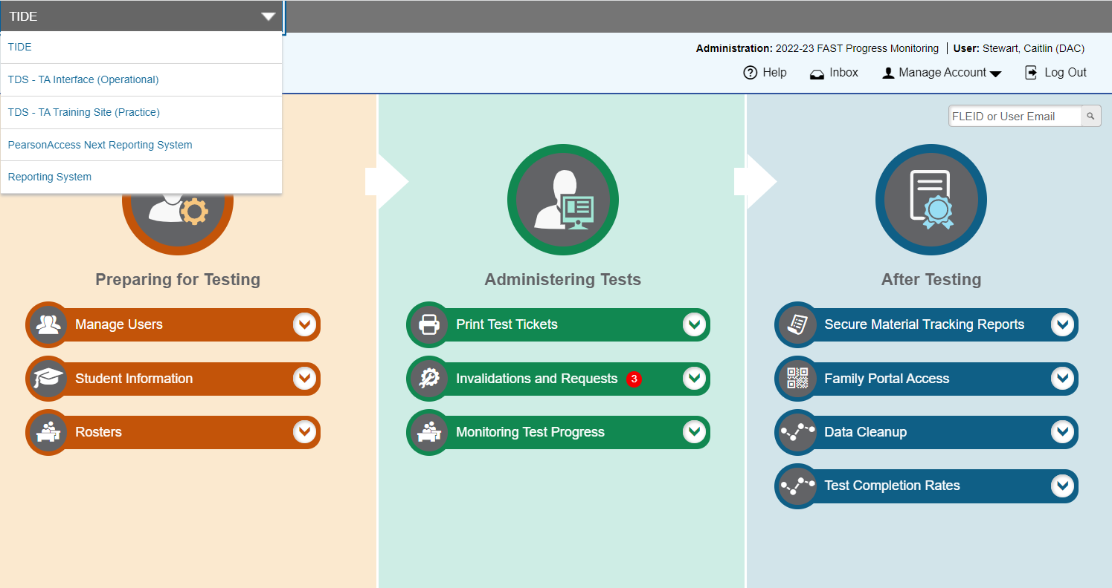
TIDE Banner and Switching Between Systems
Notes:
A banner appears at the top of each TIDE page showing the current test administration, your name, and your current user role. On the left, there is a drop-down list for accessing other Cambium Assessment applications such as the Test Administrator Interface and the reporting system. You will also find a Help button that displays the TIDE User Guide, an Inbox button, a Manage Account drop-down list where you may manage your account details, and a Log Out button.

Slide 9
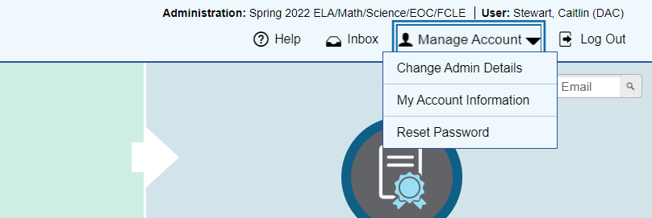
TIDE Banner: Manage Account
Notes:
The Manage Account drop-down list allows you to switch to a different administration, change the role you are using in TIDE (if you have been assigned multiple roles), update your contact information, and reset your password.

Slide 10
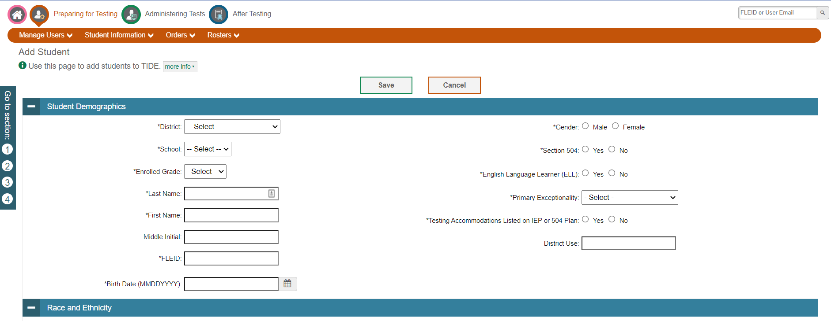
Navigation Toolbars
Notes:
When you enter any task page, a navigation toolbar appears at the top of the page. This toolbar allows you to access each task and action that was available on the dashboard. To view the task menus for a particular TIDE category, click the icon for that category above the toolbar.
Some pages in TIDE are divided into multiple panels. Each panel contains a group of related settings and fields that you can edit. You can click the minus sign in the upper-left corner of a panel to collapse it or click the plus sign in a collapsed panel to expand it. Additionally, a floating Go to section toolbar appears on the left side of each page with multiple panels. This toolbar includes a numbered button for each panel in the form. You can hover over a button to display the label of the associated panel and click the button to jump to that panel.

Slide 11
Help Text
Notes:
Most pages in TIDE have help text that describes the page and how to use it. To show or hide help text on a page, click the green more info link under the page title.
To read more-detailed information about the page that you are currently viewing, click the Help button in the banner.

Slide 12
Quick Search
Notes:
To quickly search for a user or student to view or edit, enter the user’s email address or student’s FLEID in the search box. Then, click the magnifying glass to the right of the search box.
If you are searching for a user to view or edit, the View/Edit User form will appear. If you are searching for a student to view or edit, the View/Edit Student form will appear.
When you are finished viewing/editing a student or user, click the Save button.

Slide 13
Roles and Permissions
Task​ | District Administrator​ | School Assessment Coordinator​ | Test Administrator​
Adding Students​ | ✓ | ✓ | ​
Viewing and Editing Students​ | ✓ | ✓ | View only ​
Adding User Accounts​ | ✓ | ✓ | ​
Viewing and Editing User Details​ | ✓ | ✓ | ​
Creating Invalidation Requests​ | ✓ | ✓ | View only​
Working with Rosters of Students​ | ✓ | ✓ | View only​
Monitoring Test Progress ​ | ✓ | ✓ | ​
FAST Reporting​ | ✓ | ✓ | ✓
For a detailed list of user roles and associated permissions, see the TIDE User Guide.
Notes:
Your TIDE account is assigned a role, and that role has certain permissions. This table gives the permissions associated with some TIDE roles. For example, a district-level user may be able to perform tasks that are not available to a Test Administrator user.
Permissions also limit the scope of data access. A district-level user can work with data pertaining to that district, a school-level user can work with data pertaining to that school and a test administrator can access data pertaining to their students.

Slide 14
School Assessment Coordinator
Copyright © 2021 Cambium Assessment, Inc. All rights reserved.
Notes:
Welcome to the online training module for the Test Information Distribution Engine, also known as TIDE. This portion of the training module includes many examples of TIDE’s features that a School Assessment Coordinator will see. The TIDE User Guide on the portal has additional information about features in TIDE.

Slide 15
FAST Progress Monitoring
Above Grade Testing
Available for Writing, Reading, and Mathematics.
Separate field for each subject. (Writing and Reading are no longer one field.)
Paper Accommodations
A new paper accommodation field will be added for FAST PM only.
Students needing a paper accommodation will be marked appropriately in TIDE.
If this field is marked “Y”, student will no longer be eligible for online testing.
Paper accommodations will not be available for PM 1/PM2. (These fields should be left blank in the initial PreID file upload.)
DACs will be responsible for ordering paper materials through Additional Orders; there will be no initial order for FAST PM.

Slide 16
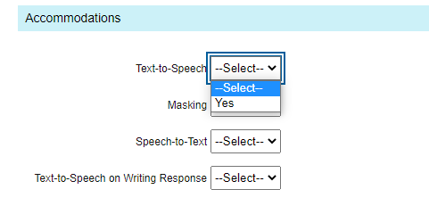
Accommodations/Class Codes
Accommodations will no longer be subject specific.
You will indicate “Y” or “Yes” to turn on an accommodation for applicable students.
If an accommodation is selected, it will be applicable for all subjects the student will test.
For example, if text-to-speech is “Yes”, the student will receive this accommodation for all eligible tests.
Class codes have been removed from all layouts – PreID rosters will no longer be generated in TIDE.

Slide 17
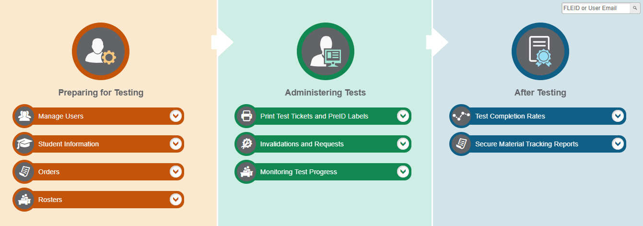
TIDE Home Page
Notes:
The TIDE home page appears after you log in. The home page is designed to reflect the stages of the testing process. Each of TIDE’s three sections lists menus for the tasks available in that section. For example, the Users menu contains options for adding users; viewing, editing, or exporting users; and uploading users. To expand a task menu and view its set of related tasks, click the down arrow on the end of that menu. To perform a task, click the name of that task listed in the menu.

Slide 18
TIDE Tasks: Preparing for Testing
Notes:
Tasks in the Preparing for Testing section are typically performed before testing begins. This category includes tasks for managing records for users, students, test settings, and rosters.
TIDE can group students into rosters. A roster is a collection of students who are assigned to a specific teacher. Once scores are calculated, school users can view student performance for their school or by roster.

Slide 19
TIDE Tasks: Administering Tests
Notes:
Tasks in the Administering Tests section are typically performed during the test window.​ ​
School assessment coordinators may use TIDE to print test tickets and PreID labels, create/view invalidations and requests, and monitor test progress.

Slide 20
TIDE Tasks: After Testing
Notes:
In the After Testing section, you can get access to test completion rates and get Family Portal access codes.

Slide 21
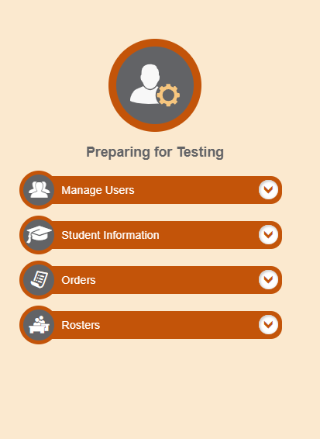
Things All TIDE Users Must Know How To Do
How to add records one at a time
How to modify records one at a time
Notes:
Records for users, students, and rosters must be added to TIDE and kept up to date for the testing process to flow properly. Users not added to TIDE will not have access to any CAI systems, students who are not added will be unable to test, and rosters not added will not be available in the Reporting System. The process for adding and modifying records are similar for users, students, and rosters. This next section of the module will walk you through how to add records one at a time, how to modify records one at a time, and how to add or modify multiple records at once.

Slide 22
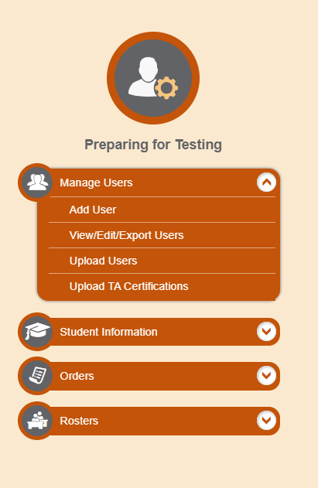
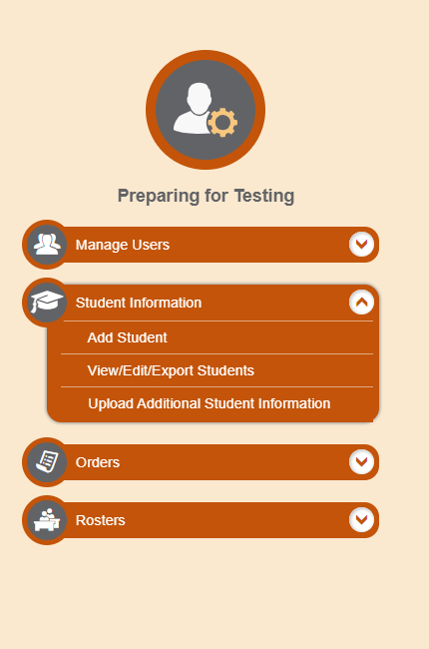
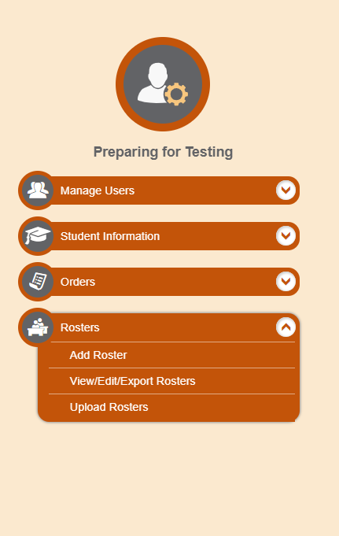
Add Records One at a Time
Notes:
To add records one at a time, start on the TIDE home page. In the Preparing for Testing section, choose the task for which you want to add a new record: users, students, or rosters, then click add.
On the following page, fill out the information, verify its accuracy, and select Save.

Slide 23
Add Users One at a Time
Reminder: SACs can add other SACs and TAs
When adding users one at a time:
Enter the email address for the user you want to add.
Click + Add user or add roles to user with this email.
If the email exists, then options will be available to add multiple roles for the user.
The new user’s email address will serve as his or her username.
Notes:
When adding users one at a time, enter the email address for the user you want to add. Click + Add user or add roles to user with this email. If the email exists, then options will be available to add multiple roles for the user.
The new user’s email address will serve as his or her username when he or she logs in to any Cambium Assessment system. The new users you add will receive an activation email from DoNotReply@cambiumassessment.com.

Slide 24
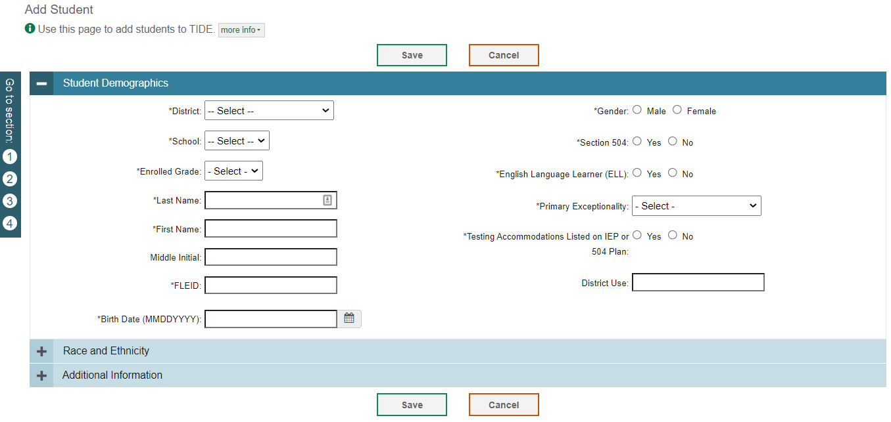
Add Students One at a Time
Notes:
When adding students one at a time, begin by adding information to the Student Demographics panel. The fields marked with an asterisk are mandatory. The FLEID and student name you enter must match a student who already exists in Florida's enrollment system. This page contains additional panels including Race and Ethnicity, and Additional Information where you will indicate test eligibility and/or accommodations. Complete the required information in all panels and click Save.

Slide 25
Rosters
PreID rosters will no longer be generated in TIDE.
User-Defined rosters will need to be created in TIDE for teachers to view their student results in the FAST Reporting system.
Teachers or other staff who will need access to a roster of students but will not be administering assessments should be added to TIDE with the TA role.
Users with the following roles will appear in the Teacher Name drop-down field when adding or viewing/editing rosters: SAC, SA, TA, and AVA.
Role | DAC/DA | SAC/SA/SAC | TA
Student Access in FAST Reporting | All students in your district | All students in your school | All students in your roster

Slide 26
Rosters, Cont.
Evaluation Services will create rosters for each school based on the following criteria:
Elementary Schools – Each teacher will have ALL assigned students listed as a Roster. Roster name will be your Last name
Middle and High Schools – Each teacher will have BY PERIOD assigned students, even if you have multiple preps in that period. Roster name will be “Period-Lastname” (ie 02- Rykard)
If your schools has students who visits a teacher for pull out instruction, you may add an additional roster so that the pull out teacher may see results. For example, McArthur’s “Walk and Read”.

Slide 27
Rosters
Roster relationships will be shown on the View/Edit Student page, similar to the Student Participation section. Users will be able to see all rosters a student is assigned to.
TAs will have access to view rosters in TIDE and FAST Reporting.

Slide 28
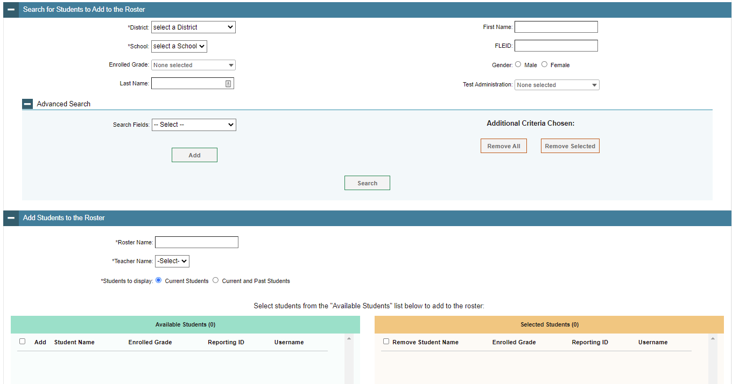
Add Rosters One at a Time
Note: Roster Name is limited to 50 characters.
To search for students, complete the fields under the Search for Students to Add to the Roster panel.
Refine the list of available students by completing the fields in the Add Students to the Roster panel.
Notes:
The Add Roster page contains two panels, a Search for Students to Add to the Roster panel and an Add Students to the Roster panel.
To search for students, complete the fields under the Search for Students to Add to the Roster panel. The fields marked with an asterisk are mandatory. You can further refine your search by selecting criteria under the Advanced Search section.
Refine the list of available students by completing the fields in the Add Students to the Roster panel. To display current students only, click the Current Students radio button. To display current and past students, click the Current and Past Students radio button. Then click Search.

Slide 29
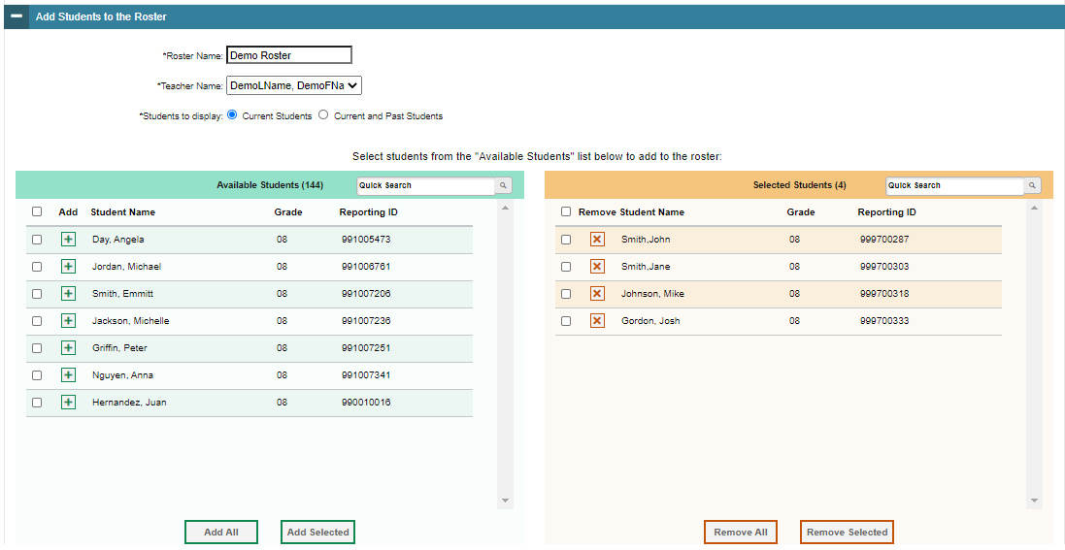
Add Rosters One at a Time, continued
The students in the left column are available to be added to the roster, and students in the right column are currently in the roster.
You can add multiple students by marking checkboxes next to the students then clicking Add Selected. Add all available students to the roster by clicking Add All.
Notes:
In the Add Students to the Roster panel, the students in the left column are available to be added to the roster, and students in the right column are currently in the roster.
First, enter a name for the roster and select the teacher who should be associated with the roster. Select if you want to display Current Students or Current and Past Students.
Next, add students to the new roster. To add a single student to the roster, click the green plus sign next to a student in the left column. You can add multiple students to the roster by marking checkboxes next to the students you want to add and then clicking Add Selected. Add all available students to the roster by clicking Add All.
To remove a single student from the roster, click the orange X next to a student in the right column. You can remove multiple students from the roster by marking checkboxes next to the students you want to remove and then clicking Remove Selected. Remove all students from the roster by clicking Remove All.

Slide 30
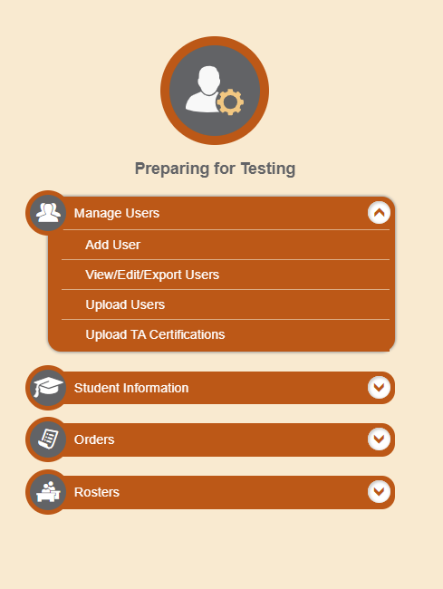
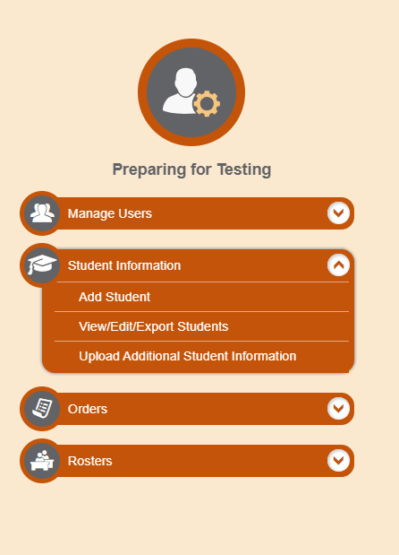
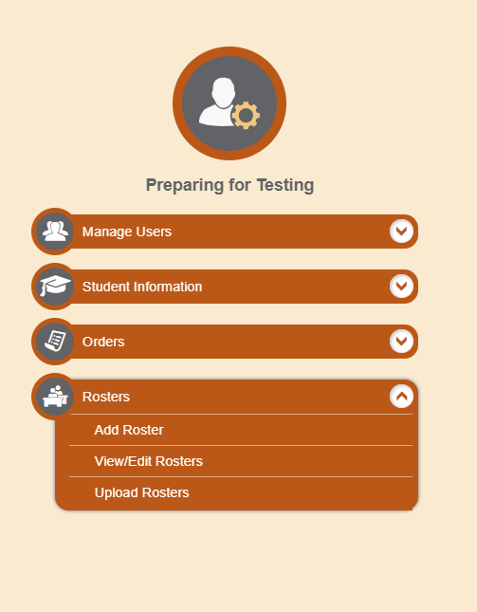
Modify Records One at a Time
Notes:
If a record’s information changes after you’ve added the record to TIDE, you must edit the record to match the most up to date information. You can do this by modifying existing records one at a time.
Begin on the TIDE homepage. In the Preparing for Testing section, choose the task for which you want to modify a record: users, students, or rosters, then click View/Edit/Export.

Slide 31
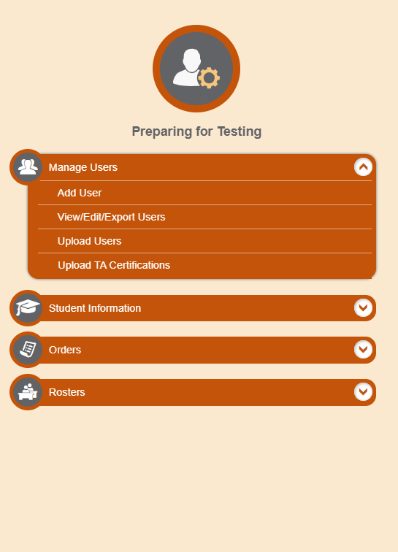
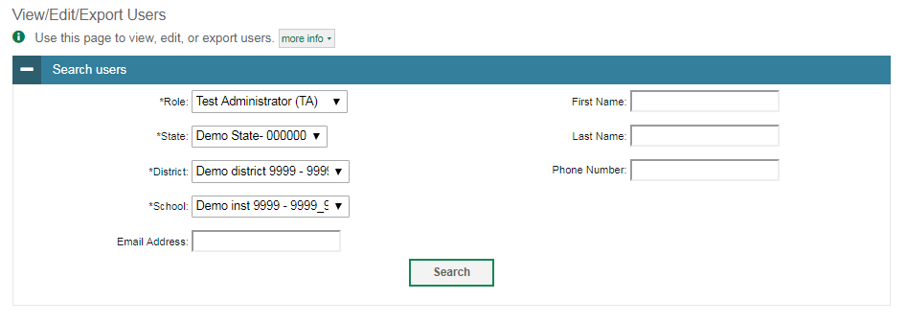
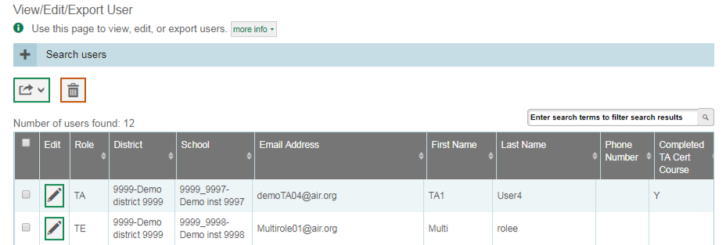
Modify Users One at a Time
Notes:
The View/Edit/Export Users page includes a form for setting selection criteria to retrieve users. In this example, the required criteria are the user’s role, state, district and school. Other criteria are optional, such as the first or last name. Click Search to continue. The search panel will automatically collapse, and your search results will appear below.
After you click Search, TIDE will display all the users satisfying the search criteria. If your user role permits, you can edit a user’s information by clicking the green pencil icon. Another page will appear for you to edit and save information.
To export user information, mark the checkboxes next to the users you wish to export and click the green export button above the search results. A pop-up window will appear with the option to export to the Inbox in either Excel or CSV format.
To delete users from TIDE, mark the checkboxes next to the users you wish to delete and click the orange trash can button above the search results.
To make the search form reappear and search for additional users, click the plus sign in the Search users panel, which appears as a blue bar.
For more-detailed information on managing users, see the TIDE User Guide.

Slide 32
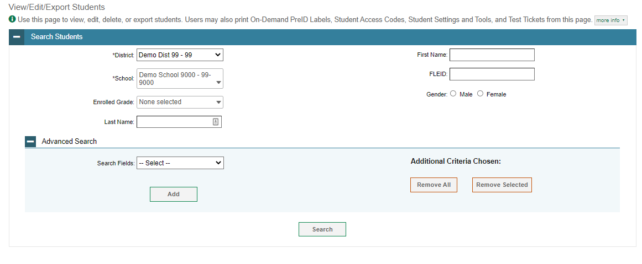
Modify Students One at a Time
Notes:
The View/Edit/Export Students page includes a form for setting selection criteria to retrieve students. Required criteria, such as the district and school in this example, are marked with asterisks. Other criteria are optional, such as the FLEID and the student’s first or last name.
You can further refine your criteria by entering additional demographic information or test settings in the Additional Search panel.
The students you can retrieve on this page are limited by your role’s scope. As a school-level user, you can only retrieve students enrolled within your school.
Click Search to continue.

Slide 33
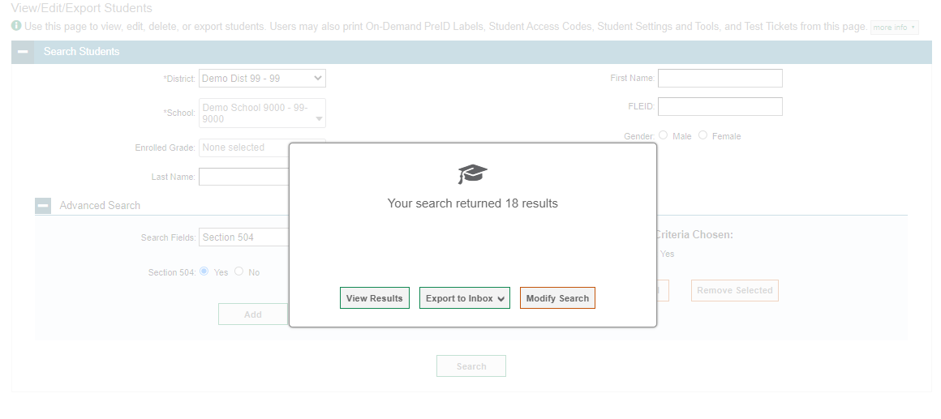
Modify Students One at a Time, continued
Notes:
After you click Search, you will see a message asking whether you would like to view the results of your search, export the list of students to your Inbox, or modify your search criteria and try again. If you choose to export the results to your Inbox, you will receive an email when the file is ready for you to download.

Slide 34
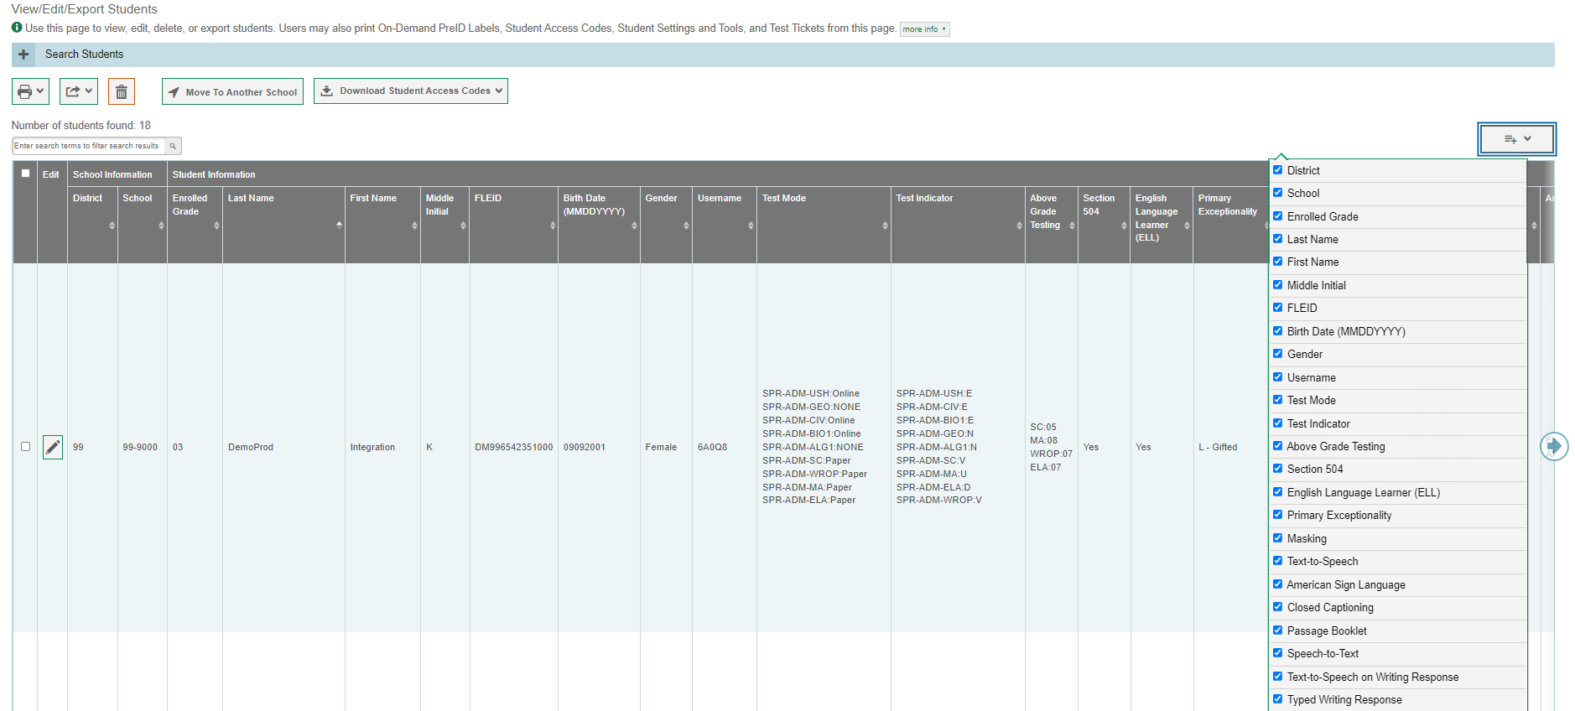
Modify Students One at a Time, continued
Notes:
When you click View Results, TIDE will display all the students satisfying the search criteria. Because not all columns can fit on the screen at once, click the blue arrow on the right side of the screen to scroll right and display more information. To add or delete columns to display, click the drop-down menu at the upper-right corner of the results. You can edit a student’s information, including test settings and accommodations and student test participation data, by clicking the green pencil icon.
Print students or delete them from TIDE by selecting the desired students and clicking the Print or Delete button above the search results.
To export the results, mark the checkboxes next to the results you wish to export and click the green export button above the search results. A pop-up window will appear with the option to export to the Inbox in either Excel or CSV format.
To make the search form reappear and search for additional students, click the plus sign in the Search Students panel, which appears as a blue bar.
For more-detailed information on managing students, see the TIDE User Guide.

Slide 35
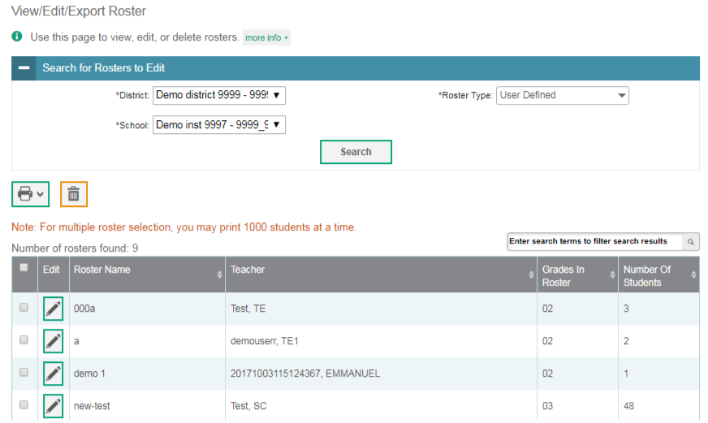
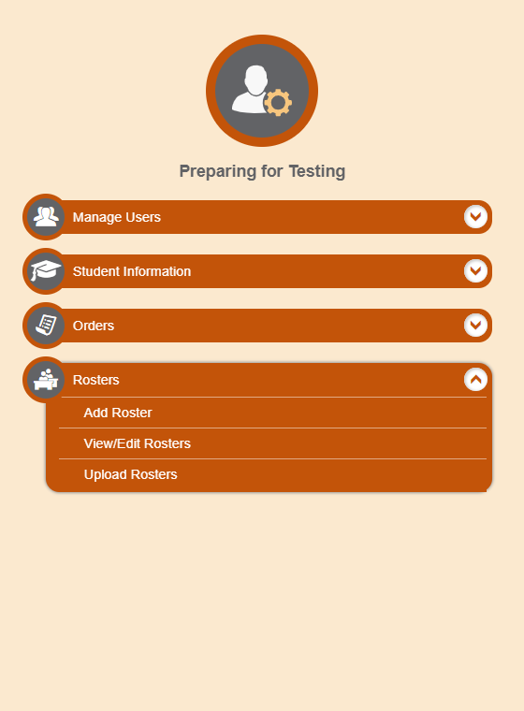
Modify Rosters One at a Time
Notes:
The View/Edit Roster page includes a form for setting selection criteria to retrieve rosters. The district, school, and roster type criteria are required. Click Search to display a list of rosters matching your criteria.
Print, export, or delete rosters from TIDE by selecting the desired rosters and clicking the Print, Export, or Delete buttons above the search results.
Click the pencil icon next to a roster to view or edit its details. The Edit Roster form will appear. This form is like the form used to add rosters, and you may edit the roster name, teacher name, and students to display in the roster in the same way that you would for a new roster.

Slide 36
Administering Tests
Notes:
Administering tests is where users will go to print test tickets and PreID labels, handle invalidations and requests and monitor test progress.

Slide 37
Print Test Tickets and PreID Labels
Notes:
A test ticket is a printed form that includes a student’s login information to start taking a test. You can print test tickets from a student list.

Slide 38
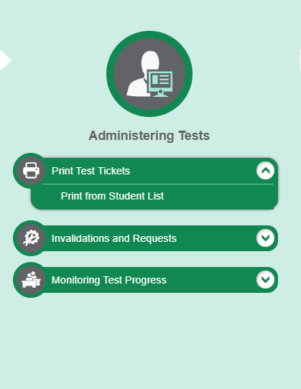
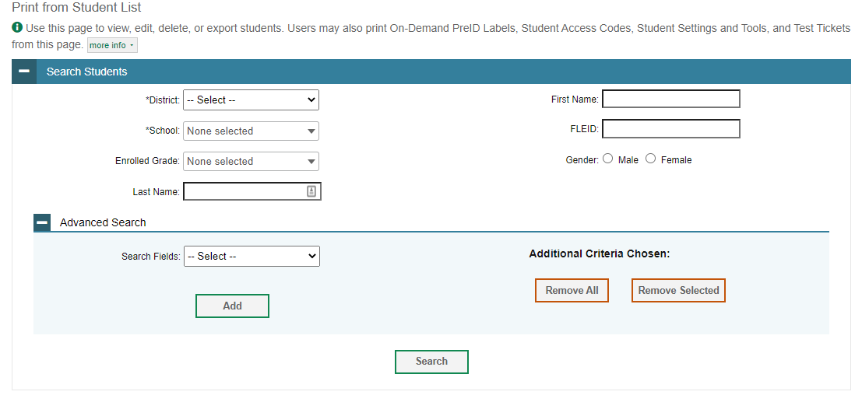
Print Test Tickets from a Student List
Notes:
To print test tickets from a student list, select Print from Student List from the Print Test Tickets task menu. Complete the fields under the Search Students panel. The fields marked with an asterisk are mandatory. To further refine your search results, select additional search fields in the Advanced Search panel. Click Search to view your results.

Slide 39
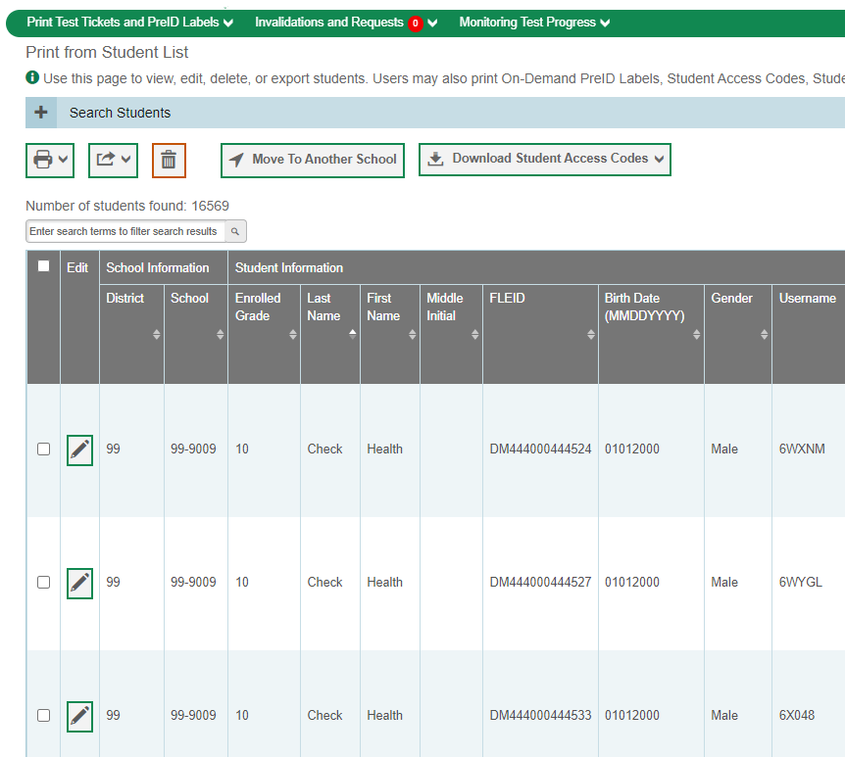
Print Test Tickets from a Student List, continued
All students
Specific students
Notes:
Next, select the students for whom you want to print test tickets. To print test tickets for specific students, mark the checkboxes for the students you want to print. To print for all students on the page, mark the checkbox at the top of the table. To print for all retrieved students, no additional action is necessary. This option is available by default.
Click the printer icon and select an option from the drop-down menu. A test-ticket layout screen will appear. Choose a test-ticket layout and the test tickets print option. When you click Print, a PDF file of the test tickets will be downloaded.

Slide 40
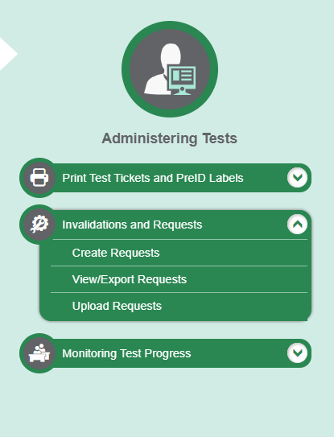
Invalidations and Requests
Notes:
The Invalidations and Requests page is where you can create a request for a test, view/export requests or upload requests. The first step is to select the type of request you want to create/view or export. The TIDE User Guide lists the available request types and explains the implications of each.

Slide 41
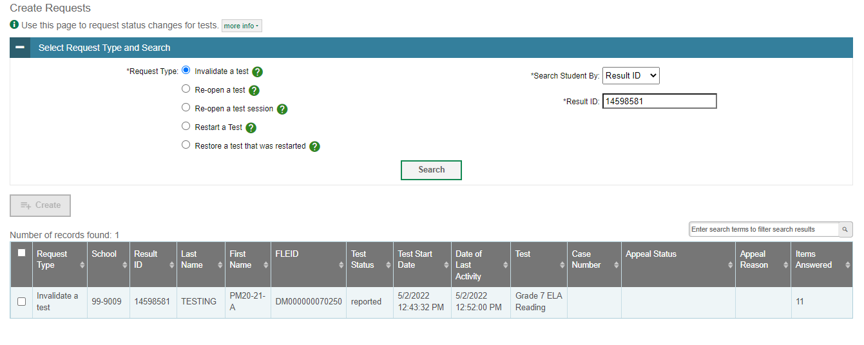
Invalidations and Requests
Notes:
The Create Requests page is where you can create a request for a test.
The first step is to select the type of request you want to create. The TIDE User Guide lists the available request types and explains the implications of each.
Next, search for the test result for which you wish to create a request. From the drop-down lists and in the text field, enter your search criteria and click Search. TIDE will display the search results below.
Mark the checkbox next to each test result for which you wish to create a request and click Create. A pop-up window will ask you to enter a reason for the request. To create the request, enter a reason and click Submit.

Slide 42
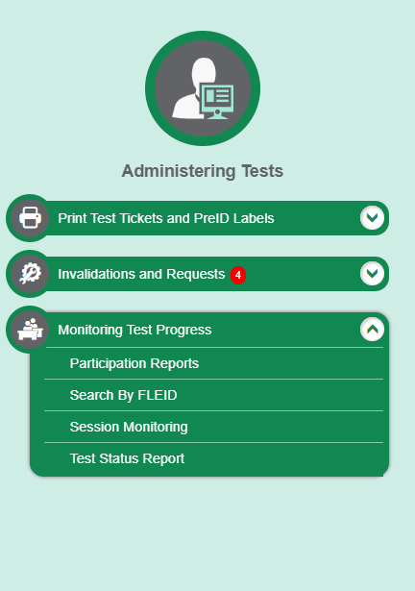
Monitoring Test Progress
Notes:
The tasks available in the Monitoring Test Progress task menu allow you to generate various reports that provide information about a test administration's progress.
Several types of participation reports are available:
The Participation Reports shows test participation using selected criteria.
The Search By FLEID page allows you to generate participation reports for specified students.
The Session Monitoring report summarizes the number of students who have started or completed a test. It also shows tests that are paused and the total number of tests in session.
The Test Status Report displays participation for all eligible tests for all students for a test administration.

Slide 43
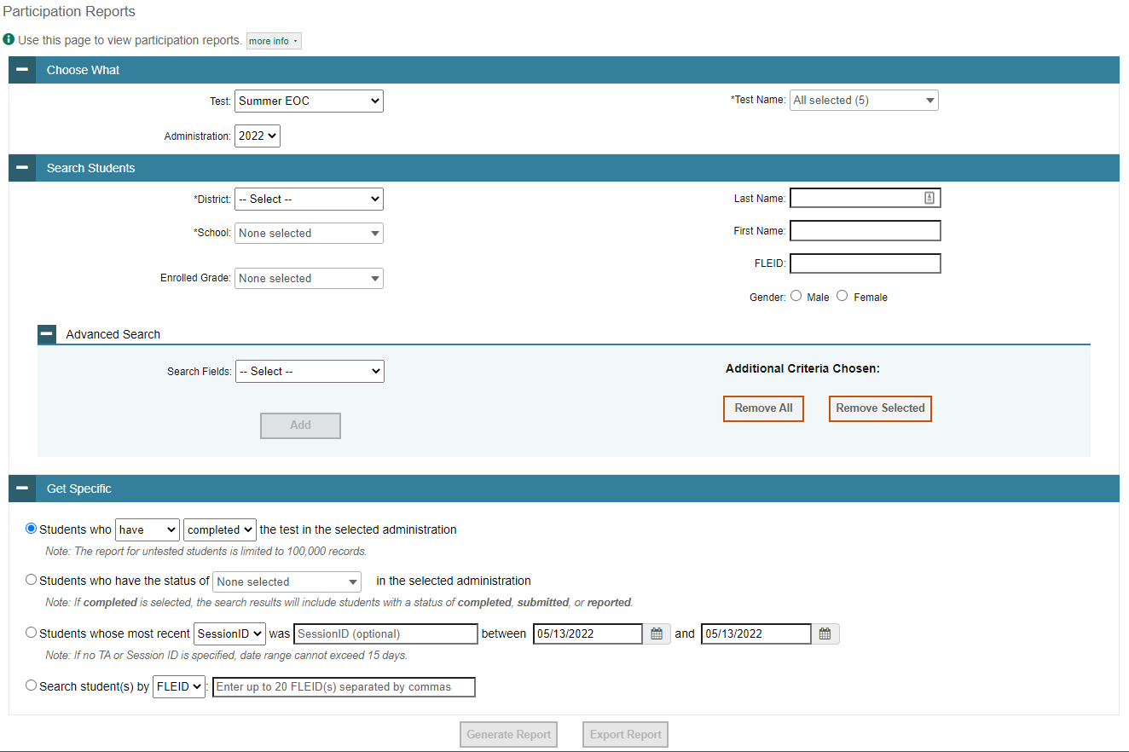
Participation Reports
Notes:
The Participation Report details all of a student’s test opportunities and the status of each test opportunity. Because the report lists testing opportunities, a student can appear more than once on the report.
To generate a report from the Participation Report page, select a test and administration under the Choose What Report panel.
Next, in the Search Students panel, select a district, school, and Enrolled Grade, if applicable. The fields marked with an asterisk are mandatory. You can refine your search by adding additional criteria under the Advanced Search section.
Finally, in the Get Specific Test Filter Report panel, choose one of the filter options available and select parameters for that option.
Click Generate Report to view your Participation Report or click Export Report to open the report in Excel.

Slide 44
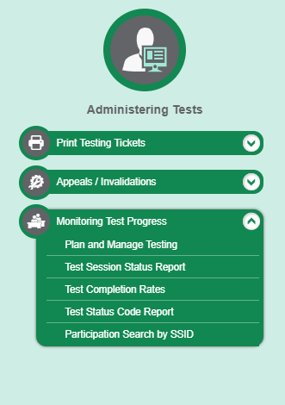
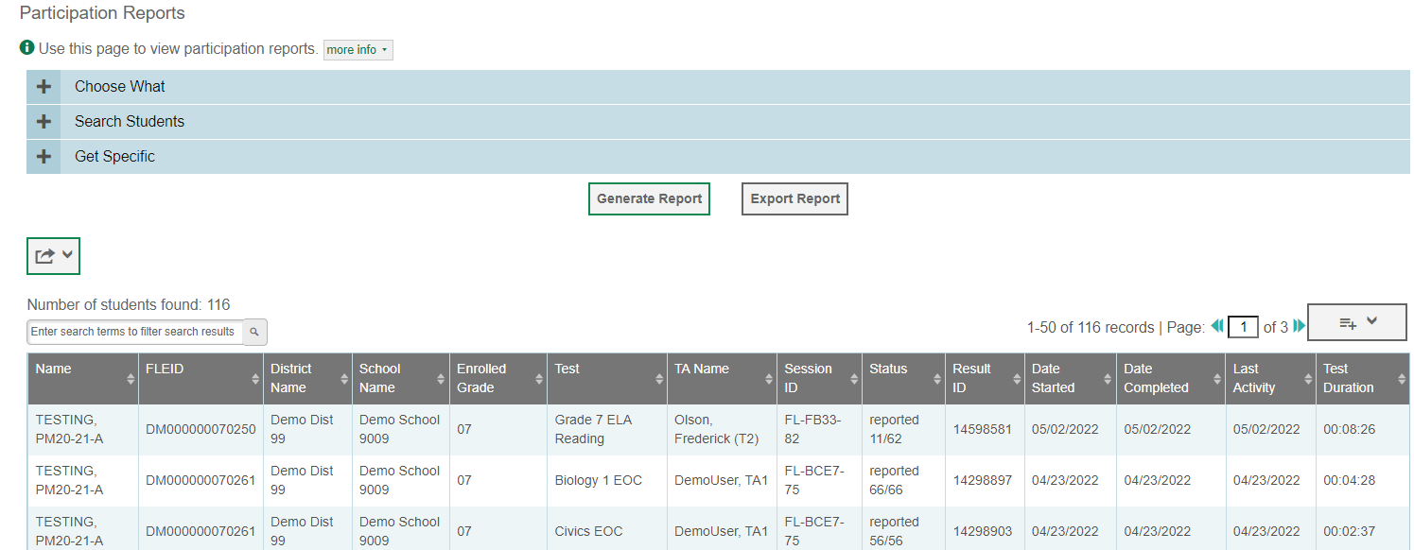
Participation Reports: Results
Notes:
Clicking Generate Report will display the report and collapse the selection criteria panels.

Slide 45
Monitoring Test Progress Examples
Which students have not yet tested?
Which students have paused tests?
Did all students in a test session submit their tests?
Notes:
This slide illustrates some common questions that can be answered using the options available in the Get Specific panel.
To find students who have not yet tested, select the first radio button and search for students who have not completed their test opportunity in the selected administration.
To find students who have paused tests, select the third radio button and search for students who have a status of paused in the selected administration.
To find out if all students in a test session submitted their tests, select the fourth radio button and search for students by test session ID (optional) between the dates when the test session took place.

Slide 46
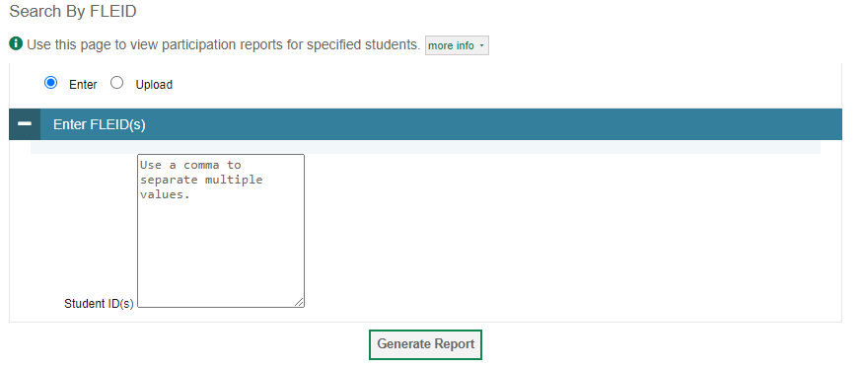
Search By FLEID
Notes:
The Search By FLEID page allows you to generate participation reports for specified students. Enter a single FLEID or multiple FLEIDs separated by commas in the Student ID(s) box. You can also upload a single-row Excel file containing FLEID numbers. Click Generate Report to view the results.

Slide 47
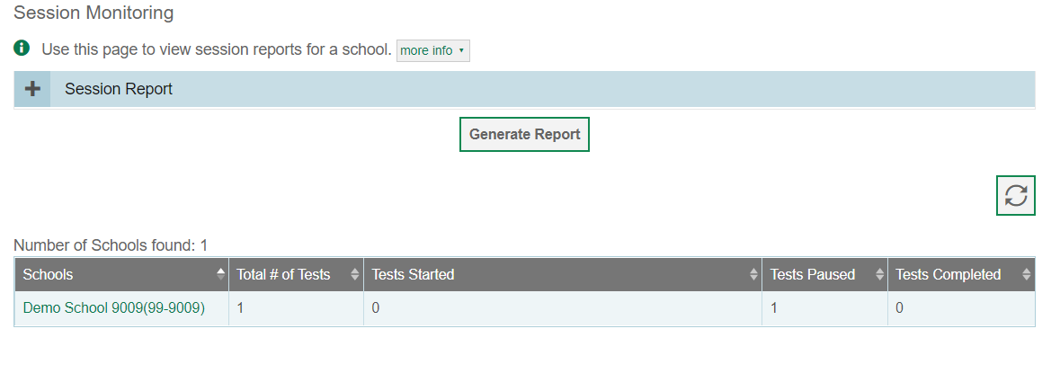
Session Monitoring
Notes:
Session monitoring allows school users to see information about active sessions. Users can view the total number of tests as well as how many tests have started, are paused and have been completed.

Slide 48
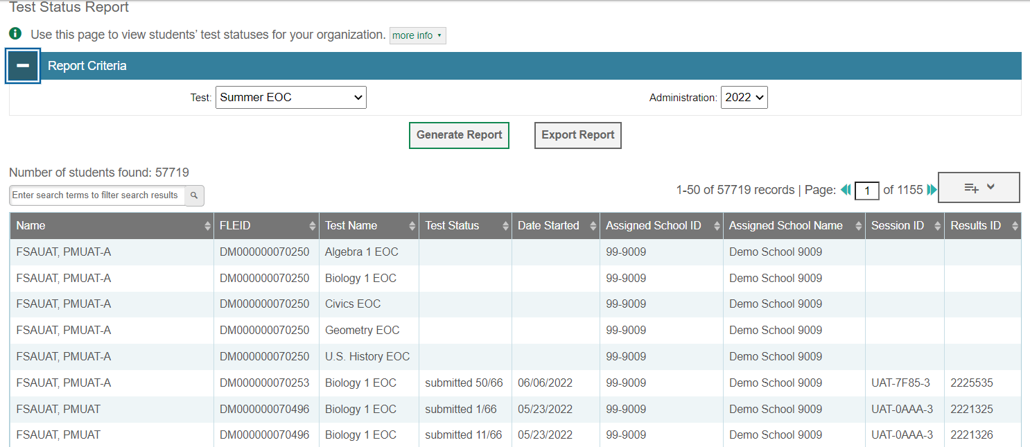
Test Status Reports
Notes:
Test status reports offer the ability to see all test statuses for the entire school. Select the test administration and then choose to generate or export the report. The report shows all tests each student is eligible for. If the student has started/completed a test, the Test Status, Date Started, Session ID and Result ID fields will be completed. If the student has not started these fields will be blank.

Slide 49
Test Delivery System (TDS) TA and Student Interface
Copyright © 2022 Cambium Assessment, Inc. All rights reserved.

Slide 50
TA Certification Course
https://flfast.org/teachers.html

Slide 51
Start a Session
The Help Desk (as well as the DACs) received a large number of calls regarding students seeing “No Tests Available” on the Your Tests page after logging in to the Secure Browser.
While troubleshooting, the Help Desk determined that the most common problem was that the test the TA and students were looking for had not been added to the test session.
The following slides walk through the process of starting a test session.

Slide 52
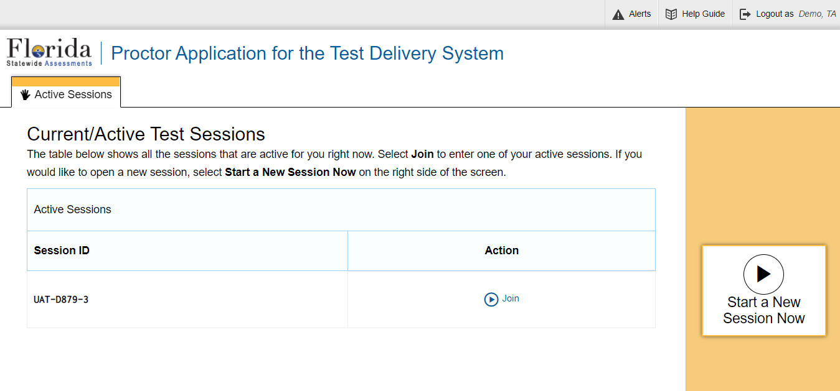
Transferring Sessions
Notes:
In the event that you have problems with your computer or web browser or need to change computers during an active test session, you can transfer the session from one computer, mobile device, or browser to another without stopping the session or interrupting in-progress tests. To transfer a test session to a new device or browser, remember the following:
• Do not log out of the session you are currently in or stop the test session. If you do, you will end the test session and pause all students’ tests.
• Log in to the TA Interface on the new machine or in the new browser.
The test session on the previous computer or browser will close automatically. This will not stop the session or pause student tests.

Slide 53
Troubleshooting
Description | What to Do
What should I do if a test session ends? | Log in and start a new session. Provide the students with a new session ID.
What should I do if a student gets logged out of a test while a session is still active? | If a student’s test session is interrupted, the student should log back in and rejoin the session.
What should I do if forbidden applications are running? | The Secure Browser will not allow the student to begin testing if forbidden applications are running. You will see messages advising you which applications must be closed before testing can begin.
What should I do if a student’s test freezes? | Force-quit the Secure Browser and log back in. For instructions, refer to the Test Administration Manual.
Notes:
This table presents some of the common issues that you or your students may encounter during a test session. Please take a moment to review this information. For more detailed information, please refer to your Test Administration Manual.

Slide 54
What Is the Secure Browser?
The Secure Browser is designed to ensure test security by prohibiting students from accessing any other programs or websites during testing.
Secure Browser
If you have questions about installation of the Secure Browser, contact your Technology Coordinator.
Notes:
Students must use the Secure Browser to log in to the Student Interface. The Secure Browser is designed to ensure test security by prohibiting students from accessing any other programs or websites during testing.
Your school’s Technology Coordinator is responsible for ensuring that the Secure Browser has been correctly installed on all testing devices. If you have questions about installation of the Secure Browser, please contact your Technology Coordinator.

Slide 55
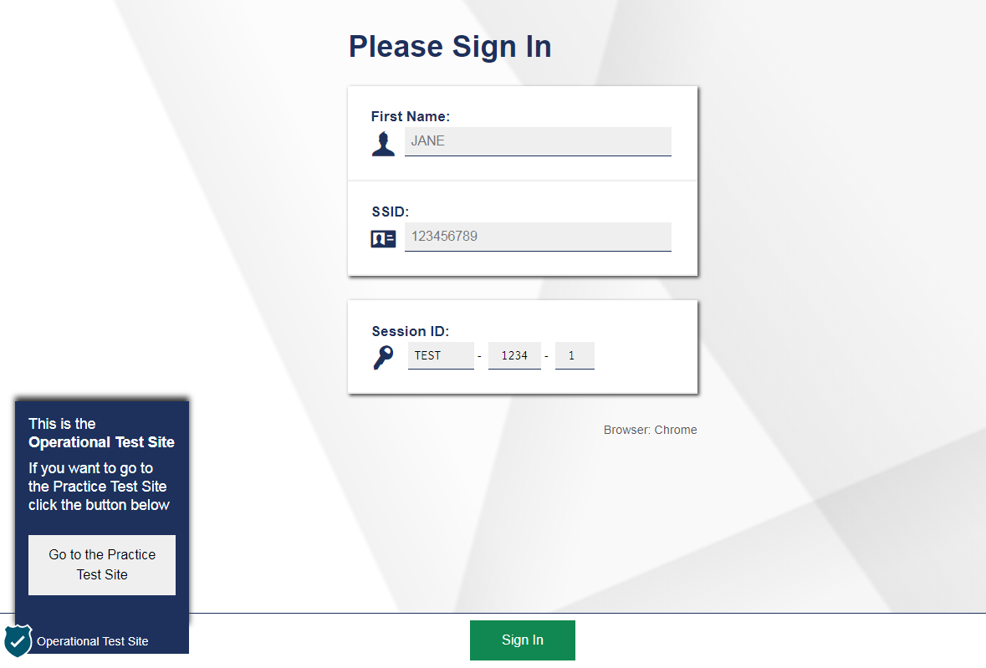
Secure Browser Login
Notes:
To log in to the online testing system, students must use the Secure Browser on a separate computer or device than the one used by the TA. Students must enter three pieces of identifying information: their first name, their username, and the current test session ID.
The test session ID is generated when the TA creates the test session. It needs to be given to students by the TA when it is time for them to log in to the test. Session IDs should not be generated more than 20 minutes before students are ready to log in.
When entries are complete, students will click the Sign In button to log in to the test. The TA may assist students with logging in, if necessary.

Slide 56
Student Login Errors
Issue | Error Message | What to Do
Student first name and Username do not exactly match what is in the system. | Please check that your information is entered correctly. If you need help, ask your Test Administrator. | Verify that the student has entered the correct first name and exact username. You may need to use the Student Lookup Tool, which is located in the Test Administrator Interface, to verify that the student is in the system.
Student enters the session ID incorrectly. | The session is not available for testing. | Verify that the student has entered the correct session ID with no extra spaces or characters.
Student enters a session ID for an incorrect or expired session. | Session has expired. | Ensure that the student enters the correct session ID for the current session. If this does not work, verify that your session is open using the Test Administrator interface.
One person (either the TA or the student) is using the Operational Test Administration Site, and the other is using the Practice Site. | The session is not available for testing. | If taking a practice test, make sure that you and the student are both on the Practice Site. If taking an operational test, make sure that the student is using the Secure Browser and you are using the Operational Test Administration Site.
Notes:
If a student is having difficulty logging in, an error message and code will display on the login screen. The most common errors occur when the student’s first name and username do not match what is in the system and when usernames are entered incorrectly. If the student receives an error message indicating that he or she has entered incorrect information in the first name or username fields, the TA should use the Student Lookup Tool in the TA Interface to verify the student’s information.
Another common error occurs when the student enters an incorrect session ID. If a student receives the message “The session is not available for testing,” verify that the session ID was entered correctly, with no extra spaces or characters. The session ID can be found in the TA Interface.
If a student receives the error message “Session has expired,” ensure that the student has entered the correct session ID for the current session. If the student has entered the session ID correctly, use the TA Interface to verify that your session is still open.
Finally, if administering a practice test, make sure that the TA and the student each use the appropriate practice and training test site. If administering an operational test, ensure that the TA is using the Operational Test Administration Site and the student is using the Secure Browser.

Slide 57
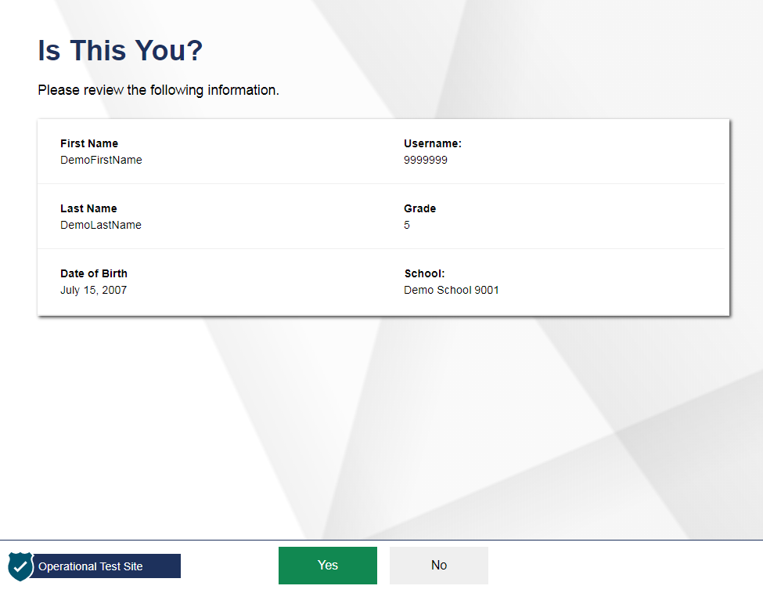
Student Verification
Notes:
After logging in, students need to complete a few more steps before they begin testing. Students will be asked to view and verify their personal information. If their information is correct, they should click Yes to proceed. If their information is incorrect, they should click No to return to the login page. You must then contact your School or District Assessment Coordinator to have the student’s information updated in the Test Information Distribution Engine (TIDE) before the student attempts to log in again.

Slide 58
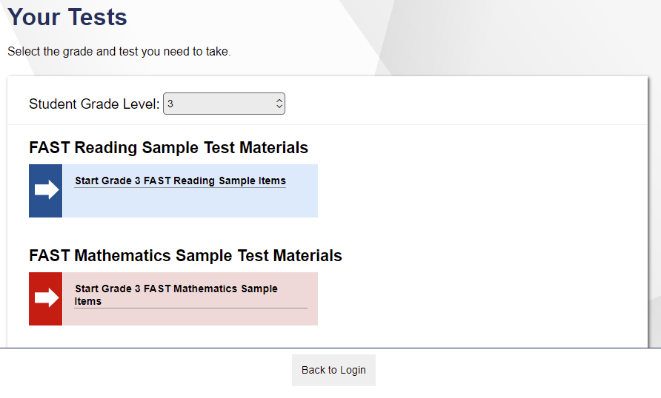
Student Test Selection
Notes:
On the Your Tests screen, students will see a list of their assigned tests for this test session. If the tests displayed are incorrect, or the expected test is not listed, students should click the Back to Login button to return to the login page and consult the TA to resolve the issue. If there are no errors, students should select the correct test and wait for TA approval to proceed.

Slide 59
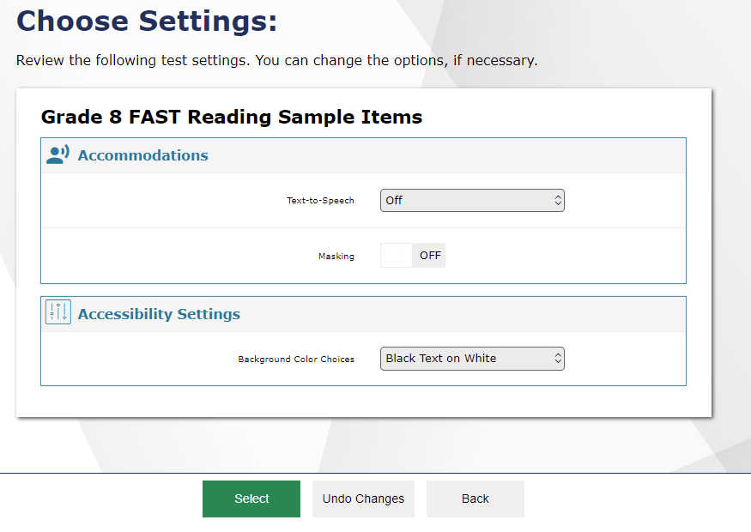
Verifying Test Information
Notes:
After the TA has approved students for a test session, students will see a screen titled “Choose Settings.” This screen displays the name of the test and any selected accessibility resources. If the information is correct, students should click Select. If any of the information is incorrect, they should click Back to Login and then wait to be advised by the TA or select Undo Changes if they would like to revert back to the default. Note that the actual settings students see may vary from what is shown on this slide. Be sure to refer to the scripts located in the Test Administration Manual (TAM) to guide your students through the login and confirmation process.
After verifying their test, students will proceed through one or more functionality checks to make sure that their testing device is functioning properly. The functionality checks that appear will depend on the test that the student is taking.

Slide 60
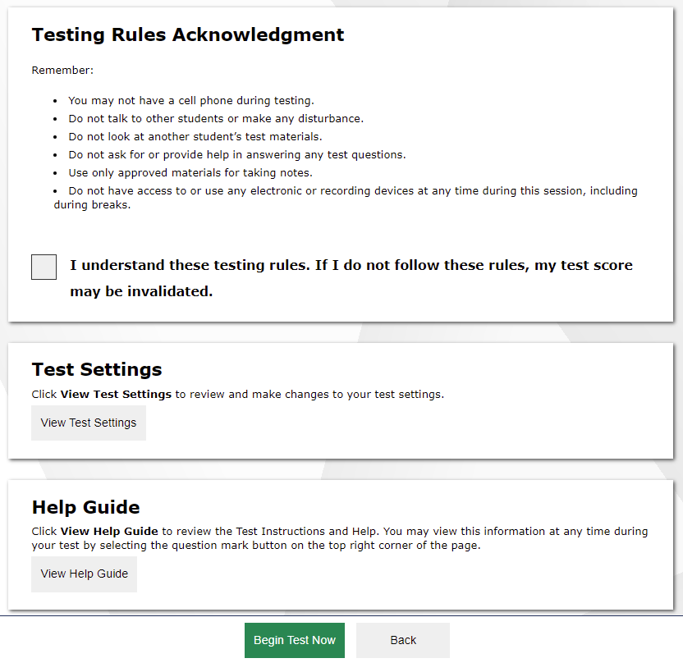
Before You Begin
Notes:
Next, students will view and acknowledge the Testing Rules Acknowledgment and have the opportunity to review detailed information about the tools and navigation features they will use during testing from the Instructions and Help screen.
The Test Settings section allows students to view their current test settings.
The Help Guide section contains an overview of the test site, test rules, and information on Text-to-Speech and other applicable features.
When students click Begin Test Now, they will enter their test and be presented with electronic devices cover page.

Slide 61
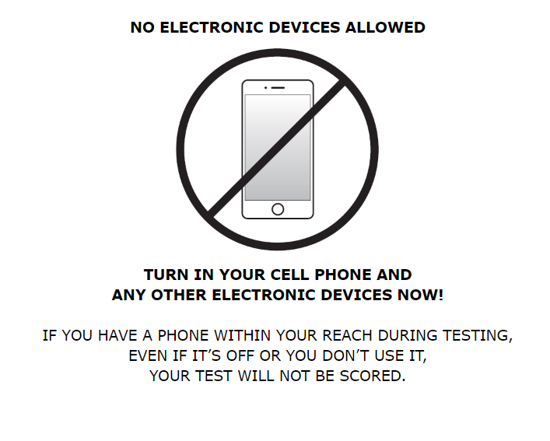
Cover Page
Notes:
Before students view the first item on their test, they will be presented with a cover page which reminds students that they may not have any electronic devices in their possession throughout the duration of their test.

Slide 62
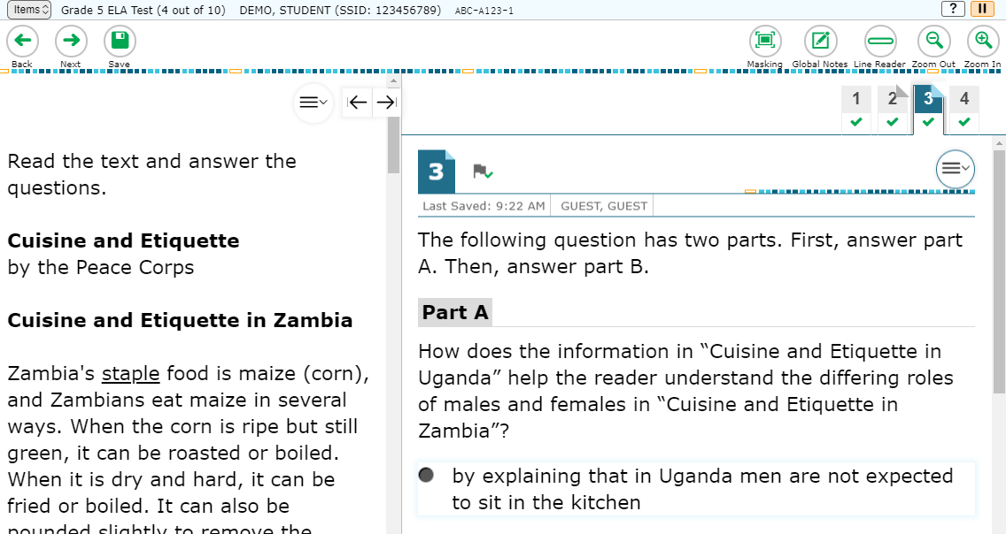
Test Interface
Notes:
Universal tools and other features are available for all students to use during testing. These tools and features will be discussed in detail on the following slides.

Slide 63
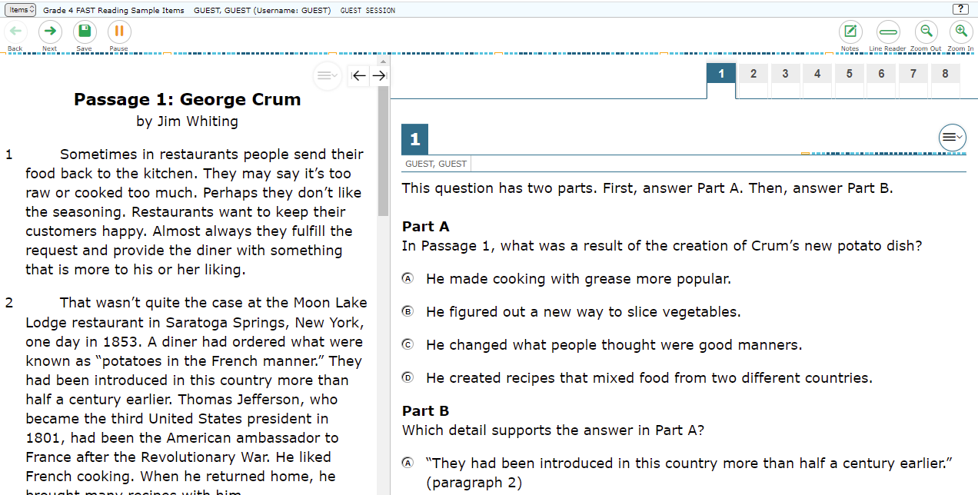
Global Menu
Navigation Buttons
Test Tools
Notes:
The global menu appears at the top of the Student Interface. The left side of the menu contains navigation buttons that students use to advance through the test:
All students can navigate between pages using the Back and Next arrow buttons. Students can also navigate between items using the Items drop-down menu located above the navigation buttons. We will discuss the items menu later in this module.
The Save button ensures that a response is committed to the system. However, the Save button is not required to save an item. Other actions, such as moving forward to the next question, will also save the response. The Pause button pauses a student’s test and logs the student out of the Student Interface. We will discuss more about pausing a test later in this presentation.
The right side of the menu contains test tools that students may use during testing. Some test tools, such as the Zoom In and Zoom Out buttons, are universal tools available to all students.
Other tools are designated supports or accommodations that must be set up in TIDE for students to use them.

Slide 64
Items Drop-Down Menu
Notes:
In addition to using navigation buttons in the global menu, students can move through the test using the Items drop-down menu. The Items drop-down menu lists all items completed thus far and displays a blue flag for items that have been marked for review. For FAST Progress Monitoring tests, items cannot be skipped so students can only navigate to items previously answered. Students will always see an orange triangle on the next question, as the very next item is generated based on previous responses.

Slide 65
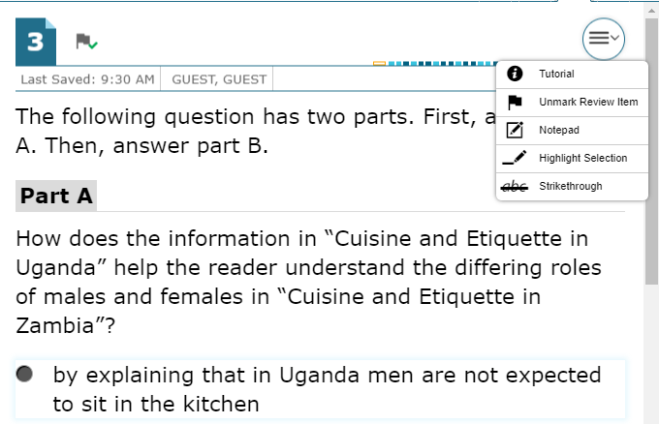
Context Menus
Context menus allow students to:
Mark items for review
View item tutorials
Access additional features depending on test settings and item types
Notes:
Test items and stimuli contain context menus. Students may use context menus to mark items for review, view item tutorials explaining how a particular item type works, and access additional test tools and features. The Global notes are available throughout the entire test for Reading and Writing tests, and Mathematics tests have item specific notepads.

Slide 66
Universal Tools: Expandable Items and Passages
Passage
Notes:
Students can expand passages and test items so that they take up a larger area of the screen for easier reading. This can be done by clicking the double-arrow icon in the upper-right corner of the passage, stimulus, or item. To collapse the item and make the passage viewable, students should click the right arrow icon. To collapse the passage and make the item viewable, students should click the left arrow icon.

Slide 67
Universal Tools: Notes
resize
Notes:
Students can use the Global Notes tool in Reading and Writing tests to make notes that will persist throughout the entire test. The notes will also be retained if the student logs out of the test to resume at a later time. Students can copy and paste text from the notepad into the item response area, but this can only be done at the page level.
In addition, the Notes window can be resized by dragging the blue dots on the outer edge.

Slide 68
Universal Tools: Notepad
resize
Notes:
Students can use the Notepad located in the context menu to make notes about an item in a Mathematics test. The Notepad is item specific for Mathematics, so students can access their notes for a question when they are on that question’s test page. Notes will continue to be saved when students move on to the next segment or if their tests are paused. Test items with notes will display with a small notepad and pencil badge next to the item number.
The Notepad window can also be resized by dragging one of the blue dots on the outer edges. The text entered in this tool can be copied and pasted into text response areas of items displayed on that page. For example in Mathematics, students cannot copy notes taken on item #1 and paste them to an item displayed on the next page.

Slide 69
Universal Tools: Highlighter
Notes:
Students can use the Highlighter tool to mark text that they want to remember in reading passages, mathematics stimuli, and in text-based answer options, such as those that ask the student to click a section of text to choose an answer. To do this, students must select the desired text, right-click, and then click the Highlight Selection button that pops up. Students can select the color in which to highlight the text. To remove highlighting, students will right-click in the area of the highlighted text and select the Reset Highlighting button that pops up. If a student pauses the test, any highlighting made before pausing will be retained. The highlighter tool can also be accessed from the context menu.

Slide 70
Universal Tools: Strikethrough
Notes:
For multiple-choice and multiselect questions, students can use the Strikethrough tool to strike out the answer options they do not wish to choose.
To do this, students can right-click the answer option they want to strike out, and then click the Strikethrough button that pops up. The answer option will then display with a line through it. If an answer option spans multiple lines, as shown in this image, and if the enhanced Strikethrough mode is enabled, the entire answer text will display lines through it. To remove the strikethrough, students must right-click and then click the Undo Strikethrough button that pops up. Alternatively, students can open the context menu and select Strikethrough to activate Strikethrough mode and then select each answer option they wish to strike out. To deactivate Strikethrough mode, they can press Esc or click outside the question’s response area.
It is important to note that striking through answers does not indicate a response to the question. Students must still select a response to answer each question. Also, striking out an answer option does not prevent the student from selecting that answer option as a response.

Slide 71
Universal Tools: Mark for Review
Notes:
Another element of the online test that helps students succeed is the Mark for Review feature. As they proceed through a test, students are required to answer each question on the screen before they can go on, or they must acknowledge a warning message that appears when attempting to skip an unanswered question (skipping is not available on FAST assessments). Students can then mark these items to review before completing the test. To mark an item for review, the student can open the context menu for an item and select Mark for Review. The item number will display a dog-eared corner and a small flag badge.
At any time during a test segment, students can navigate back to marked items (within the segment) and review and change their answers as desired. This can be done either by clicking the Back button in the navigation toolbar until they reach the desired item or by using the Items drop-down menu, located in the upper-left corner of the page, to select a specific item. To unmark an item, students can open the context menu for the item and select Unmark Review Item. Note that once a student has completed a test segment in a test that prohibits navigation to previous segments, or if his or her test is paused for more than 8 hours, returning to the items marked for review will not be allowed.

Slide 72
Universal Tools: Zoom
Notes:
During testing, students can use the Zoom feature to increase the size of text and graphics up to four times their default size by using the Zoom In button. Text can be returned to a smaller size using the Zoom Out button. The default size for all tests is 14-point type. If desired, prior to testing, a Test Coordinator may increase the default print size for the entire test by setting the zoom level in TIDE, or the TA can change the text size setting in the TA Interface during the approval process.
Please note that the Zoom tool is not the same as magnification, which students can access using their own assistive devices.

Slide 73
Universal Tools: Line Reader
Notes:
Students can highlight an individual line of text in a passage or question by selecting the Line Reader button in the global menu near the top of the window. All content except for the line in focus is grayed out for greater emphasis. To turn off the line reader, students click the Line Reader button again.
Note that the Line Reader tool is not available when the Highlighter tool is in use.

Slide 74
Universal Tools: Select Previous Version
Notes:
The Select Previous Version tool allows students to view and restore responses that they previously entered and saved for a Text Response item. To use this tool, students open the context menu for a Text Response item and click Select Previous Version. A window will appear, listing any saved responses for the item and the text associated with each one. To view previous responses, students select a response version in the left panel and read the associated text in the right panel. To restore a selected response, students click Select at the bottom of the window. The selected response will appear in the answer area for the item.
Please note that the Select Previous Version tool cannot restore responses that were entered prior to pausing a test.

Slide 75
Universal Tools: Calculator
Minimize/
maximize
resize
Notes:
For certain mathematics tests, students can use the on-screen calculator. Depending on the grade of the test, students will see different types of calculators. To use the calculator, students need to select the Calculator button from the global menu near the top of the page. The calculator window can also be resized by dragging resizing handle on the outer edge of the calculator window. Students can also maximize or minimize the window by selecting the arrows in the top right-corner of the window. To remove the calculator window, students will click the X button in the upper-right corner.

Slide 76
Accessibility Resources: Color Contrast
Black Text on White
Black Text on Yellow
Black Text on Light Blue
Black Text on Blue
Black Text on Magenta
White Text on Black
White Text on Navy
White Text on Red
Yellow Text on Black
Yellow Text on Dark Blue
Red Text on White
Notes:
In addition to universal tools, which are available to all students, designated supports are available for use by any student for whom the need has been indicated by an educator. Accommodations are changes in procedures or materials that increase equitable access during the test. Accommodations are available for students with documentation of the need for the accommodations on an Individualized Education Program (IEP) or Section 504 accommodation plan.
Color Contrast is an accessibility resource that is available to eligible students. By default, tests are presented with black text on a white background. Students who require a different combination of font color and background color may choose a different color combination when logging into the test.

Slide 77
Accessibility Resources: Masking
Notes:
The Masking tool allows students to cover up a distracting area of the test page. To use this tool, students click the Masking button and then click and drag their mouse to select a rectangular area on the screen that they wish to mask. To deactivate masking mode, students must click the Masking button again. Masked areas remain on the screen even after masking mode is deactivated. To remove a masked area, students click the X button in the upper-right corner of the masked area.

Slide 78
Accessibility Resources: Text-to-Speech
Notes:
Text-to-Speech (TTS) allows eligible students to listen to test content. TTS must be set up in TIDE prior to testing. It is available as an embedded accommodation for students with an identified need on an IEP.
Please note that a test may include text that is not permissible to be read aloud. This text will be skipped when using TTS.
To use this tool, the student will select the desired Text-to-Speech option from the pop-up menu to hear the audio (for example: Speak Question, Speak Options, Speak Passage). We recommend that students who will be using this feature have the opportunity to try it by taking the practice test prior to testing. As mentioned earlier, you should ensure that all students requiring the Text-to-Speech feature have headphones and that they have completed the audio check successfully.

Slide 79
Item Tutorial
Notes:
Students can use the Item Tutorial tool to get more information about a particular item type. Selecting Tutorial from the context menu for a question opens a pop-up box that will show the student how that type of item works (for example, whether they should select an answer, drag-and-drop answers, etc.). The tutorial does not include any sound.

Slide 80
Test Pause
Notes:
You may also allow students to pause if they are taking a break from testing or if they need to leave the room for any reason. Whether they have been instructed to do so or not, students have the ability to pause their test at any time by clicking the Pause button in the upper-left corner of the screen. When they do so, a pop-up message will appear, asking them to confirm that they want to pause the test. Students should click Yes to confirm the pause or No to resume testing.

Slide 81
Test Timeout
Test Timeout Due to Inactivity
As a security measure, after a predetermined amount of time of inactivity, students are logged out and their tests are paused automatically.
Inactivity is determined by whether the student is interacting with the test by selecting answers or using navigation tools. Clicking an empty space on the screen is not considered activity.
Students will receive a warning message prior to being logged out and must click OK on the pop-up message within 60 seconds in order to avoid automatic logout and pausing of their test.
If a student’s test is paused due to inactivity, the same rules apply as when the student intentionally pauses the test.
Notes:
As a security measure, after a predetermined amount of time of inactivity, students are logged out, and their tests are paused automatically. Inactivity is determined by whether the student is interacting with the test by selecting answers or using navigation tools. Clicking an empty space on the screen is not considered activity. Students will receive a warning message prior to being logged out and must click OK on the pop-up message within 60 seconds in order to avoid automatic logout and pausing of their test. If a student’s test is paused due to inactivity, the same rules apply as when the student intentionally pauses the test. The student can log in to the test again and resume.
Additionally, if a screen saver is activated during testing, the security breach feature will log the student out of the test. To avoid any such interruption, schools should either deactivate screen savers before students start testing or ensure that screen savers are set to more than the allocated testing time.

Slide 82
End of Segment
Notes:
Some tests, such as Grades 6-8 FAST Mathematics tests, are separated into segments. When students reach the end of a test segment, they will see a message on the review screen advising that they cannot return to change their answers in the current segment once they have moved on. Once they confirm they want to end the segment, a warning will appear asking if they are sure they want to leave the current segment and move on to the next segment. Test Administrators should ensure that students understand the outcome of ending the test segment and encourage students to check their answers before moving on.
Students should click Yes to move to the next segment and No to return to the review screen.

Slide 83
End Test
Notes:
When students answer the final question on the test, the End Test button will appear in the upper-left section of the screen. The End Test button does not become visible until the student has selected at least one response to every question on the test. If students click the Next button at this point, they will see a pop-up message advising them to click the End Test button when they have completed reviewing their answers. They may also click the Back button to go back and revisit previous items, subject to the pause rule if it has been applied during the test.

Slide 84
Test Submission
Notes:
When students are ready to end the test, they should click the End Test button. A pop-up message will appear allowing them to select Yes if they are ready to finish the test and No if they are not. If students click No, they will return to the last item of the test and can revisit previous items. If students click Yes, they will be taken to the review screen, where they have the choice to review their answers or submit the test. Their ability to review and change answers is subject to the pause rule, if applicable, for this test.
Students who are ready to submit their tests should click Submit Test to finish. They will receive a confirmation pop-up message asking if they are sure they want to submit. Clicking No will return them to the review screen. Clicking Yes will take them to Test Completion page, which shows a message indicating that the test was successfully submitted and advises the student to log out.

Slide 85
Contact the Help Desk
You can contact the Help Desk for assistance with any technical issues you encounter.
When contacting the Help Desk, please be ready to provide the following information:
Any error messages that are appearing (including codes)
Your operating system and browser information
Your network configuration information
Your contact information for follow-up by telephone or email
Any other relevant information, such as test names or content areas, student IDs, session IDs, and search criteria
For test administration or policy issues, please contact your District Test Coordinator.
Notes:
You can find the TIDE User Guide and other helpful resources on the portal. However, if you still require assistance with troubleshooting a technical issue, you may also contact the Help Desk. When contacting your Help Desk, please be ready to provide the following information:
Any error messages that are appearing (including codes)
Your operating system and browser information
Your network configuration information
Your contact information for follow-up by telephone or email
Any other relevant information, such as test names or content areas, student IDs, session IDs, and search criteria
If you are a school level user and you have questions about test administration or policy issues, please contact your District Test Coordinator.

Slide 86
Thank You!
Contact Us
Florida Help Desk (for FAST, NGSSS, EOC, B.E.S.T., and FCLE Assessments)
Toll-Free Phone Support: 1-866-815-7246
Email Support: FloridaHelpDesk@cambiumassessment.com
The Help Desk is open Monday – Friday from 7:00 a.m. to 8:30 p.m. ET (except holidays or as otherwise indicated on the Florida Statewide Assessments Portal)
Notes:
Thank you for taking the time to view this training module. If you have general questions or need further information, visit the portal, or consult the Florida Help Desk for assistance.

Slide 87
Evaluation Services
Heather Rykard, TSA
850-469-5387
hrykard@ecsdfl.us
Nate Hazewinkel, Director
850-469-5386
nhazewinkel@ecsdfl.us

