Slide 1
FAST Grades 3–10 Progress Monitoring Training Cambium's Testing Systems: TIDE and TDS
Copyright © 2022 Cambium Assessment, Inc. All rights reserved.

Slide 2
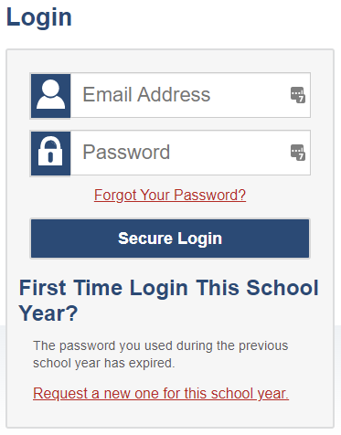
Logging in to TIDE
At the beginning of the new school year, all TIDE user accounts will have their passwords reset.
Beginning August 8, when you log into any Cambium system, you will be required to reset your password.
Please note, if new users are created before August 8, those users will also need to reset their password.
Notes:
If you already have a TIDE account, at the beginning of a new school year, your TIDE password and security details will be automatically reset. To reset your password and security details, go to your portal and select the TIDE icon. On the login page select Request a new one for this school year.

Slide 3
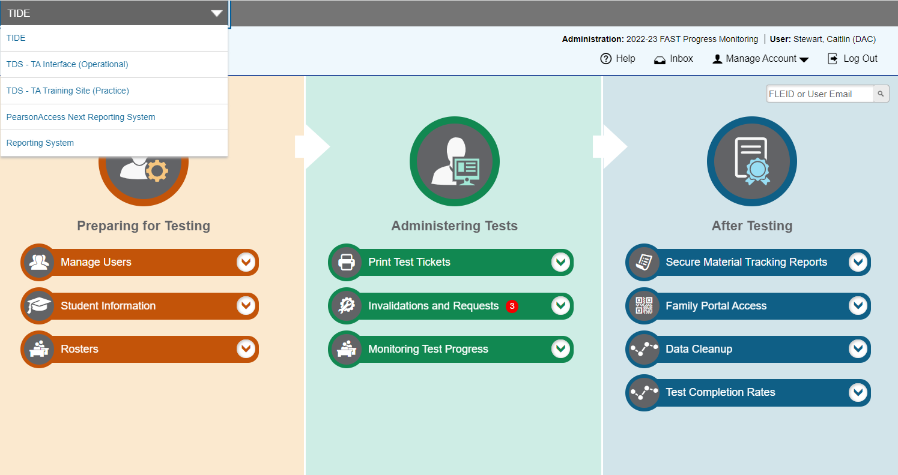
TIDE Banner and Switching Between Systems
Notes:
A banner appears at the top of each TIDE page showing the current test administration, your name, and your current user role. On the left, there is a drop-down list for accessing other Cambium Assessment applications such as the Test Administrator Interface and the reporting system. You will also find a Help button that displays the TIDE User Guide, an Inbox button, a Manage Account drop-down list where you may manage your account details, and a Log Out button.

Slide 4
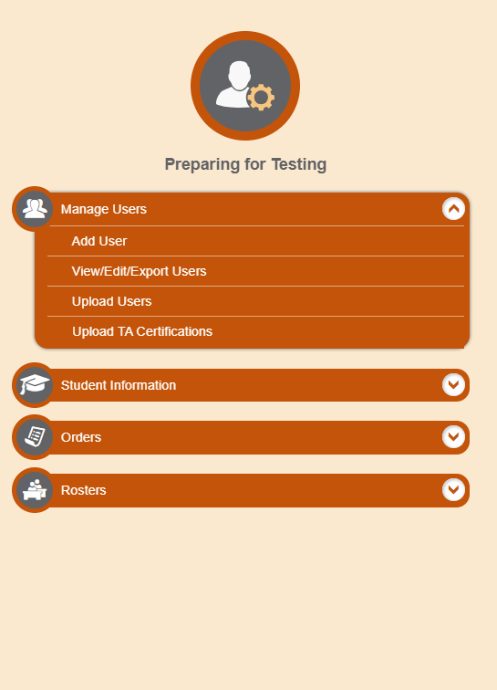
Add Users One at a Time
When adding users one at a time:
Enter the email address for the user you want to add.
Click + Add user or add roles to user with this email.
If the email exists, then options will be available to add multiple roles for the user.
The new user’s email address will serve as his or her username.
Notes:
When adding users one at a time, enter the email address for the user you want to add. Click + Add user or add roles to user with this email. If the email exists, then options will be available to add multiple roles for the user.
The new user’s email address will serve as his or her username when he or she logs in to any Cambium Assessment system. The new users you add will receive an activation email from DoNotReply@cambiumassessment.com.

Slide 5
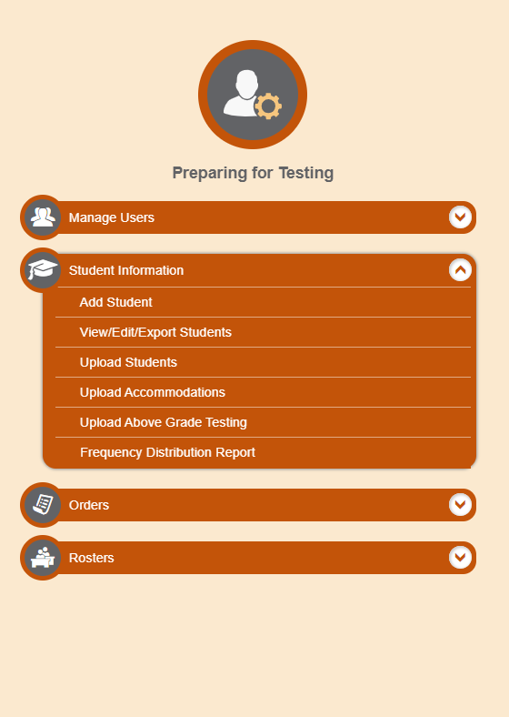
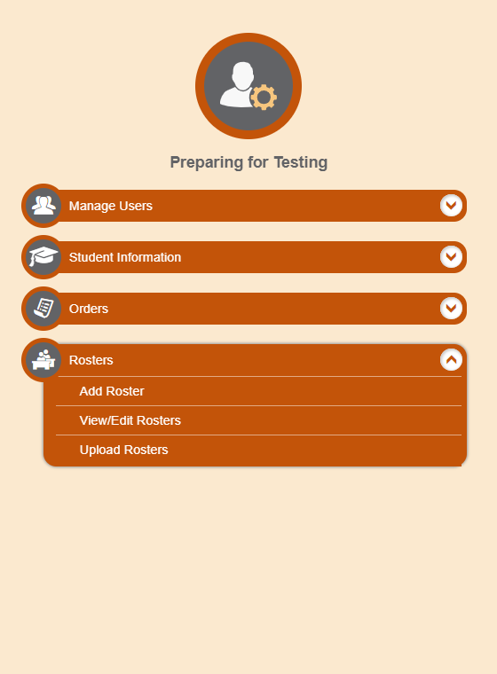
Add Records One at a Time
Notes:
To add records one at a time, start on the TIDE home page. In the Preparing for Testing section, choose the task for which you want to add a new record: users, students, or rosters, then click add.
On the following page, fill out the information, verify its accuracy, and select Save.

Slide 6
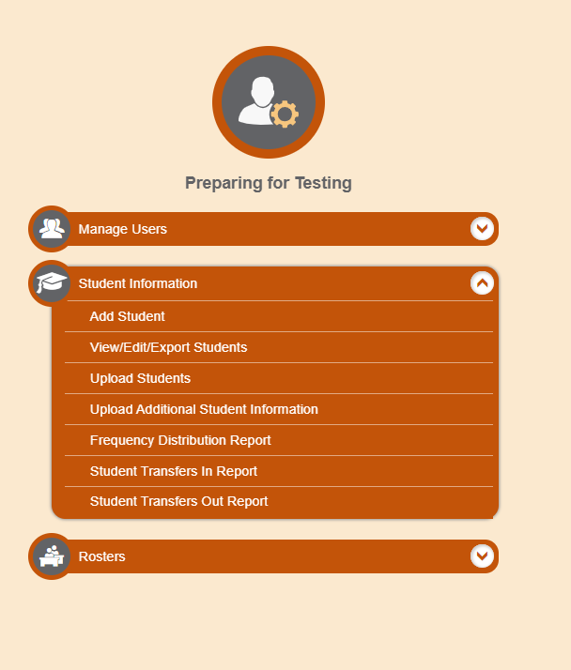
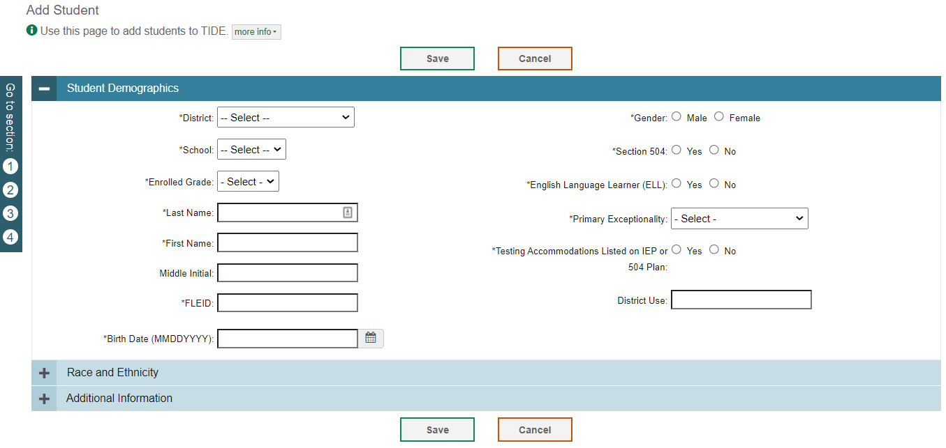
Add Students One at a Time
Notes:
When adding students one at a time, begin by adding information to the Student Demographics panel. The fields marked with an asterisk are mandatory. The FLEID and student name you enter must match a student who already exists in Florida's enrollment system. This page contains additional panels including Race and Ethnicity, and Additional Information where you will indicate test eligibility and/or accommodations. Complete the required information in all panels and click Save.

Slide 7
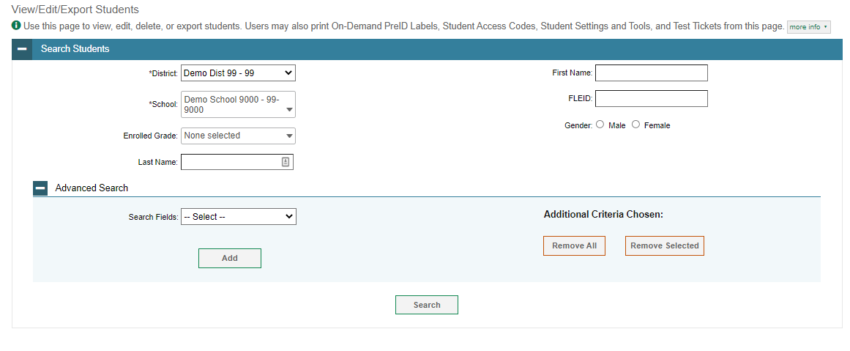
Modify Students One at a Time
Notes:
The View/Edit/Export Students page includes a form for setting selection criteria to retrieve students. Required criteria, such as the district and school in this example, are marked with asterisks. Other criteria are optional, such as the FLEID and the student’s first or last name.
You can further refine your criteria by entering additional demographic information or test settings in the Additional Search panel.
The students you can retrieve on this page are limited by your role’s scope. For example, if you are a district-level user, you can retrieve only students enrolled within your district. If you are a school-level user, you can only retrieve students enrolled within your school.
Click Search to continue.

Slide 8
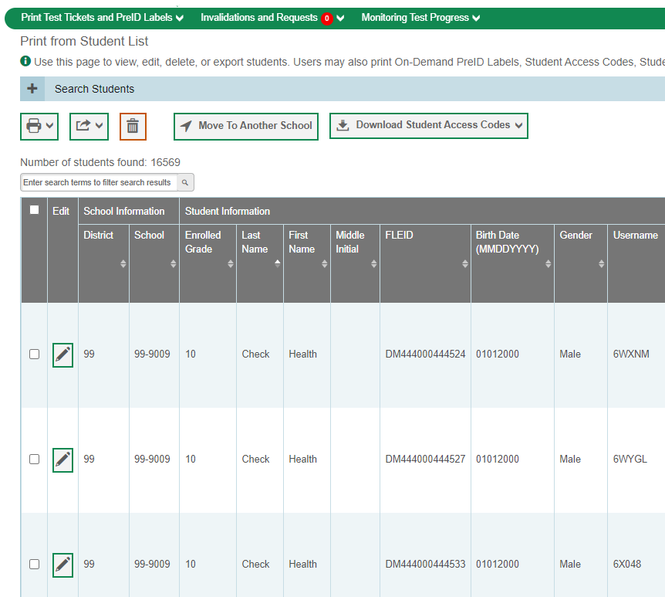
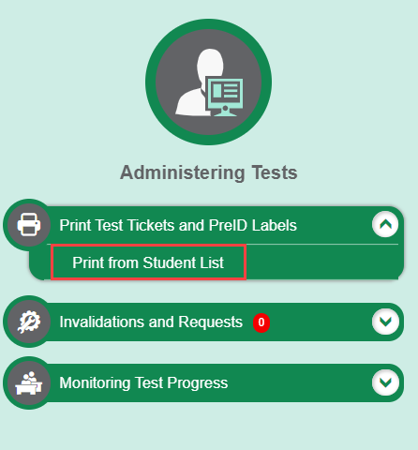
Print Test Tickets from a Student List, continued
All students
Specific students
Notes:
Next, select the students for whom you want to print test tickets. To print test tickets for specific students, mark the checkboxes for the students you want to print. To print for all students on the page, mark the checkbox at the top of the table. To print for all retrieved students, no additional action is necessary. This option is available by default.
Click the printer icon and select an option from the drop-down menu. A test-ticket layout screen will appear. Choose a test-ticket layout and the test tickets print option. When you click Print, a PDF file of the test tickets will be downloaded.

Slide 9
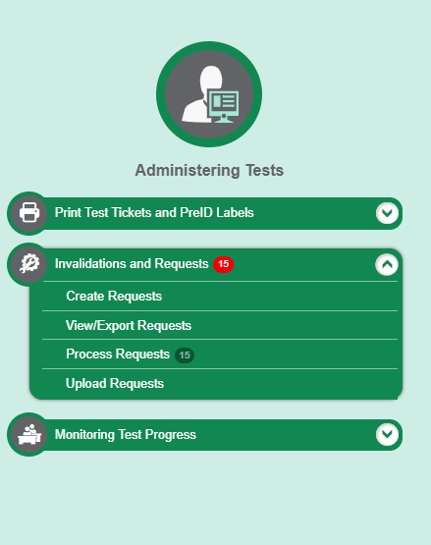
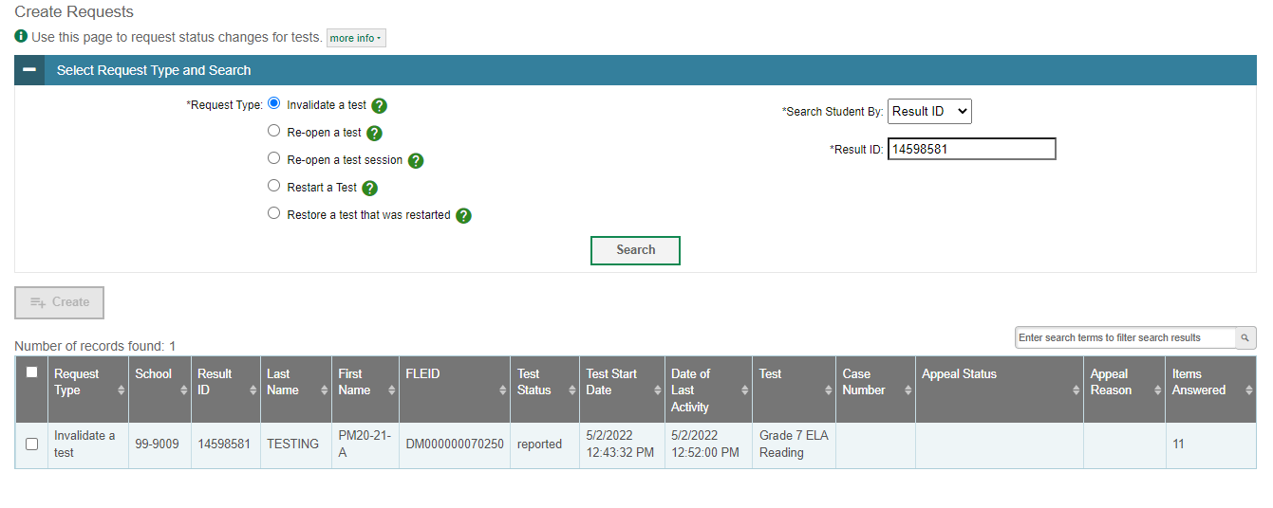
Invalidations and Requests
Notes:
The Create Requests page is where you can create an appeal for a test.
The first step is to select the type of request you want to create. The TIDE User Guide lists the available request types and explains the implications of each.
Next, search for the test result, session ID or FLEID for which you wish to create a request then click Search. TIDE will display the search results below.
Mark the checkbox next to each test result for which you wish to create a request and click Create. A pop-up window will ask you to enter a reason for the request. To create the request, enter a reason and click Submit.

Slide 10
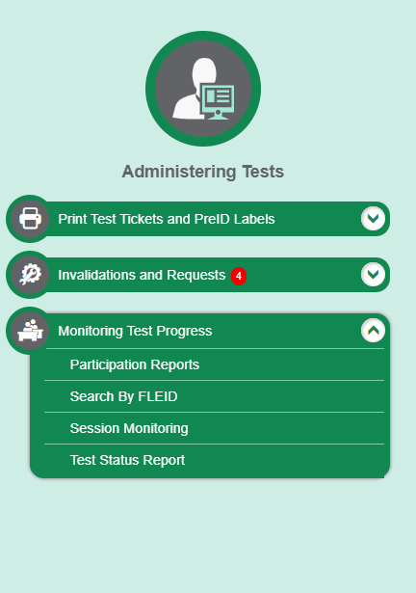
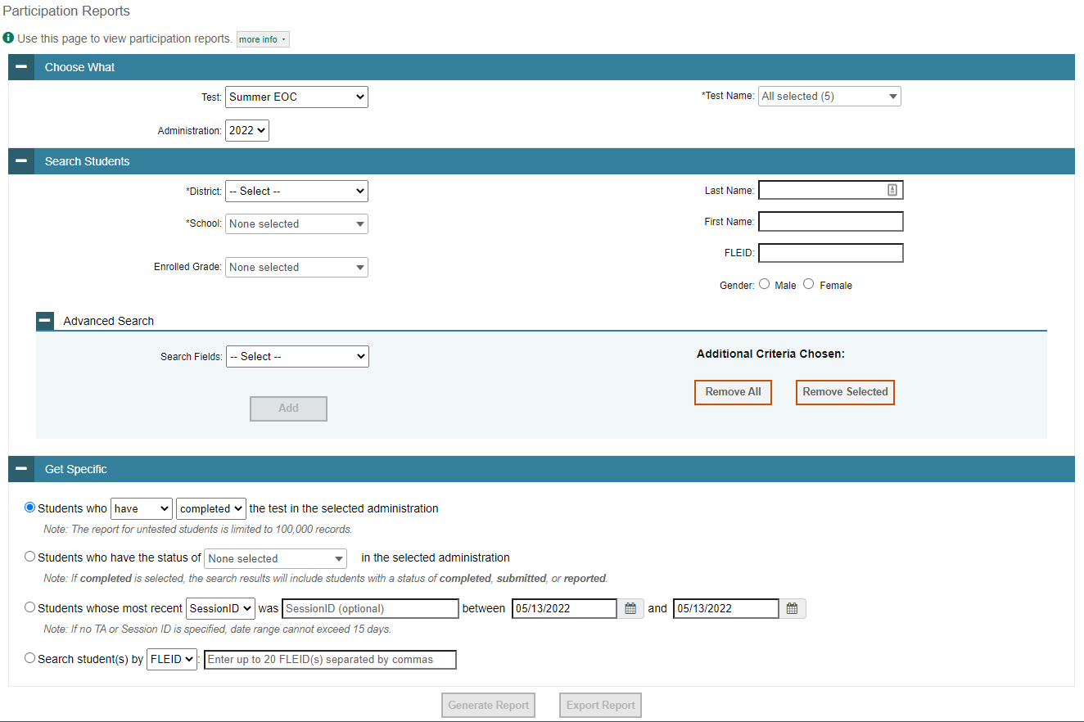
Participation Reports
Notes:
The Participation Report details a student’s test opportunities and the status of each test opportunity. Because the report lists testing opportunities, a student can appear more than once on the report.
To generate a report from the Participation Report page, select a test and administration under the Choose What Report panel.
Next, in the Search Students panel, select a district, school, and Enrolled Grade, if applicable. The fields marked with an asterisk are mandatory. You can refine your search by adding additional criteria under the Advanced Search section.
Finally, in the Get Specific Test Filter Report panel, choose one of the filter options available and select parameters for that option.
Click Generate Report to view your Plan and Manage Testing report or click Export Report to open the report in Excel.

Slide 11
Monitoring Test Progress Examples
Which students have not yet tested?
Which students have paused tests?
Did all students in a test session submit their tests?
Notes:
This slide illustrates some common questions that can be answered using the options available in the Get Specific panel.
To find students who have not yet tested, select the first radio button and search for students who have not completed their test opportunity in the selected administration.
To find students who have paused tests, select the third radio button and search for students who have a status of paused in the selected administration.
To find out if all students in a test session submitted their tests, select the fourth radio button and search for students by test session ID (optional) between the dates when the test session took place.

Slide 12
FAST Progress Monitoring
Above Grade Testing
Available for Writing, Reading, and Mathematics.
Separate field for each subject. (Writing and Reading are no longer one field.)
Paper Accommodations
A new paper accommodation field will be added for FAST PM only.
Students needing a paper accommodation will be marked appropriately in TIDE.
If this field is marked “Y”, student will no longer be eligible for online testing.
Paper accommodations will not be available for PM 1/PM2. (These fields should be left blank in the initial PreID file upload.)
DACs will be responsible for ordering paper materials through Additional Orders; there will be no initial order for FAST PM.

Slide 13
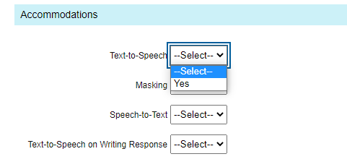
Accommodations/Class Codes
Accommodations will no longer be subject specific.
You will indicate “Y” or “Yes” to turn on an accommodation for applicable students.
If an accommodation is selected, it will be applicable for all subjects the student will test.
For example, if text-to-speech is “Yes”, the student will receive this accommodation for all eligible tests.
Class codes have been removed from all layouts – PreID rosters will no longer be generated in TIDE.

Slide 14
Rosters
PreID rosters will no longer be generated in TIDE.
User-Defined rosters will need to be created in TIDE for teachers to view their student results in the FAST Reporting system.
Teachers or other staff who will need access to a roster of students but will not be administering assessments should be added to TIDE with the TA role.
Users with the following roles will appear in the Teacher Name drop-down field when adding or viewing/editing rosters: SAC, SA, TA, and AVA.
Role | DAC/DA | SAC/SA/SAC | TA
Student Access in FAST Reporting | All students in your district | All students in your school | All students in your roster

Slide 15
Rosters, Cont.
Evaluation Services will create rosters for each school based on the following criteria:
Elementary Schools – Each teacher will have ALL assigned students listed as a Roster. Roster name will be your Last name
Middle and High Schools – Each teacher will have BY PERIOD assigned students, even if you have multiple preps in that period. Roster name will be “Period Username” (ie 02- Rykard)
If your schools has students who visits a teacher for pull out instruction, you may add an additional roster so that the pull out teacher may see results. For example, McArthur’s “Walk and Read”.

Slide 16
Rosters
Roster relationships will be shown on the View/Edit Student page, similar to the Student Participation section. Users will be able to see all rosters a student is assigned to.
TAs will have access to view rosters in TIDE and FAST Reporting.

Slide 17
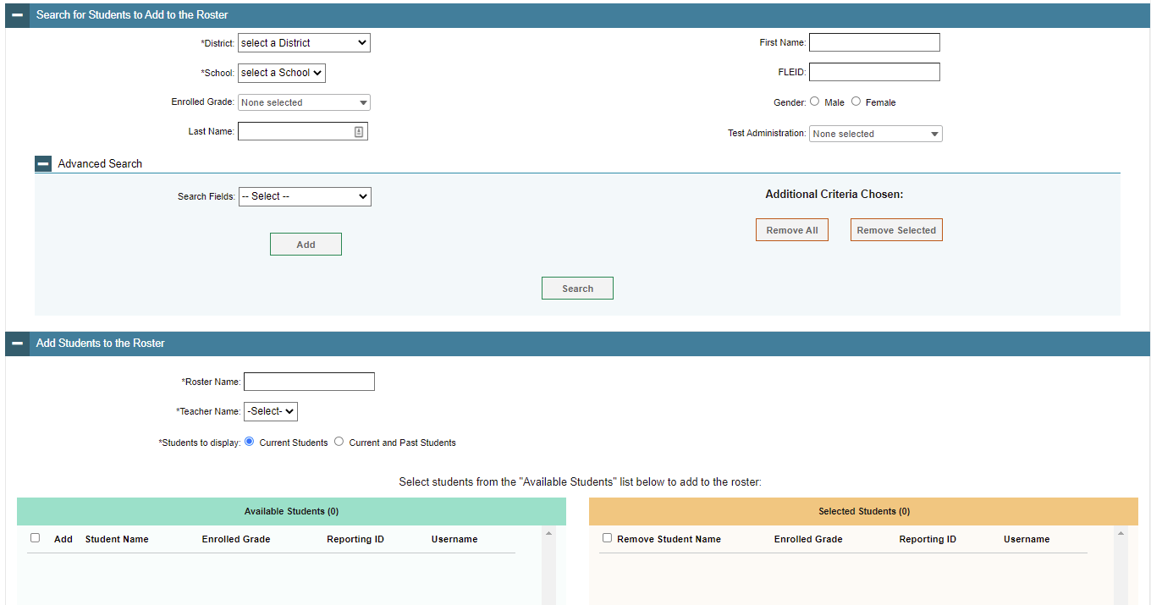
Add Rosters One at a Time
To search for students, complete the fields under the Search for Students to Add to the Roster panel.
Refine the list of available students by completing the fields in the Add Students to the Roster panel.
Notes:
The Add Roster page contains two panels, a Search for Students to Add to the Roster panel and an Add Students to the Roster panel.
To search for students, complete the fields under the Search for Students to Add to the Roster panel. The fields marked with an asterisk are mandatory. You can further refine your search by selecting criteria under the Advanced Search section.
Refine the list of available students by completing the fields in the Add Students to the Roster panel. To display current students only, click the Current Students radio button. To display current and past students, click the Current and Past Students radio button. Then click Search.

Slide 18
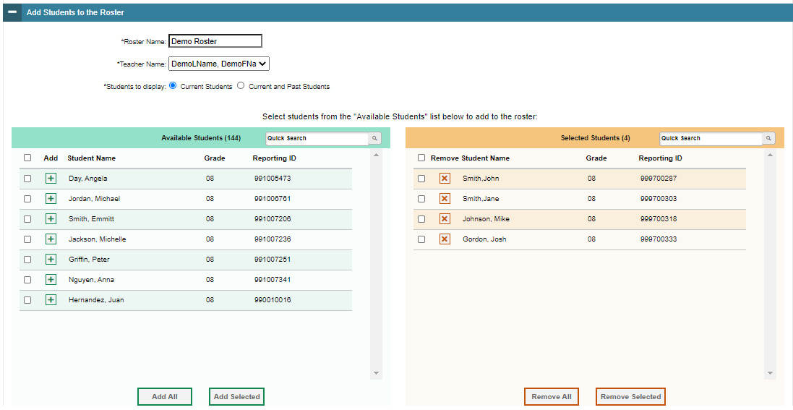
Add Rosters One at a Time, continued
The students in the left column are available to be added to the roster, and students in the right column are currently in the roster.
You can add multiple students by marking checkboxes next to the students then clicking Add Selected. Add all available students to the roster by clicking Add All.
Notes:
In the Add Students to the Roster panel, the students in the left column are available to be added to the roster, and students in the right column are currently in the roster.
First, enter a name for the roster and select the teacher who should be associated with the roster. Select if you want to display Current Students or Current and Past Students.
Next, add students to the new roster. To add a single student to the roster, click the green plus sign next to a student in the left column. You can add multiple students to the roster by marking checkboxes next to the students you want to add and then clicking Add Selected. Add all available students to the roster by clicking Add All.
To remove a single student from the roster, click the orange X next to a student in the right column. You can remove multiple students from the roster by marking checkboxes next to the students you want to remove and then clicking Remove Selected. Remove all students from the roster by clicking Remove All.

Slide 19
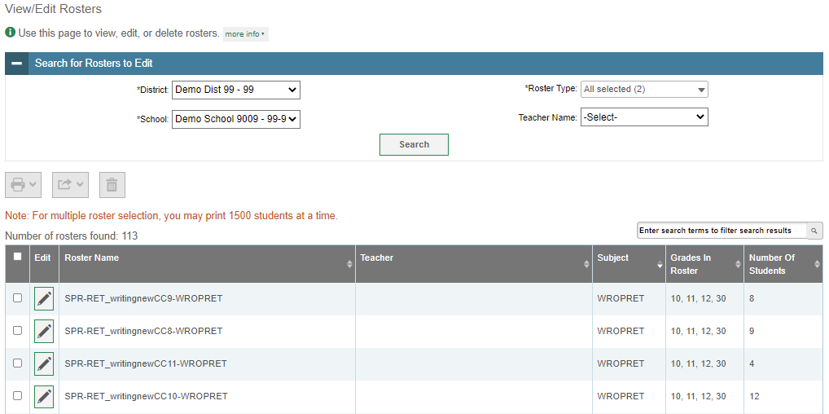
Modify Rosters One at a Time
Complete the required information then click Search to display a list of rosters matching your criteria.
Notes:
The View/Edit Roster page includes a form for setting selection criteria to retrieve rosters. The district, school, and teacher name criteria are required. Click Search to display a list of rosters matching your criteria.
Print, export, or delete rosters from TIDE by selecting the desired rosters and clicking the Print, Export, or Delete buttons above the search results.
Click the pencil icon next to a roster to view or edit its details. The Edit Roster form will appear. This form is like the form used to add rosters, and you may edit the roster name, teacher name, and students to display in the roster in the same way that you would for a new roster.

Slide 20
Test Delivery System (TDS) TA and Student Interface
Copyright © 2022 Cambium Assessment, Inc. All rights reserved.

Slide 21
TA Certification Course
https://flfast.org/teachers.html

Slide 22
Start a Session
The Help Desk (as well as the DACs) received a large number of calls regarding students seeing “No Tests Available” on the Your Tests page after logging in to the Secure Browser.
While troubleshooting, the Help Desk determined that the most common problem was that the test the TA and students were looking for had not been added to the test session.
The following slides walk through the process of starting a test session.

Slide 23
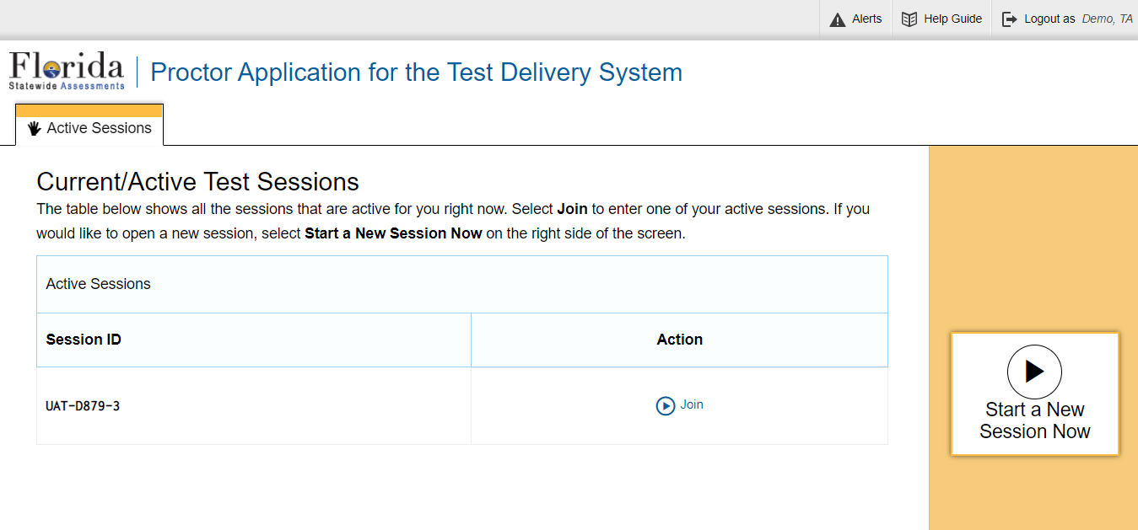
Transferring Sessions
Notes:
In the event that you have problems with your computer or web browser or need to change computers during an active test session, you can transfer the session from one computer, mobile device, or browser to another without stopping the session or interrupting in-progress tests. To transfer a test session to a new device or browser, remember the following:
• Do not log out of the session you are currently in or stop the test session. If you do, you will end the test session and pause all students’ tests.
• Log in to the TA Interface on the new machine or in the new browser.
The test session on the previous computer or browser will close automatically. This will not stop the session or pause student tests.

Slide 24
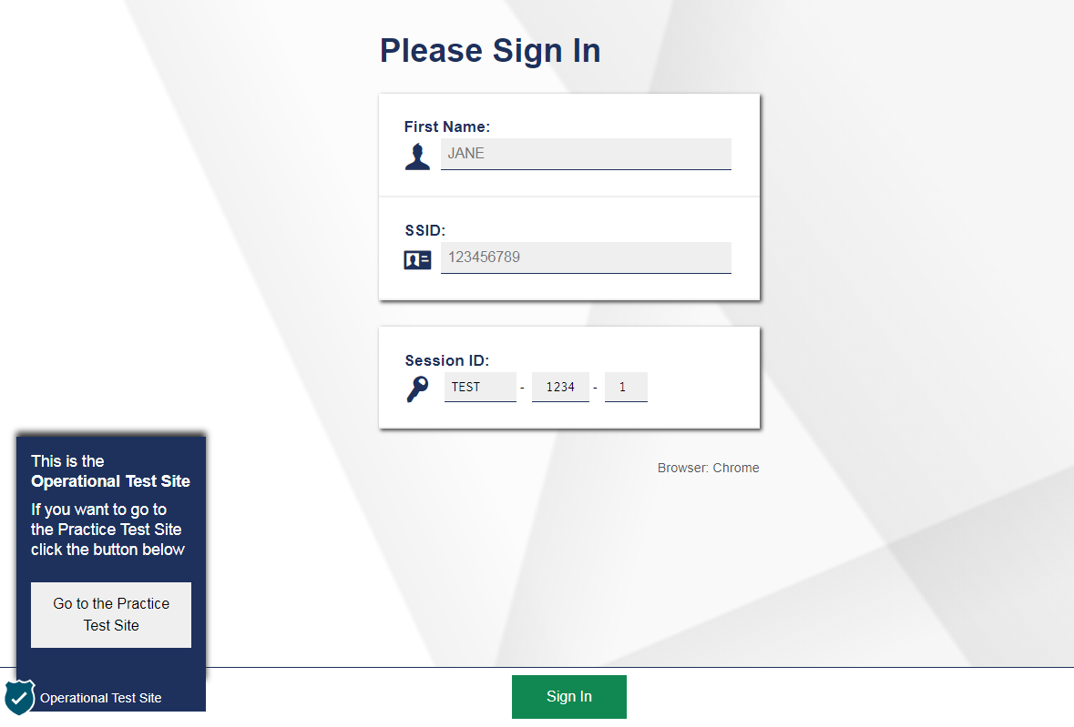
Secure Browser Student Login
Notes:
To log in to the online testing system, students must use the Secure Browser on a separate computer or device than the one used by the TA. Students must enter three pieces of identifying information: their first name, their username, and the current test session ID.
The test session ID is generated when the TA creates the test session. It needs to be given to students by the TA when it is time for them to log in to the test. Session IDs should not be generated more than 20 minutes before students are ready to log in.
When entries are complete, students will click the Sign In button to log in to the test. The TA may assist students with logging in, if necessary.

Slide 25
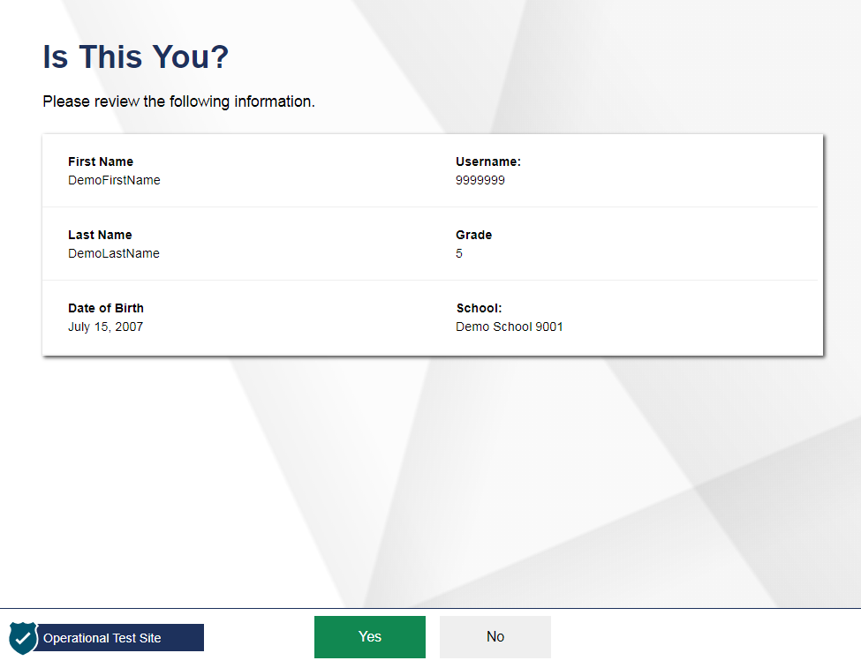
Student Verification
Notes:
After logging in, students need to complete a few more steps before they begin testing. Students will be asked to view and verify their personal information. If their information is correct, they should click Yes to proceed. If their information is incorrect, they should click No to return to the login page. You must then contact your School or District Assessment Coordinator to have the student’s information updated in the Test Information Distribution Engine (TIDE) before the student attempts to log in again.

Slide 26
Student Login Errors
Issue | Error Message | What to Do
Student first name and Username do not exactly match what is in the system. | Please check that your information is entered correctly. If you need help, ask your Test Administrator. | Verify that the student has entered the correct first name and exact username. You may need to use the Student Lookup Tool, which is in the Test Administrator Interface, to verify that the student is in the system.
Student enters the session ID incorrectly. | The session is not available for testing. | Verify that the student has entered the correct session ID with no extra spaces or characters.
Student enters a session ID for an incorrect or expired session. | Session has expired. | Ensure that the student enters the correct session ID for the current session. If this does not work, verify that your session is open using the Test Administrator Interface.
One person (either the TA or the student) is using the Operational Test Administration Site, and the other is using the Practice Site. | The session is not available for testing. | If taking a practice test, make sure that you and the student are both on the Practice Site. If taking an operational test, make sure that the student is using the Secure Browser and you are using the Operational Test Administration Site.
Notes:
If a student is having difficulty logging in, an error message and code will display on the login screen. The most common errors occur when the student’s first name and SSID do not match what is in the system and when FLEIDs are entered incorrectly. If the student receives an error message indicating that he or she has entered incorrect information in the first name or FLEID fields, the TA should use the Student Lookup Tool in the TA Interface to verify the student’s information.
Another common error occurs when the student enters an incorrect session ID. If a student receives the message “The session is not available for testing,” verify that the session ID was entered correctly, with no extra spaces or characters. The session ID can be found in the TA Interface.
If a student receives the error message “Session has expired,” ensure that the student has entered the correct session ID for the current session. If the student has entered the session ID correctly, use the TA Interface to verify that your session is still open.
Finally, if administering a practice test, make sure that the TA and the student each use the appropriate practice and training test site. If administering an operational test, ensure that the TA is using the Operational Test Administration Site and the student is using the Secure Browser.

Slide 27
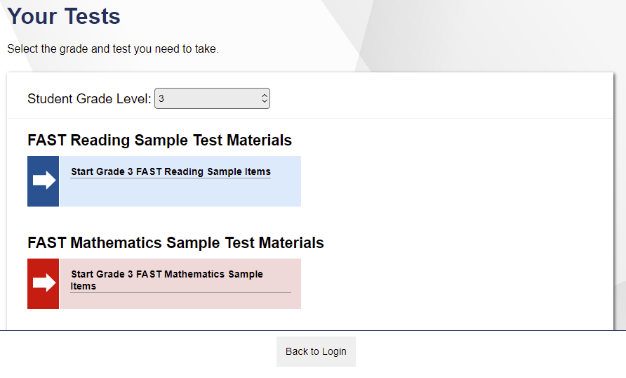
Student Test Selection
Notes:
On the Your Tests screen, students will see a list of their assigned tests for this test session. If the tests displayed are incorrect, or the expected test is not listed, students should click the Back to Login button to return to the login page and consult the TA to resolve the issue. If there are no errors, students should select the correct test and wait for TA approval to proceed.

Slide 28
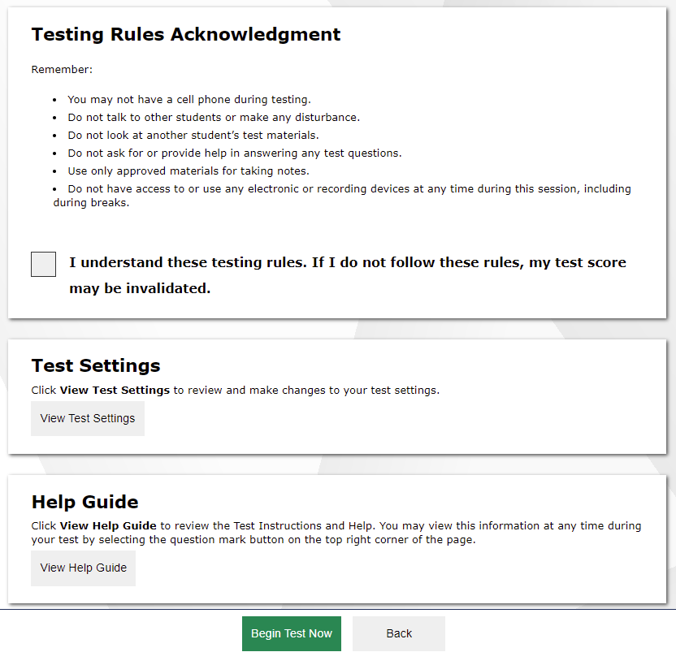
Before You Begin
Notes:
Next, students will view and acknowledge the Testing Rules Acknowledgment and have the opportunity to review detailed information about the tools and navigation features they will use during testing from the Instructions and Help screen.
The Test Settings section allows students to view their current test settings.
The Help Guide section contains an overview of the test site, test rules, and information on Text-to-Speech and other applicable features.
When students click Begin Test Now, they will enter their test and be presented with electronic devices cover page.

Slide 29
End Test
Notes:
When students answer the final question on the test, the End Test button will appear in the upper-left section of the screen. The End Test button does not become visible until the student has selected at least one response to every question on the test. If students click the Next button at this point, they will see a pop-up message advising them to click the End Test button when they have completed reviewing their answers. They may also click the Back button to go back and revisit previous items, subject to the pause rule if it has been applied during the test.

Slide 30
Troubleshooting
Description | What to Do
What should I do if a test session ends? | Log in and start a new session. Provide the students with a new session ID.
What should I do if a student gets logged out of a test while a session is still active? | If a student’s test session is interrupted, the student should log back in and rejoin the session.
What should I do if forbidden applications are running? | The Secure Browser will not allow the student to begin testing if forbidden applications are running. You will see messages advising you which applications must be closed before testing can begin.
What should I do if a student’s test freezes? | Force-quit the Secure Browser and log back in. For instructions, refer to the Test Administration Manual.
Notes:
This table presents some of the common issues that you or your students may encounter during a test session. Please take a moment to review this information. For more detailed information, please refer to your Test Administration Manual.

Slide 31
Thank You!
Contact Us
Florida Help Desk (for FAST, NGSSS, EOC, B.E.S.T., and FCLE Assessments)
Toll-Free Phone Support: 1-866-815-7246
Email Support: FloridaHelpDesk@cambiumassessment.com
The Help Desk is open Monday – Friday from 7:00 a.m. to 8:30 p.m. ET (except holidays or as otherwise indicated on the Florida Statewide Assessments Portal)
Notes:
Thank you for taking the time to view this training module. If you have general questions or need further information, visit the portal, or consult the Florida Help Desk for assistance.

Slide 32
Evaluation Services
Heather Rykard, TSA
850-469-5387
hrykard@ecsdfl.us
Nate Hazewinkel, Director
850-469-5386
nhazewinkel@ecsdfl.us

