Slide 1
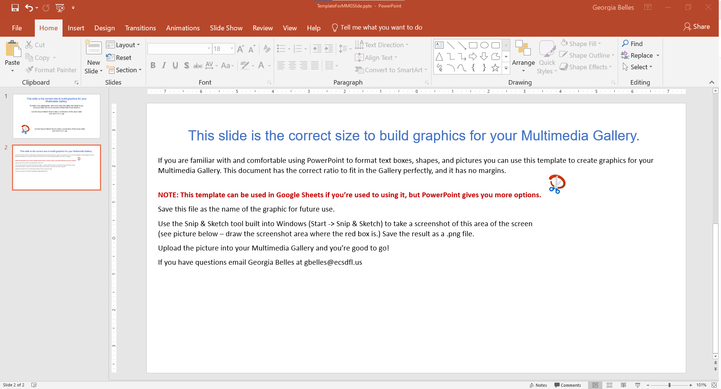
This slide is the correct size to build graphics for your Multimedia Gallery.
If you are familiar with and comfortable using PowerPoint to format text boxes, shapes, and pictures you can use this template to create graphics for your Multimedia Gallery. This document has the correct ratio to fit in the Gallery perfectly, and it has no margins.
NOTE: This template can be used in Google Sheets if you’re used to using it, but PowerPoint gives you more options.
Save this file as the name of the graphic for future use.
Use the Snip & Sketch tool built into Windows (Start -> Snip & Sketch) to take a screenshot of this area of the screen (see picture – draw the screenshot area where the red box is.) Save the result as a .png file.
Upload the picture into your Multimedia Gallery and you’re good to go!
If you have questions email Georgia Belles at gbelles@ecsdfl.us
Haven’t used the Snip & Sketch tool yet? It’s amazingly handy! Here’s a brief tutorial video: https://www.youtube.com/watch?v=OO0aS7gh3Rg

